Slide 1
State of Nutrition Dashboard
Unveiling the New
Stakeholders:

Slide 2
Areas of Discussion
Overview
Dashboard Implementation Process
Indicators
Dashboard Design
Use Cases for the SON Dashboard

Slide 3
Overview
One of the critical factors that inform and guarantee successful global health strategies is knowledge sharing. The state of nutrition dashboard exemplifies this by integrating data from various sources to provide a comprehensive view of a nation’s nutritional status. This dashboard supports informed decision-making, enabling evidence-based policy formulation and efficient resource allocation. It also allows for continuous monitoring and impact assessment of nutritional initiatives. This dashboard is created to foster collaboration among stakeholders, raise public awareness, and ensure coordinated efforts to improve nutrition in Nigeria. It also seeks to address regional disparities, combat malnutrition, and enhance food security, thereby contributing to improved health outcomes and socio-economic development.
Informed decision-making
Evidence-based Policy Formulation
Efficient Resource Allocation

Slide 4
Dashboard Implementation Process (Activities)
02
Requirements Validation
04
Established and validated dashboard requirement and data source validation.
Frame Design
Designed the framework and layout of the dashboard.
06
Development
Developed user-friendly dashboard.
07
Deployment
Train, document, launch, and handover.
01
03
05
Stakeholder Engagement
Hosting and Scripting
Data Modelling & Visualization
Identified stakeholders, responsibilities, and contact persons for the project.
Identified dashboard file hosting and script functions for best performance.
Designed and implemented robust data models to link datasets.

Slide 5
Indicators
Percentage of population using basic hygiene services
Percentage of population using basic sanitation services
Severe Acute Malnutrition (SAM) in U5 children
Deworming tablets to U5 children during the year
Stunting
Poverty Headcount rate
Household Food Insecurity Access Scale (HFIAS)
Proportion of population using a safely managed drinking water service
Vitamin A supplementation for children 6-59 months
Minimum dietary diversity of children aged 6 -23 months
Wasting
Anemia in Children under 5
Low birth weight Infants
Iron folate supplementation for pregnant women; women of childbearing age; adolescent girls in Primary & secondary schools
Anemia in Pregnant women
Nutrition Interventions focus areas
Coping Strategies Index (CSI)
Overweight & obesity in children
Early initiation of BF within 1 hour
Proportion of population using a safely managed sanitation service
Minimum Acceptable Diet, Minimum Dietary Diversity, Nutrition Governance
Nutrition Partnerships and Interventions
Exclusive Breastfeeding
Household food consumption score
Percentage of women with low BMI
EBF of infants up to 6 months

Slide 6
Data Sources
Demographic and Health Surveys (DHS)
Multiple Indicator Cluster Surveys programme (MICS)
Malaria Indicator Survey (MIS)
Nigeria Demographic and Health Survey (NDHS)
National Food Consumption and Micronutrient Survey (NFCMS)
National Bureau of Statistics (NBS)

Slide 7
Dashboard Design

Slide 8
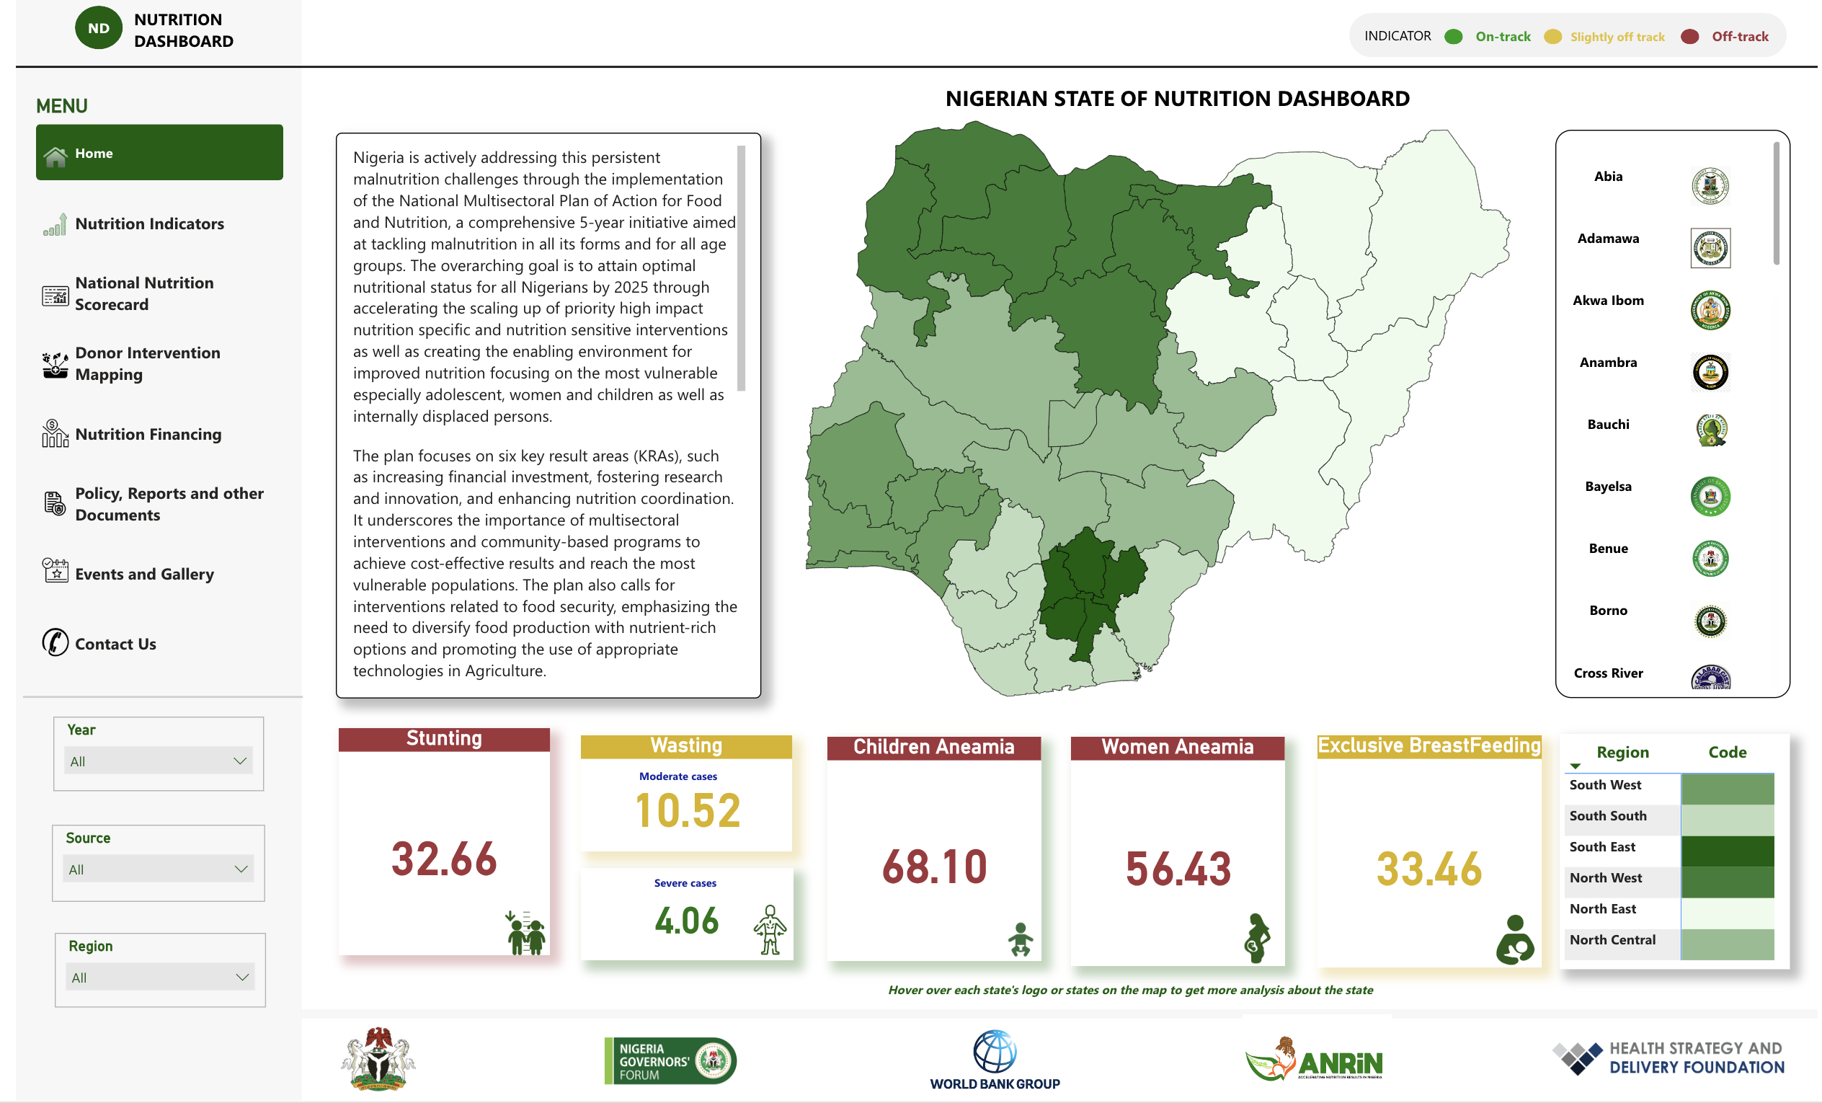
Dashboard
Stunting
Wasting
Children Anaemia
Women Anaemia
Exclusive Breastfeeding

Slide 9
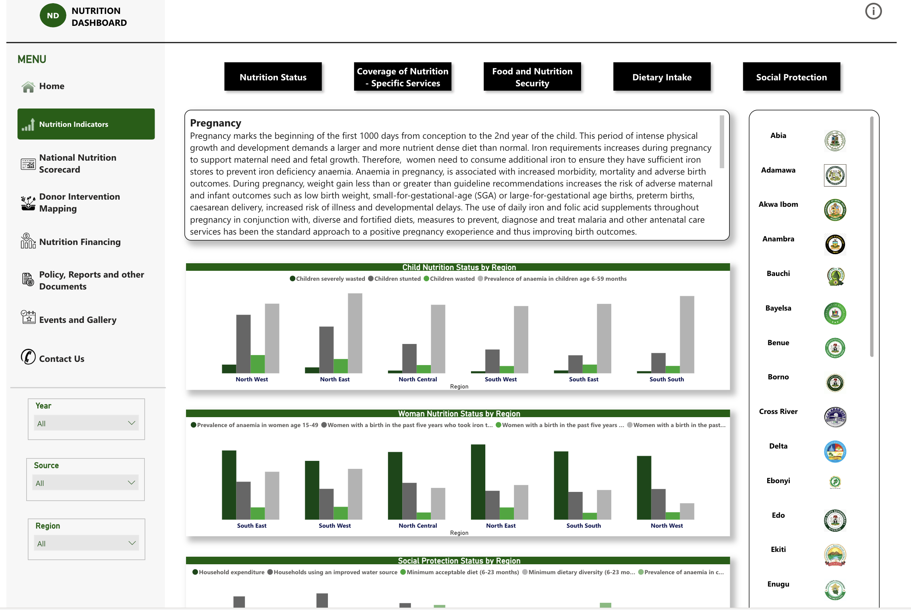
Dashboard

Slide 10
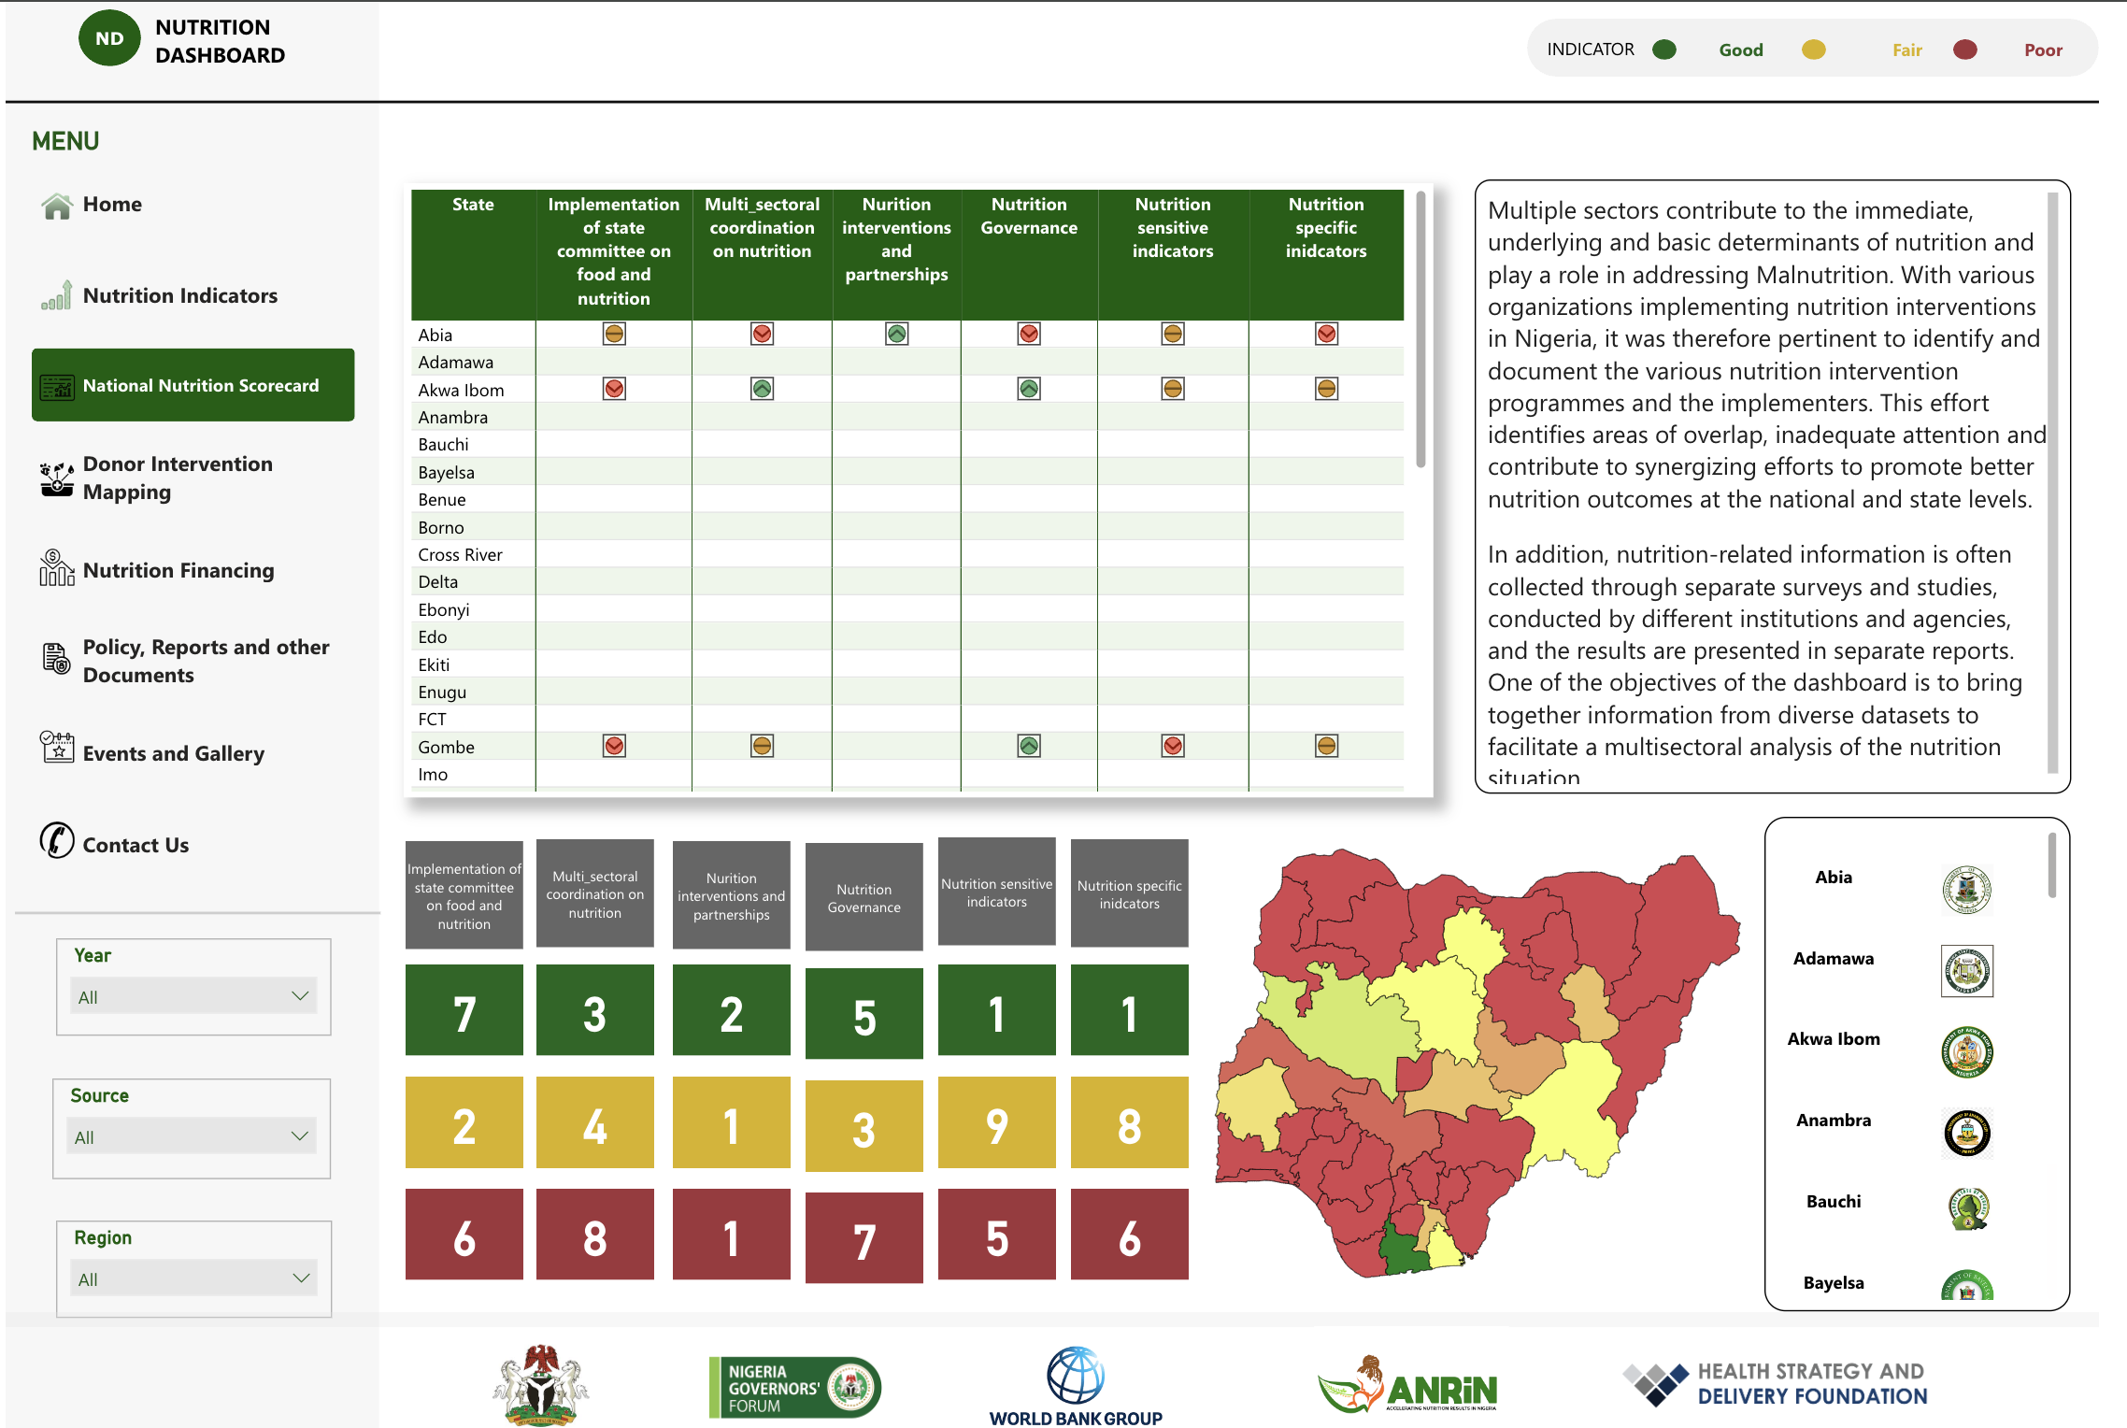
Dashboard

Slide 11
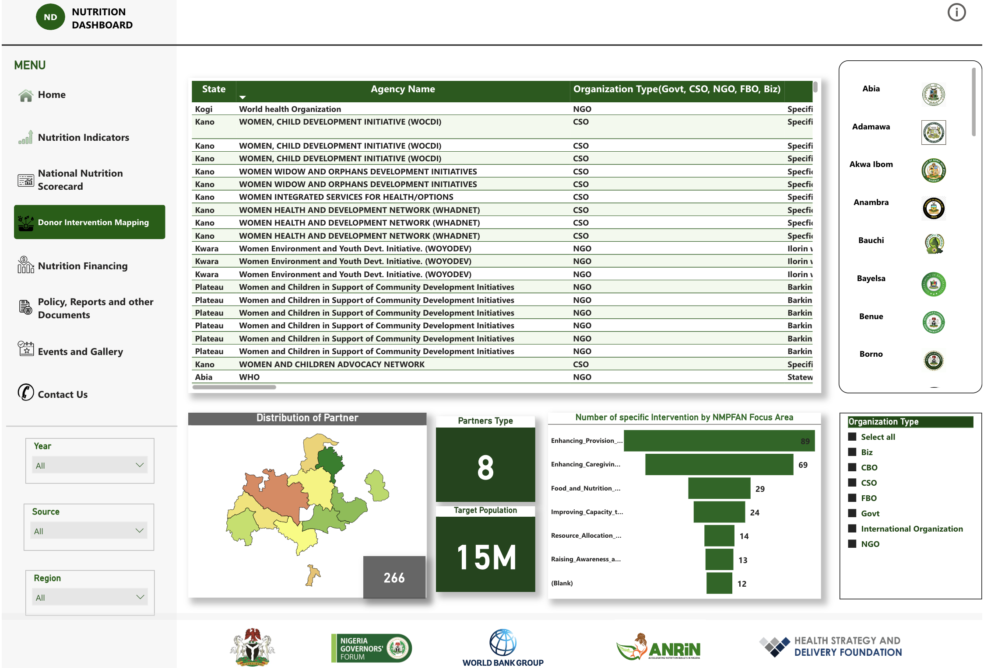
Dashboard

Slide 12
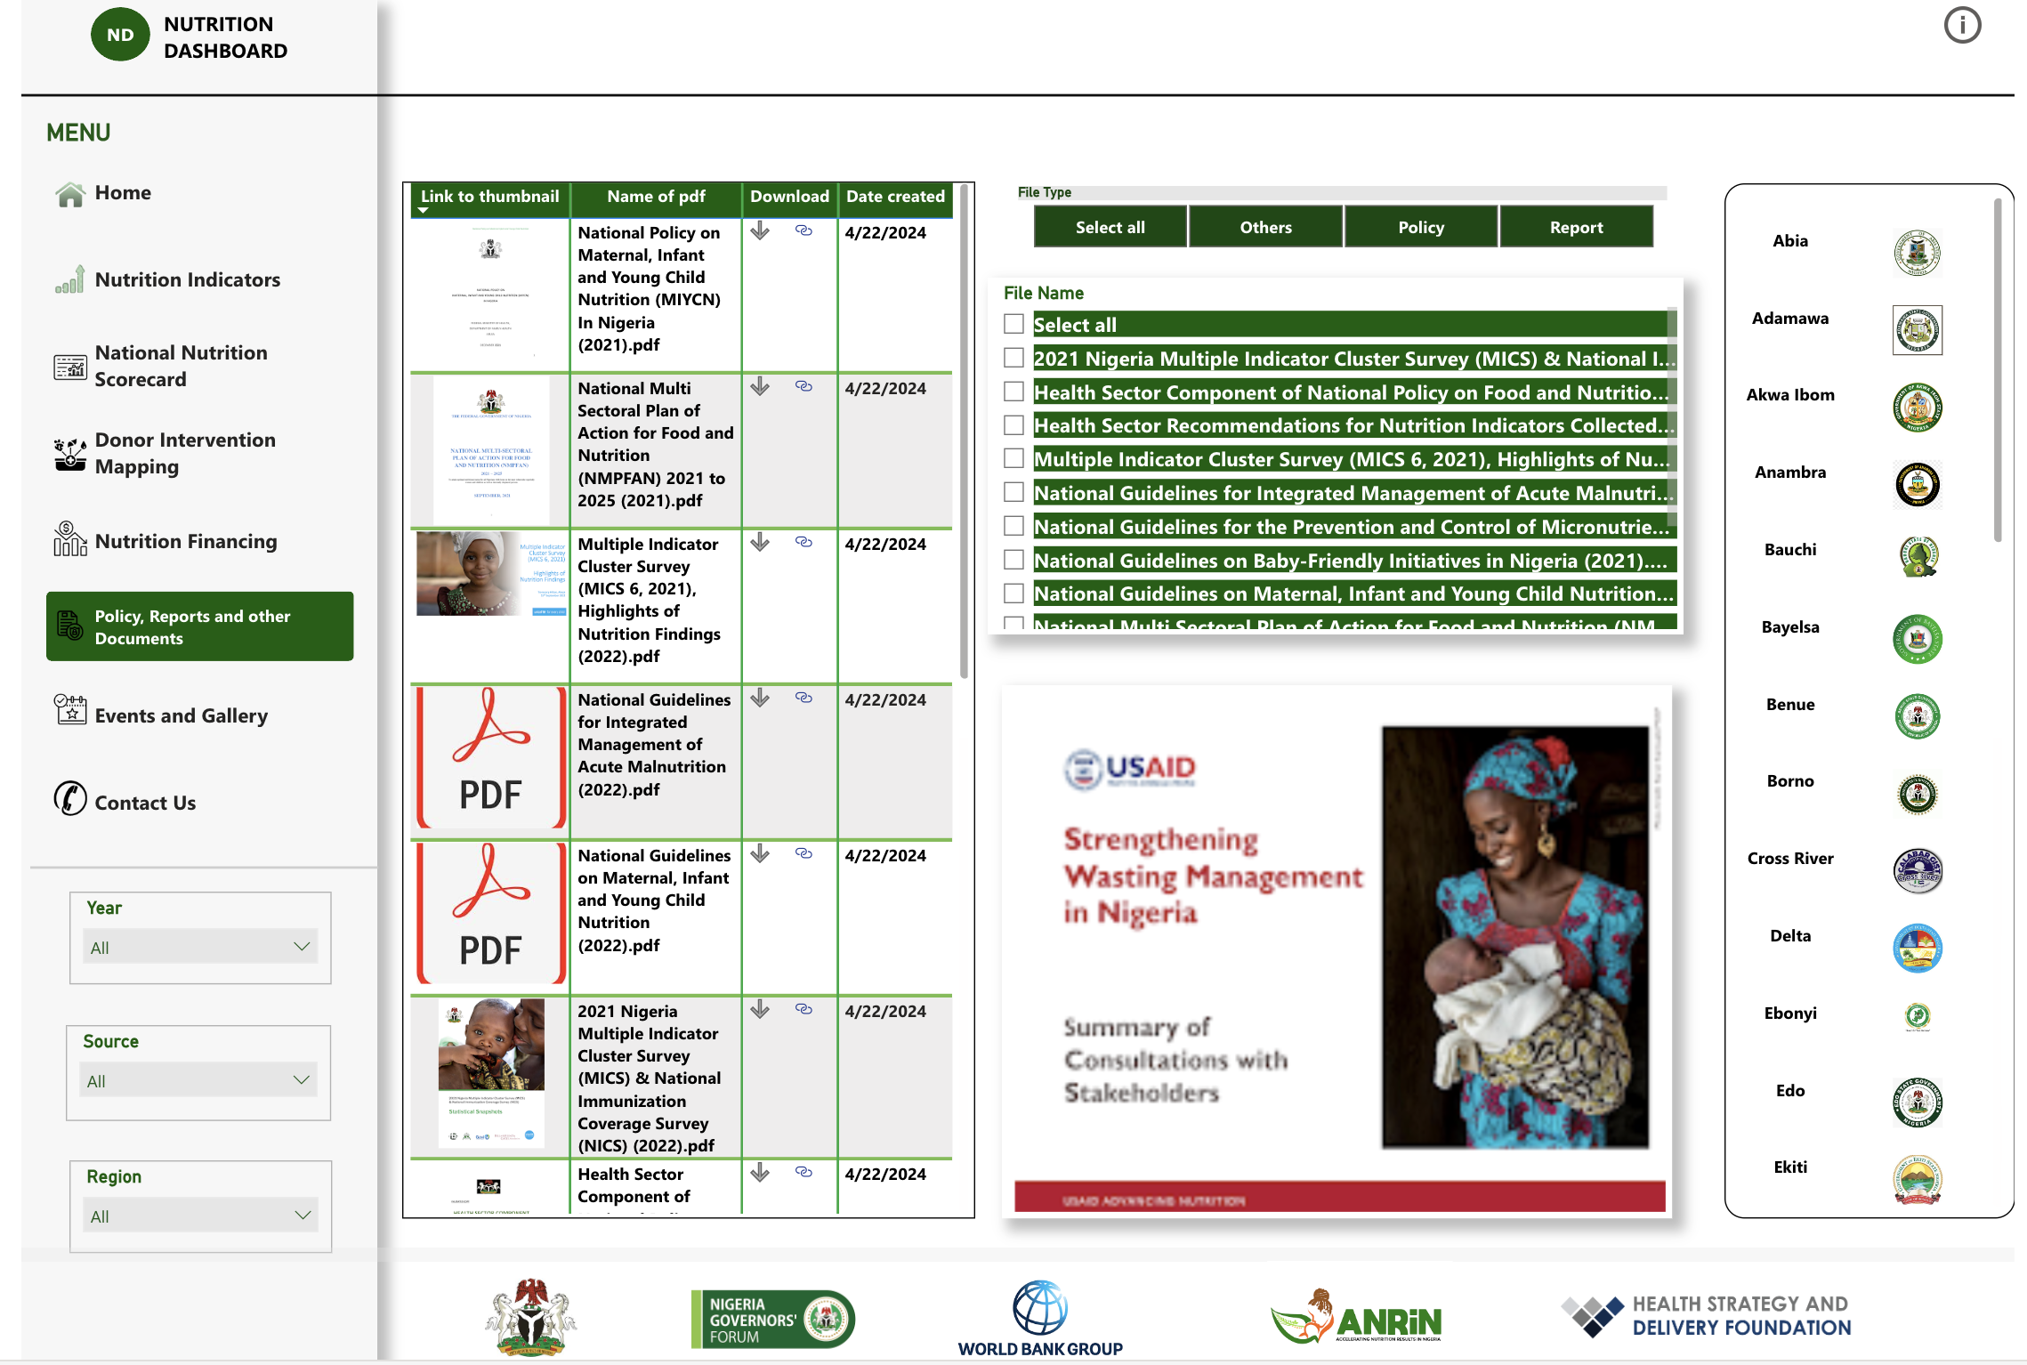
Dashboard

Slide 13
Use Cases / Impact
Improving Food Security
Effort Monitoring and Evaluation
Public Awareness and Advocacy on Nutrition
Provide Market Analysis on Nutritional Trends
Source for Research and Academia References
Evidence-Based Policy and Decision-making
Fostering Stakeholder Collaboration
Resource Allocation
Easy identification of malnutrition hotspots
Intervention Priority Areas
Seamless Coordination of efforts
Impact Analysis and Assessment

Slide 14

Dashboard Link
https://nutrition.nationalplanning.gov.ng/

Slide 15
Thank you

Slide 16






Introduction to
UPGRADED PERFORMANCE MANAGEMENT SYSTEM (PMS)​
AUGUST 2026

Slide 17


Presentation Outline
Overview of PMS and
Dashboard Foundation
PMS Dashboard guide:
1

Slide 18
Overview of PMS Dashboard Foundations
Understanding Slicers, Architecture, and Filter Context

Slide 19




Who Is This Dashboard For?
2
Dashboard Users & Leadership Teams:
MDAs Nutrition Desk Officers:
1
Track sector and ministry-level contributions, verify alignment with NMPFAN priorities, and monitor target reach.
Utilize the system for high-level monitoring of performance trends, state benchmarking, and strategic priority adjustments
Technical Reviewers
4
3
Program Analysts:
Verify institutional compliance, audit program delivery, and identify operational gaps before publishing reporting summaries.
.
Perform deep-dives into question-level indicators, extract actionable evidence, and export datasets for secondary modeling
2

Slide 20




Strategic Questions the Dashboard Answers
Pillar Performance:
Bottleneck Identification:
How is a specific state performing overall compared to the national trend?
02
Which states are performing best and worst?
04
Are planned activities, beneficiaries, and budget delivery translating into actual results?
How is a state performing in each specific core pillar?
Which specific pillar is dragging down overall performance?
01
03
05
Overall Standing:
Peer Comparison:
Operational Conversion:
2
Notes:
How is a specific state performing overall compared to national trends?
Which thematic framework area shows weak institutional compliance?
Which states are leading or lagging in active comparison groups?

Slide 21
What the Dashboard Combines
  Overall PMS Scores: The single headline indicator of cumulative state performance.
  Pillar-Level Scores: Thematic breakdowns across four critical operational areas.
  State Rankings: Relative performance positions within active filtered comparison groups.
  Benchmark Cards: Dynamic reference averages at the national and state levels.
  Trend & Comparison Charts: Visual tracking showing progress over time and geography.
  Detailed Table Views: Granular data for deep-dive question-level reviews.

Slide 22


Understanding Filter Context
Context-Driven Measures
Single Selection Effect:
MDA Selection Effect:
Dynamic Recalculation:
No Selection Effect:
Every single number in the report is read within the current filter context.
Slicer selections force the dashboard to instantly recalculate measures for only that selected slice.
If no State is selected, a chart compares all states across the board.
Selecting a specific MDA filters results to reflect that specific ministry, department, or agency alone.
: If one State is selected, the entire page focuses exclusively on that state’s value.
01
02
03
04
05

Slide 23


The Five Main Slicers
State:
Controls the geographic boundaries of the data.
01
Year:
Filters data by the designated fiscal or calendar year.
02
Sector:
03
Narrows down performance metrics to specific operational sectors.
04
05
MDA:
Focuses directly on individual Ministries, Departments, and Agencies.
Quarter:
Breaks down annual performance into specific three-month windows.

Slide 24

Recommended Filtering Sequence
To prevent rendering blank visuals or causing logical errors, always apply filters from macro to micro:
01
Year
Establish baseline annual timeline.
02
Quarter
Isolate key calendar phases.
03
State
Isolate the targeted physical location.
04
Sector
Filter macro functional policy sectors.
05
MDA
Drill down to the targeted responsible agency.

Slide 25
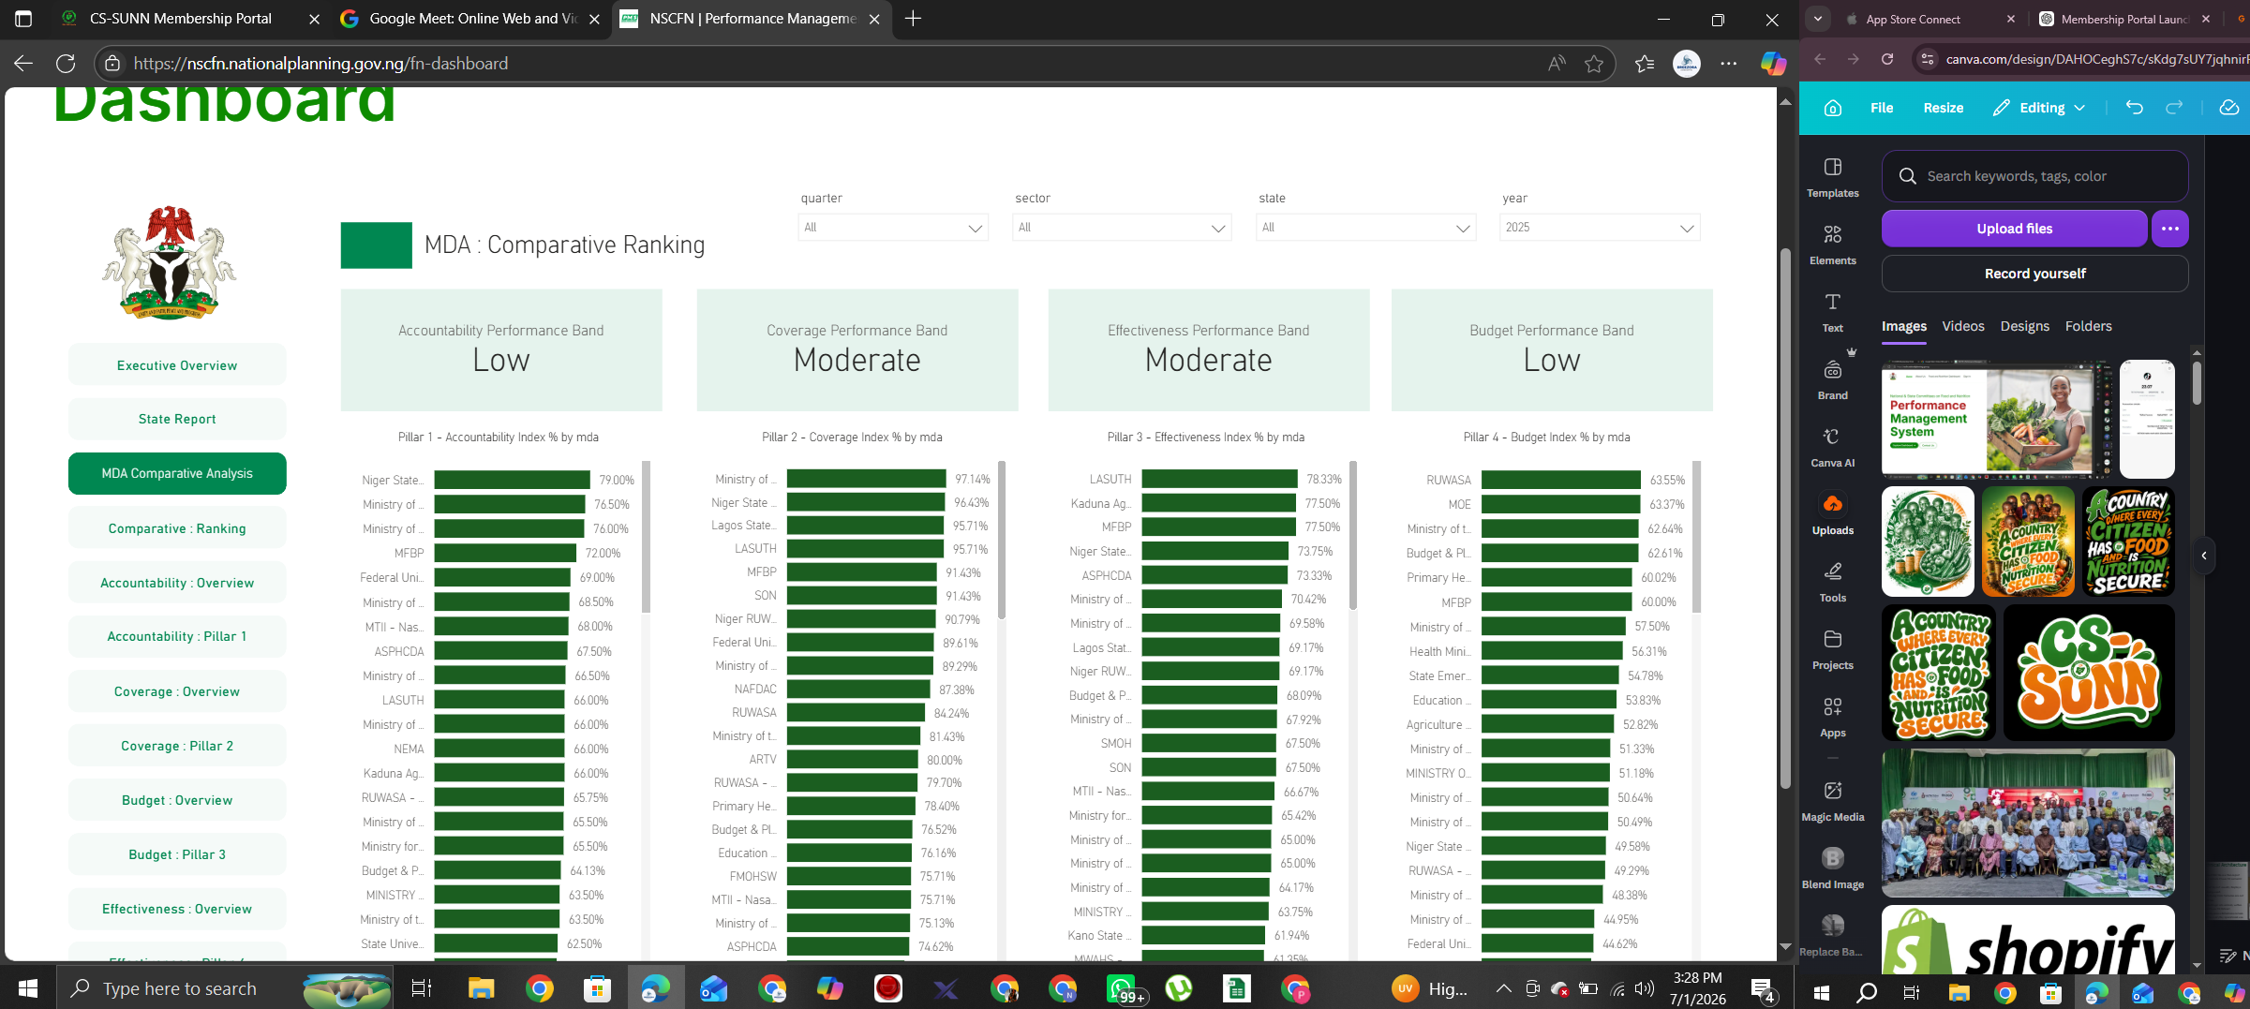
Utilizing Benchmark and Performance Location Cards
  Federal Average Index %: Reference average at the federal level within the active filter context.
  National Average Index %: Broader nationwide reference average for cross-comparison.
  State Average Index %: Average score for the selected state-level context.
  Best/Lowest Location Cards: Text labels (not percentages) identifying top and bottom performers (e.g., Best Budget Location).
  Interpretation Tip: If a state sits above both federal and national cards, it is outperforming both reference frameworks.
3

Slide 26

Page-by-Page Dashboard Guide

Slide 27

Executive Overview & State Report Pages
  Executive Overview: High-level summary landing page featuring overall scores, relative state and pillar ranks, benchmarks, and best/lowest locations.
  Primary Use: Quick performance snapshots and executive briefings.
  State Report: Dedicated operational view for a single filtered state context.
  Primary Use: Direct quarterly trend tracking and question-level chart analysis.

Slide 28



COMPARATIVE BENCHMARKING AND RANKING
The Comparative Ranking page functions as a performance league table:
League-Table Layout
Displays horizontal bar charts comparing states across selected categories.
State Accountability Index Rank (Cohort)
Kano State
89%
High-Impact Slides
Perfect for creating executive briefing slides to highlight leading and lagging areas.
Lagos State
75%
Kaduna State
58%
Volatile Rankings
Visual order shifts instantly based on your Sector, Year, or MDA filter selections.
League Leader: Kano State leads the cohort with an 89% accountability index score.

Slide 29
Accountability Detail Pages
Accountability: Overview
  Contents: Accountability Index %, Accountability Rank, Best/Lowest locations, and charts for questions B1 through B8.
  Purpose: Use this page to diagnose why an accountability score is weak.
Accountability: Pillar 1
  Contents: Detailed table view of accountability measures organized by state.
  Purpose: Ideal for deeper data reviews and exporting raw state-level patterns.

Slide 30
Coverage Detail Pages
  Coverage: Overview
    Contents: Coverage Index %, Coverage Rank, Best/Lowest locations, and C-series planning, implementation, and reach charts.
    Purpose: Identifies whether coverage gaps stem from weak planning or weak field implementation.
  Coverage: Pillar 2
    Contents: Detailed table view containing state-by-state data behind the overview.
    Purpose: Deep-dive analysis and regional verification.

Slide 31
Effectiveness Detail Pages & Tab Label Note
  Effectiveness: Overview
    Contents: Effectiveness Index %, Effectiveness Rank, Best/Lowest locations, and D-series result and assessment charts.
    Purpose: Determines whether activities are functioning effectively and achieving real field results.
  Effectiveness: Pillar 3
  Content: A detailed table view containing state-by-state information behind the effectiveness overview.

Slide 32
Budget Detail Pages & Tab Label Note
Budget: Overview
  Contents: Budget Index %, Budget Rank, Best/Lowest locations, and E-series financial execution charts.
  Purpose: Identifies financial bottlenecks across allocations, releases, or spending.
Budget: Pillar 4 (Budget data)
  Content: Detailed table view containing state-by-state budget data behind the budget overview.

Slide 33



THANK YOU
Add a little bit of body text
Scan the QR code to view our social media platforms

