Slide 1


Overview of the National Policy on Food and Nutrition (NPFN) 2026
By
Dr. Clementina Ebere Okoro
Director Food and Nutrition department and Nation Convenor for the Food Systems Pathways
Federal Ministry of Budget and Economic Planning

Slide 2
Background
NPFN guides food and nutrition actions by government at all levels
provides strategic direction for a multisectoral approach to deliver food and nutrition services and interventions
Food security and nutrition are critical factors in the development of any nation
  Iinfluence the growth
  productivity
  health
  overall wellbeing of the population

Slide 3
Why a New NPFN (2026–2035)?
unclear MDA responsibilities
fragmented implementation
weak coordination
inadequate financing
poor accountability
weak linkage between policy and implementation
insufficient data-driven planning
absence of operational guidance
Responds to emerging challenges: Climate change and insecurity, Rising NCDs, Food systems failures, Gender inequality

Slide 4
What Makes the 2026 NPFN Different?
Highlight innovations:
  Clearly defined sector responsibilities
  Life-course approach
  Food systems approach
  Climate resilience
  Systems thinking
  Strong governance architecture
  Results-based implementation
  Data-driven planning
  Knowledge management
  Digital monitoring
  MEAL framework
These innovations justify why MDAs need sectoral strategic plans.

Slide 5
Vision
“A country where the people are equitably food and nutrition-secure, with high quality of life and socioeconomic development, contributing to human capital development objectives of Nigeria’s Agenda 2050 and beyond”
Aligned with:
  Nigeria Agenda 2050
  Sustainable Development Goals (SDGs)

Slide 6
Goal
To attain optimal nutritional status for all Nigerians, by ensuring the co-coverage of high-impact direct and indirect nutrition interventions at scale, prioritising vulnerable groups.
Through:
  Co-coverage of high-impact nutrition-specific and nutrition-sensitive interventions
  Priority attention to vulnerable and high-burden populations

Slide 7
Strategic Objectives of the NPFN
Strengthen the Enabling Environment for Nutrition
Transform Food Systems to Ensure Food Security and Safety at All Levels
Deliver Nutrition Services in the Health System Along the Continuum of Care Across the Life Cycle
Transform Food Environments and Improve Diet Quality for All Nigerians
Strengthen Nutrition-Related Education System Services
Increase Access to Nutrition-Sensitive Water, Sanitation, and Hygiene (WASH) Systems
Promote Optimal Nutrition for Vulnerable Groups through Social Protection Systems
Address Nutrition-Hindering Social Norms and Empower Women
Ensure that Environmental Management and Climate Change Actions Contribute to Sustainable and Optimal Nutrition
Provide Work-Related Psychosocial and Structural Support to Caregivers
Strengthen Nutrition Communication, Advocacy, and Public Orientation

Slide 8
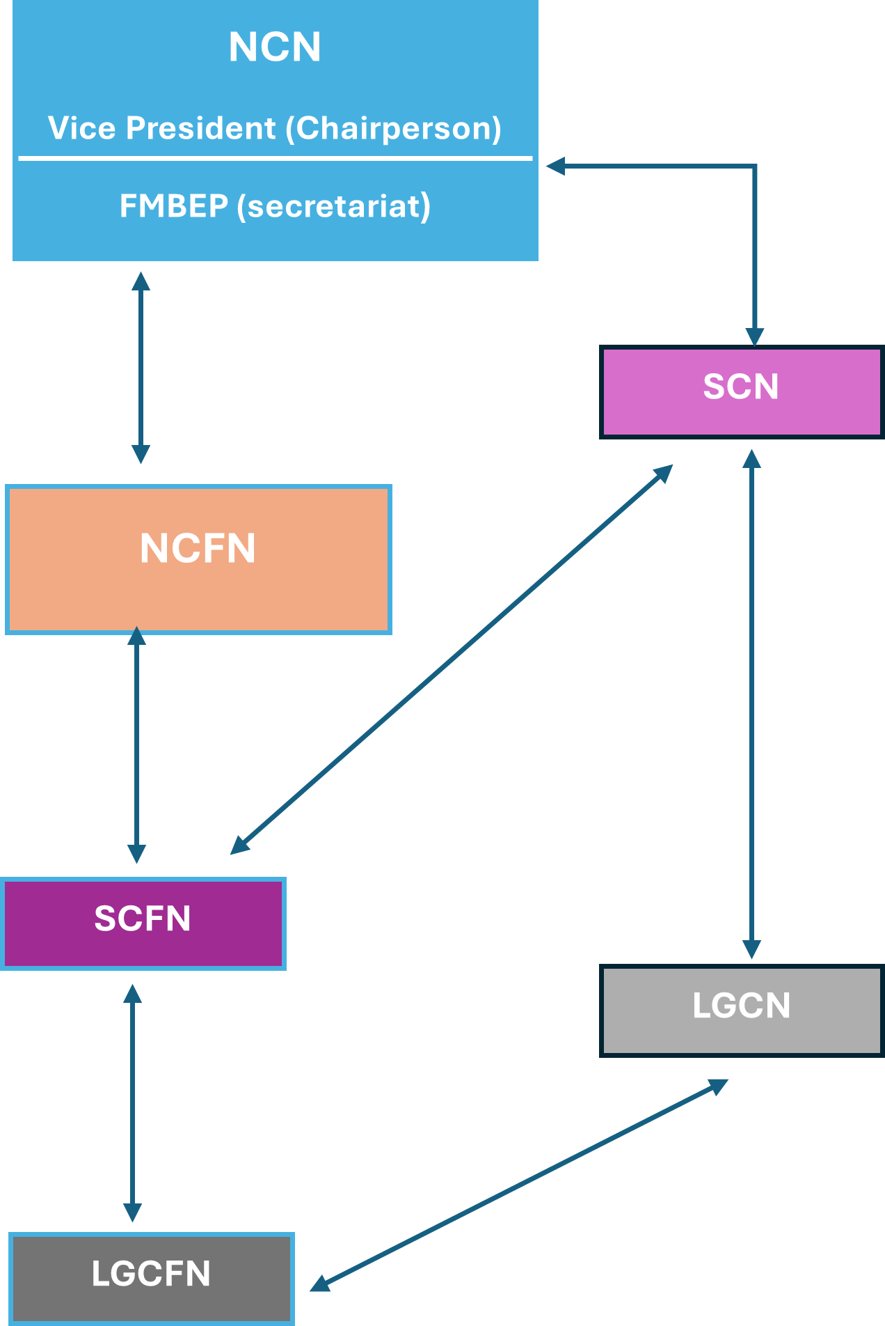
Institutional and Governance Arrangements
Designed to systematically address funding, coordination, capacity, implementation and coherence challenges
National Committee on Food and Nutrition (NCFN)
State Committees on Food and Nutrition (SCFN)
LGA Committees on Food and Nutrition (LGCFN)
Clear roles for MDAs across sectors
Strengthened coordination and accountability mechanisms

Slide 9
Financing and Partnerships
Commitment to increased domestic financing
Governments shall ensure the allocation of adequate resources
Ring-fenced budget lines for nutrition
Timely mobilisation and release of funds
Stronger donor coordination and private sector engagement
Public–private partnerships for scale and sustainability

Slide 10
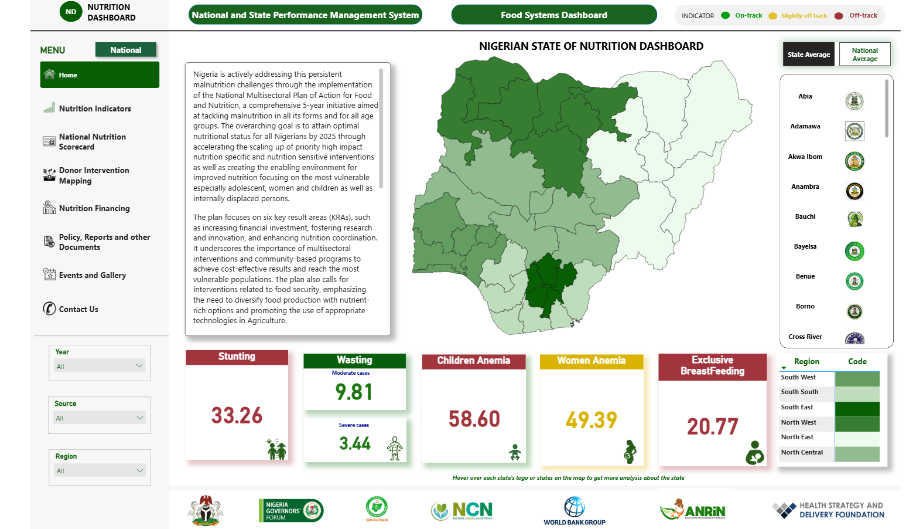
Monitoring, Evaluation, Accountability & Learning
Results-based monitoring framework
Strengthened nutrition data systems
Nutrition scorecards and dashboards
Regular reviews and learning loops
Evidence for adaptive management and accountability

Slide 11
Role of Stakeholders
All nutrition-relevant stakeholders identified in this policy have distinct and complementary roles to play in achieving the policy objectives. Their specific responsibilities and contributions are outlined within the policy framework. This includes;
Federal, State, and LGA governments
Development partners and donors
Civil society and communities
Academia and research institutions
Private sector and professional bodies

Slide 12
NPFN Innovations: MDA to Develop Nutrition Sectoral Strategic Plan
Mainstreaming Nutrition: clear sector mandates and responsibilities
NPFN implementation needs MDAs to translate policy into actions
All nutrition-relevant MDAs to integrate nutrition into:
  sector policies
  strategic plans, annual operational plans
  budgets
  monitoring systems, and performance reporting mechanisms

Slide 13
Expected Outcomes and Impact
Systemic Shifts: Transform food systems for sustainability, empower women and youth via inclusive opportunities, and strengthen local governance for community-led nutrition gains.
Malnutrition Reduction: Lower prevalence of malnutrition and micronutrient deficiencies across vulnerable groups.
Food Security Gains: Improve food and nutrition security through resilient production and access
Collaboration Boost: Enhance multisectoral collaboration for integrated policy implementation
Capacity Building: Increase awareness and capacity at all levels, from communities to national stakeholders
Target Progress: Advance toward national (NPFN) and global (SDGs) nutrition targets

Slide 14
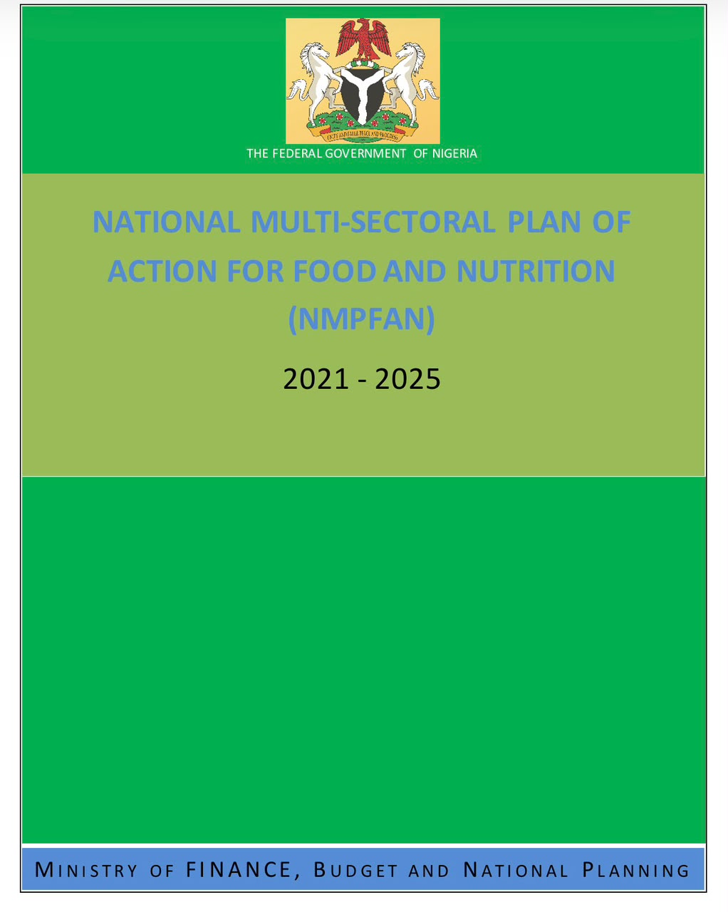
Technical Support to MDAs
FMBEP is currenting leading a coordinated technical assistance for
  Dedicated National Technical Assistant Team (NTAT)
  Active participation by all MDAs
  Continuous mentoring and quality assurance through interoperable Monitoring system.
National Technical Assistant Team are deployed to support:
  Nutrition-relevant MDA in develop costed sectoral Plan
  Consolidated NMPFAN

Slide 15


