Slide 1
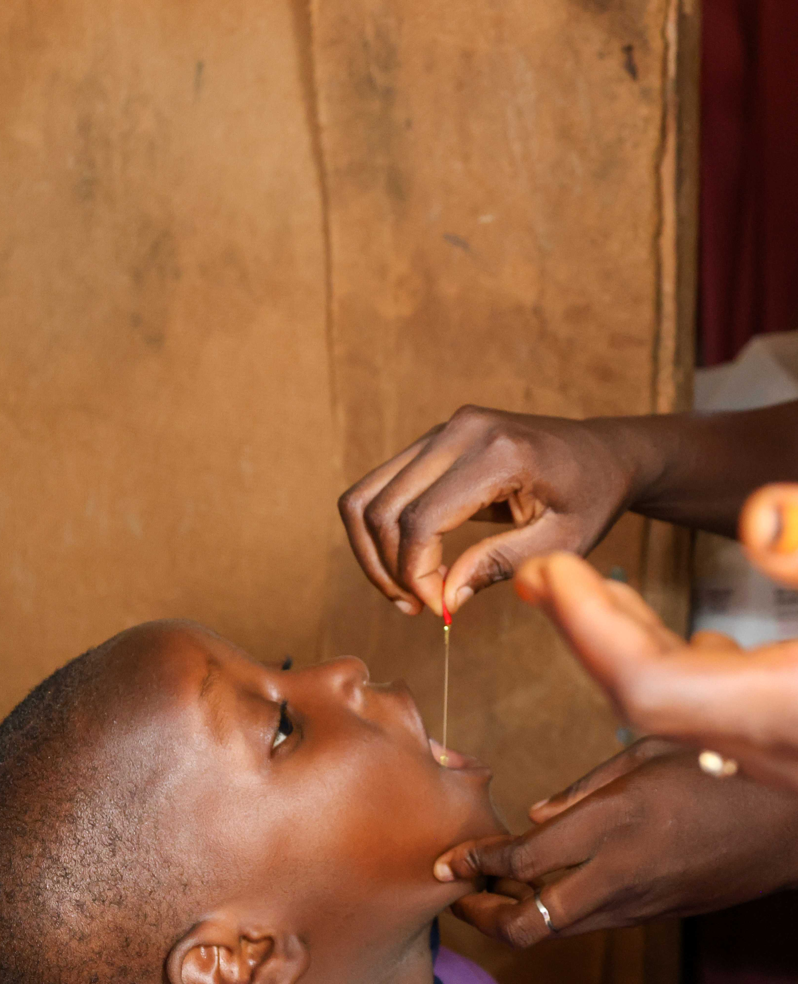
From campaign days to everyday protection
NUTRITION SOCIETY OF NIGERIA • EKO 2026
Early performance of routine vitamin A supplementation in Benue and Ebonyi States, Nigeria
Stanley Nwosu
Notes:
Campaigns can reach many children quickly, but a child who misses the campaign window may wait months. Vitamin A supplementation has traditionally surged during campaigns and faded between them. This presentation asks a simple implementation question: can everyday primary health-care contacts become reliable VAS contacts?

Slide 2
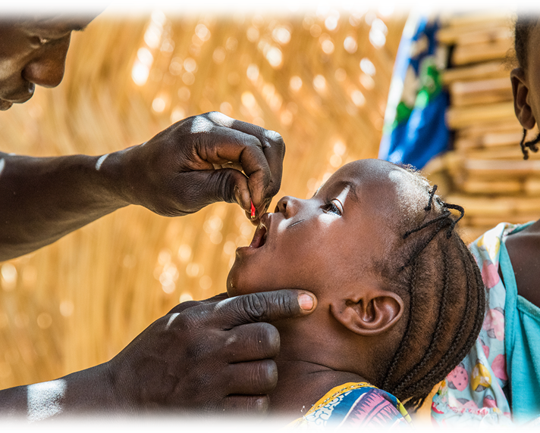
Routine delivery raised monthly VAS 4.1×
BEFORE ROUTINISATION
714
children per month
OCTOBER–DECEMBER 2025
2,933
children per month
Notes:
In Ebonyi, the monthly average before routinization was 714. During the first three monitored months, it rose to about 2,933—more than four times the starting level. This is not a causal estimate; it is an early operational signal that the service model changed what happened between campaign rounds.

Slide 3
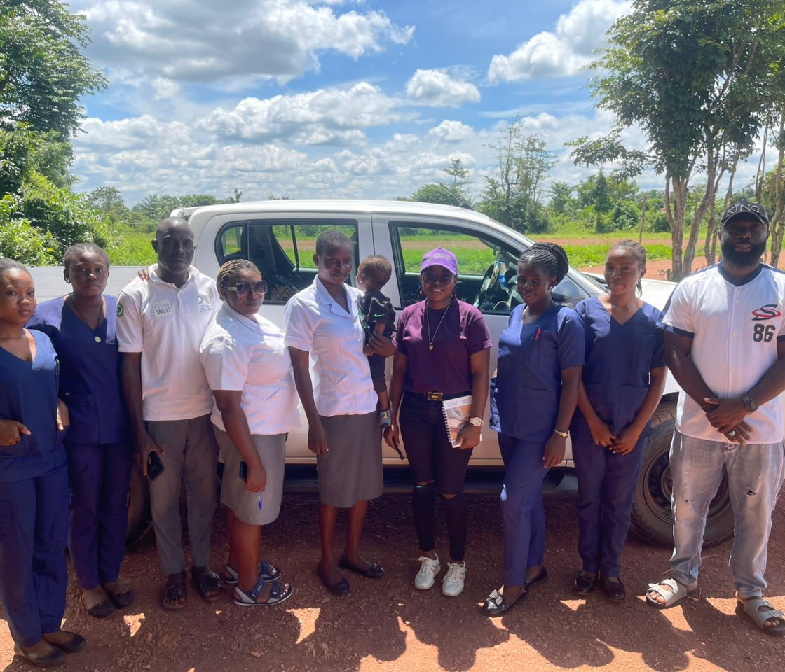
The pilot built a delivery system—not a campaign
60
primary health-care facilities in both states (30 apiece) – 1 facility per ward
11
selected LGAs across two states (6 in Benue, 5 in Ebonyi)
120
workers trained
in both states
97%
Facilities
in DHIS2
Facility-level delivery, supervision and outreach
Pilot footprint: 30 facilities in Benue and 30 in Ebonyi.
Notes:
Scale and readiness. This was deliberately a health-system pilot: 60 facilities in 11 LGAs. In Ebonyi, 120 health workers were trained and 29 of 30 facilities were integrated into DHIS2. The units of change were clinic flow, workforce practice, commodity availability and routine reporting.

Slide 4
Routine delivery worked through three functions
The intervention succeeded when service delivery, readiness and accountability moved together.
EMBED
ENABLE
VERIFY
Use every child-health contact
Keep the service ready
Make delivery visible
Routine immunization
Growth monitoring
Clinic Visits
Fixed + outreach sessions
Commodity redistribution
Worker training + coaching
Shared outreach calendars
Supportive supervision
SurveyCTO reporting
WhatsApp evidence
Monthly data validation
DHIS2 integration
Notes:
Implementation model. We grouped the bundle into three functions. First, embed VAS in the contacts already happening. Second, keep providers and commodities ready. Third, verify delivery rapidly and reconcile it into routine information systems. Removing any one function weakens the model.

Slide 5
Performance was compared across two phases
DESIGN + SETTING
OUTCOME + INTERPRETATION
Descriptive implementation evaluation
Administrative coverage
• 60 PHC facilities
• 11 selected LGAs
• Start-up through June 2026
• Phase 1 (Oct-Dec 2025) vs Phase 2 (Jan-Jun 2026) reporting rounds
reported VAS administrations
six-month target population
Results describe programme performance—not population-level effectiveness.
Notes:
Methods: This was a descriptive implementation evaluation, not a controlled effectiveness study. Coverage used the six-month administrative target. That denominator and the aggregate reporting structure shape how the results should be interpreted.

Slide 6
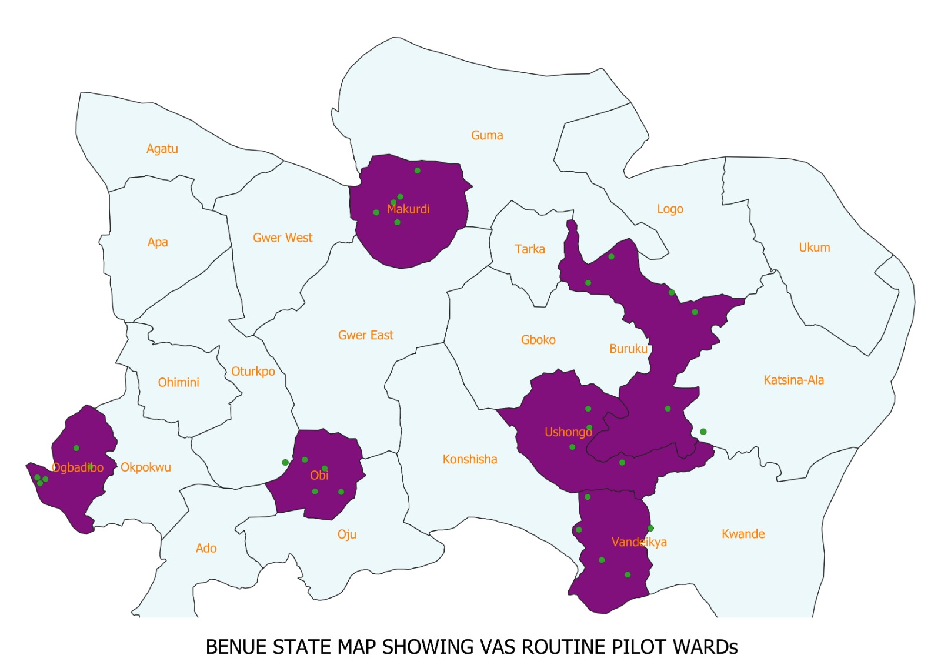
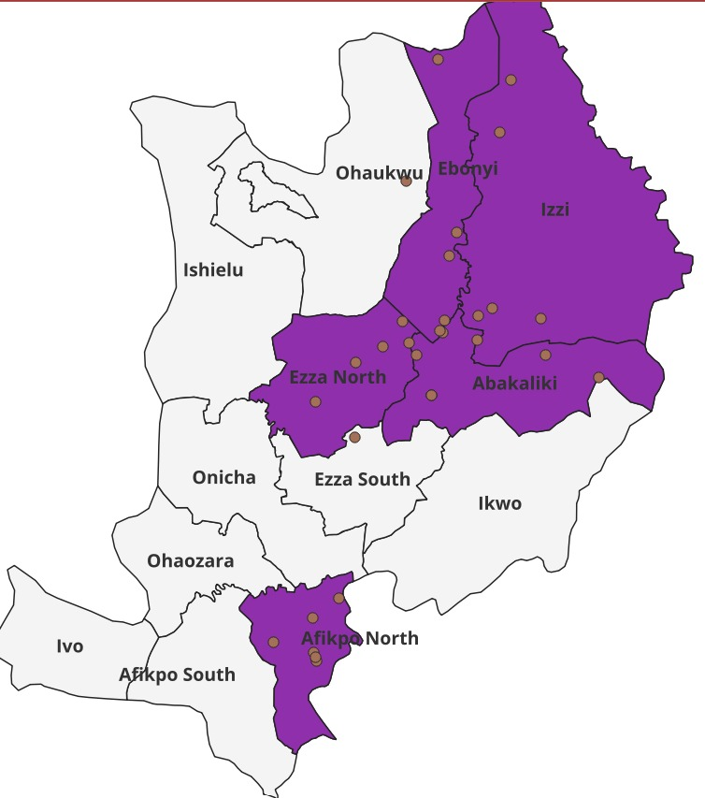
Pilot LGAs
6 LGAs, 30 Health Facilities
5 LGAs, 30 Health Facilities
Benue Target Population: 156,407.
11% of Total TP: 1,331,726
Ebonyi Target Population: 34,683.
5.5% of Total TP: 668,528

Slide 7
Coverage increased in both states
COMBINED CHANGE
+14.8
percentage points
+30,993
reported VAS administrations (+28.6%)
Largest gain: Ebonyi
37.0% → 90.3%
Coverage = reported VAS administrations ÷ six-month administrative target.(Benue: 156,407, Ebonyi: 34,683
)
Notes:
Results: Phase 2 administrative coverage was higher in both states. Combined coverage rose from 58.0% to 72.8%, an increase of 14.8 percentage points. The programme recorded 30,993 additional VAS administrations, a 28.6% increase. Ebonyi showed the largest phase change; Benue improved more modestly from a higher Phase 1 level.

Slide 8
The signal is strong, the data system needs work
WHAT THE DATA SUPPORT
WHAT REQUIRES CAUTION
Routine delivery expanded reported reach
Coverage is only as credible as its denominator
• Higher Phase 2 coverage in both states
• 30,993 additional administrations
• Feasible integration into PHC contacts
• Strongest gains where accountability matured
The denominators used by some facilities were found to be higher than actual
Some monthly actual exceeded 100% because of the census
Notes:
Interpretation: The direction and scale of the programme signal are encouraging. Some monthly or LGA estimates exceeded 100 percent. We therefore present these results as implementation performance, not population effectiveness.

Slide 9
Scale the model—and harden the data
Routine VAS can become everyday protection when scale-up strengthens delivery and measurement together.
01
Institutionalise
Fund VAS in state/LGA operational plans and protect commodity availability.
02
Sustain delivery
Continue supportive supervision, outreach calendars and workforce coaching.
03
Trust the numbers
Reconcile registers with DHIS2, validate denominators and strengthen unique-child tracking.
The opportunity is not another campaign. It is a routine system that reaches the child who arrives today.
Notes:
The programme has shown that routine VAS is operationally possible and can raise reported delivery. The next phase should not trade speed for credibility. Institutionalize financing and commodities, sustain supportive delivery, and strengthen the measurement system at the same time. Invite questions.

Slide 10
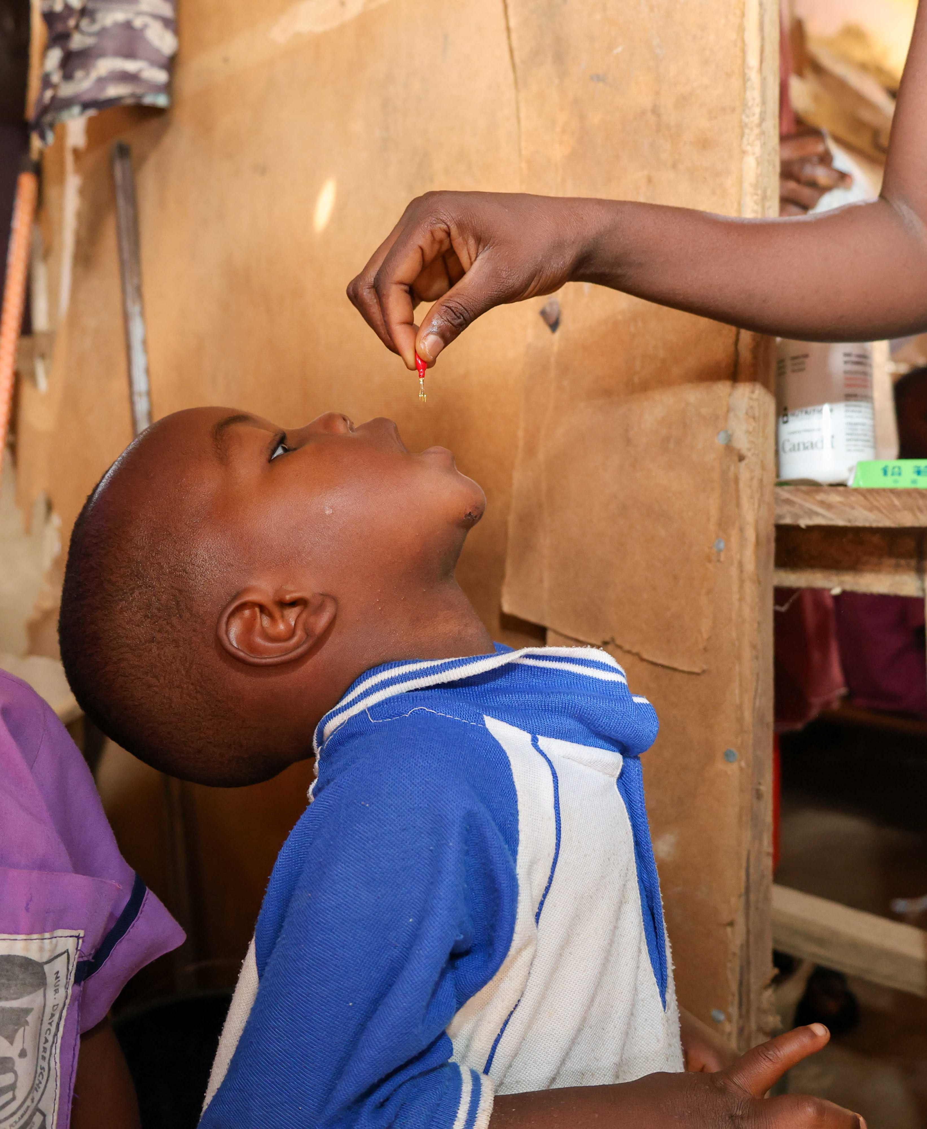
Thank you.
Questions?

