Slide 1





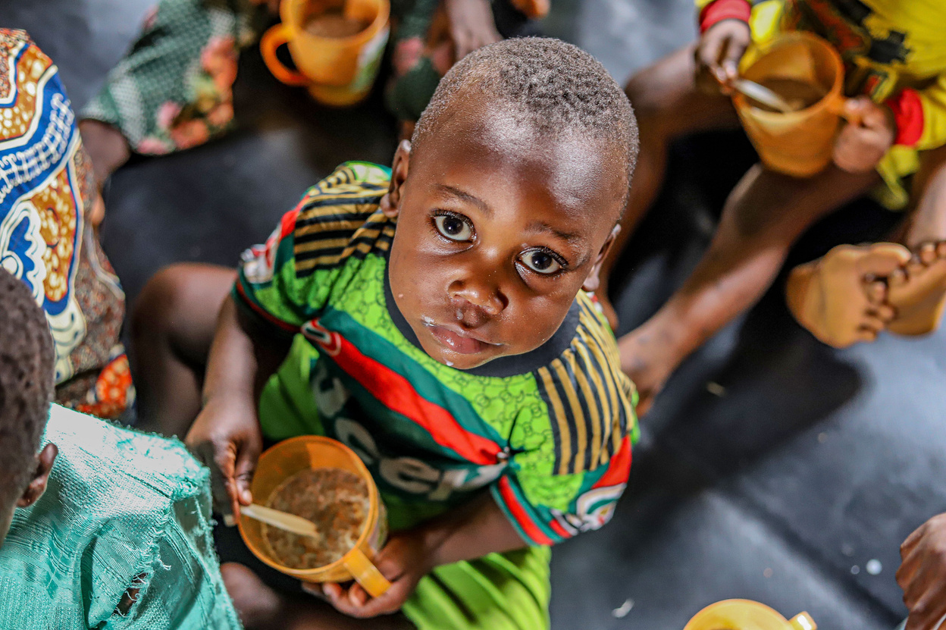
ANAEMIA & THE
CHILD NUTRITION FUND (CNF)
Connecting the burden of anaemia to nutrition financing, commodities and government action
A workshop facilitated by the Civil Society Scaling up Nutrition in Nigeria (CS-SUNN)
NSN Pre Conference Workshop, Lagos 2026
September 2026

Slide 2

Session objectives
By the end of the session, participants should be able to:
Explain
Connect
Understand
Act
What anaemia is, why it matters for child nutrition, and its major drivers.
Anaemia prevention with the broader nutrition commodities and financing agenda.
How the Child Nutrition Fund works and what the Nigeria experience demonstrates.
identify practical advocacy and financing asks that can strengthen anaemia-related nutrition action.
2

Slide 3

Workshop Flow
A practical participatory session
Opening
1
Quick poll and expectations
2
UNDERSTANDING
Anaemia burden and drivers
3
CONNECTING
Anaemia, commodities and financing
4
APPLICATIONS
CNF case exercise and group work
ACTION
5
Advocacy asks and commitments
3

Slide 4
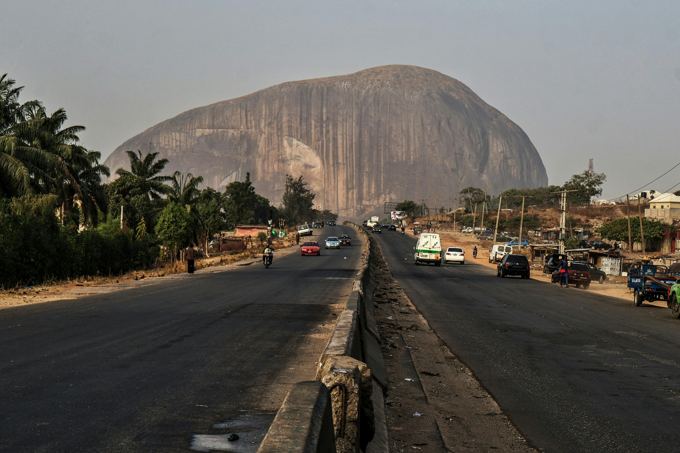
ANAEMIA IN NIGERIA
2024 National Snapshot | An intergenerational public health and development challenge
47%
50%
58%
63%
Women 15–49 are anaemic
Pregnant women are anaemic
Children 6–59 months are anaemic
Rural children are anaemic
WOMEN: ANAEMIA SEVERITY
CHILDREN: ANAEMIA SEVERITY
DISPARITY HOTSPOTS
Mild 25%
Moderate 20%
Severe 1%
Pregnant 50% | Non-pregnant 46%
Mild 30%
Moderate 27%
Severe 2%
Highest age burden: 24–35 months = 63%
WOMEN
Rural 49% vs Urban 44%
CHILDREN
Rural 63% vs Urban 51%
THE INTERGENERATIONAL IMPERATIVE → Maternal nutrition + pregnancy care + infant feeding + malaria control + early diagnosis + targeted equity action
4

Slide 5
Why put anaemia on the nutrition financing agenda?
Anaemia is both a nutrition problem and a systems challenge!
The financing question is not only “how do we treat anaemia?”
It is: how do we finance the commodities, services, supply systems and cross-sector actions that prevent and address its causes?
10

Slide 6
Anaemia: what are we talking about?
Anaemia is a condition in which the number of red blood cells or the haemoglobin concentration is lower than normal, reducing the blood’s oxygen-carrying capacity.
Nutrition-related causes
Non-nutrition causes
LESS
OXYGEN
DELIVERY
Iron deficiency is the most common nutritional cause; folate, vitamin B12 and vitamin A deficiencies can also contribute.
Infections, inflammation, chronic disease, blood loss and inherited red-cell disorders can also cause anaemia.
Key message: anaemia is an indicator of poor nutrition and/or poor health - so the response must be multisectoral.
5

Slide 7
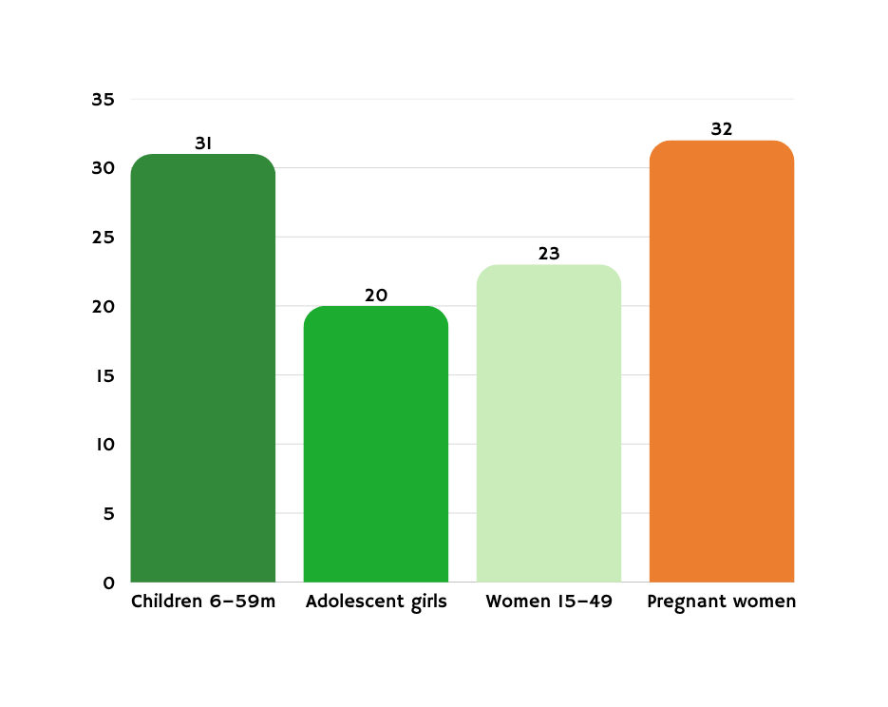
Nigeria: the burden is significant and uneven
National Food Consumption and Micronutrient Survey (2021)
Age matters
The youngest children carry particularly high risk; the 2021 survey reported 42% among children aged 6–11 months.
%
%
%
Equity matters
%
The survey found higher prevalence in rural areas and among children in lower wealth quintiles.
Implication for financing
A single national intervention package may not be enough: targeting and subnational prioritisation matter.
7

Slide 8
What drives Anaemia? Think beyond Iron?
Diet
Infection
Maternal factors
Low intake or absorption of iron and other micronutrients
  Food quality
  dietary diversity
  fortified foods
Malaria, parasitic infections and other infections
  Prevention
  diagnosis
  treatment
Low iron stores, pregnancy and blood loss
  Antenatal care
  MMS
  maternal nutrition
Environment & systems
Poverty, WASH gaps, weak access and supply constraints
  Social protection
  WASH
  primary health care
  supply chain
The financing response should therefore follow the causes- not just the diagnosis.
11

Slide 9

A practical response package
1
2
3
4
PREVENT
DETECT
TREAT
SUSTAIN
Improve diets, maternal nutrition, micronutrient intake and infection prevention.
Strengthen screening/diagnosis, referral and routine data use.
Ensure appropriate treatment and management of identified causes.
Finance commodities, supply chains, health-worker capacity and community demand.
Financing must support the whole chain - not only the commodity.
10

Slide 10
Where does the Child Nutrition Fund fit?
The CNF is not an anaemia-only fund. It is a catalytic nutrition financing mechanism that can strengthen access to essential nutrition commodities.
ANAEMIA BURDEN
CNF MECHANISM
NUTRITION OUTCOME
High burden + multiple causes
→ requires prevention, detection and treatment
Government-led investment + catalytic matching
→ unlocks procurement of eligible commodities
Better access to preventive and therapeutic nutrition commodities
→ stronger nutrition response
The opportunity is to position anaemia within broader nutrition financing, commodity availability and multisectoral action.
12

Slide 11

Child Nutrition Fund: the model at a glance
2020
2022
5
5
CNF initiated with a focus on RUTF for treatment of wasting.
Vision expanded to include preventive nutrition commodities.
Programme Window priority areas guide government-led action.
Match Window commodity categories highlighted in the supplied deck.
Core principle: catalytic financing should increase, not replace government investment.
• Government initiates the request and demonstrates commitment.
• UNICEF and partners facilitate the matching mechanism and procurement process.
• Government remains responsible for in-country logistics, duties and taxes under the Match Window.
• The mechanism is designed to accelerate access to essential nutrition commodities.
4

Slide 12
CNF Match Window: eligible commodities
Balanced Energy Supplements (BES)
MMS
SQ-LNS
RUTF
Vitamin A
Pregnant women & breastfeeding mothers
Children 6–23 months
Children 6 months–5 years with acute malnutrition
Children 6 months–5 years
Pregnant women & breastfeeding mothers
Anaemia lens: MMS and other micronutrient commodities can contribute to prevention strategies where aligned with national policy and programme design. The CNF commodity list itself should not be interpreted as an anaemia treatment list.
8

Slide 13
How the CNF Match Window works
Government request
MOU
Budget evidence
Federal/state government initiates the request.
Government and UNICEF establish the agreed framework.
Government provides evidence of budget allocation / commitment.
Confirm order
Procurement
Delivery
Cost estimates and quantities are confirmed; purchase order is issued.
UNICEF facilitates procurement and related processes.
Commodities are delivered; government manages in-country responsibilities.
Important: the Match Window covers eligible supplies and freight up to the port of entry; in-country logistics, duties and taxes are government responsibilities.
11

Slide 14
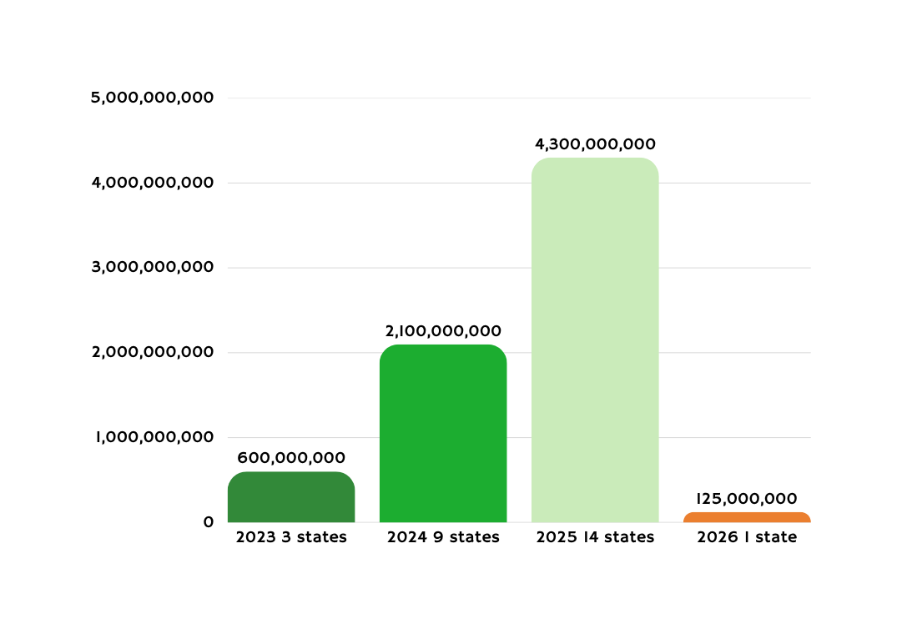
Nigeria: the burden is significant and uneven
Match Window funding released by states, 2023–2026
20
states reported in the supplied deck as having invested through the Match Window.
₦7.1bn
total state investment reported in the supplied deck for 2023–2026.
The trend is the lesson: catalytic financing can help turn nutrition commitments into budgeted and released resources.
7

Slide 15

What does the CNF experience teach us about financing anaemia?
1
Lead with government ownership
The mechanism starts with a government request and evidence of commitment.
Make the budget visible
2
Advocacy must move from policy statements to budget lines, releases and procurement.
Finance commodities + systems
3
Commodity access is necessary, but delivery requires supply chains, services, data and demand.
Use subnational evidence
4
Burden and access vary; state-level targeting can make advocacy and financing more precise.
For anaemia advocacy: convert “high burden” into a specific, costed and financeable government ask.
6

Slide 16
Who needs to do what?
Federal government
State government
Health & nutrition agencies
CSOs / CS-SUNN
Partners / donors
7

Slide 17

Three takeaways
1
Anaemia is a nutrition + health + systems challenge issue
2
CNF demonstrates how catalytic financing can turn government commitment into commodity investment.
3
The advocacy task is to connect burden → intervention → cost → budget → release → accountability.
9

Slide 18
INTERACTIVE HANDS-ON SESSIONS
9

Slide 19
Activity 1: The anaemia reality check
Interactive activity | ……minutes
PURPOSE
HOW IT WORKS
EXPECTED OUTPUT
1. Working in pairs.
2. Sharing one anaemia challenge you see most often.
3. Identifying the population most affected.
4. Naming one barrier to prevention or treatment.
Participants experience and connect national data to local realities.
One priority challenge per pair, captured on a sticky note or flipchart.
Guiding question: What is the biggest anaemia challenge that data alone may not fully explain?
11

Slide 20
Activity 2: Follow the causes, follow the money
Interactive activity | ……minutes
PURPOSE
HOW IT WORKS
EXPECTED OUTPUT
In small groups, choose one driver: diet, infection, maternal factors, or systems.
Map: Cause → Intervention → Commodity/Service → Financing need.
Identify one gap government must address.
Help participants connect anaemia drivers to interventions and financing needs.
A four-step financing map and one priority budget ask.
Challenge: Are current resources reaching the root cause?
11

Slide 21
Activity 3: CNF case simulation
Interactive activity
PURPOSE
HOW IT WORKS
EXPECTED OUTPUT
Each group acts as a state nutrition team.
1. Select an eligible nutrition commodity opportunity.
2. Define the target population.
3. Show government commitment and budget evidence.
4. Identify logistics and accountability responsibilities.
Apply the Child Nutrition Fund model to a realistic government financing decision.
A 3-minute state pitch: Why invest? What will be financed? What must government do?
Remember: catalytic financing should increase, not replace, government investment.
11

Slide 22
Activity 4: From burden to Actions
Interactive activity
PURPOSE
HOW IT WORKS
EXPECTED OUTPUT
The sequence:
1. BURDEN: What is the problem?
2. INTERVENTION: What works in your context?
3. COST: What needs financing?
4. BUDGET: Where should it sit?
5. RELEASE: What must happen next?
6. ACCOUNTABILITY: Who tracks delivery?
Converting evidence into an actionable advocacy and accountability agenda.
One concise, specific and financeable government ask per group.
Template: 'We call on [actor] to finance [intervention] through [budget mechanism] for [population], with [accountability measure].'
11

Slide 23
Action planning: What happens after this room?
Individual and institutional commitment
PRIORITY ACTION
WHO WILL LEAD?
BY WHEN?
EVIDENCE OF PROGRESS
9

Slide 24
Closing circle: One insight. One action.
5-minute plenary reflection
ONE INSIGHT
ONE ACTION
What will you do differently after this workshop to strengthen anaemia-related nutrition action?
What is the most important thing you learned about anaemia, nutrition financing or the CNF mechanism?
Take the conversation from awareness to a budgeted, released and accountable response.
11

Slide 25



Together, We Can Reduce Malnutrition and Build Healthier Communities​
Add a little bit of body text
Thank You

