Slide 1
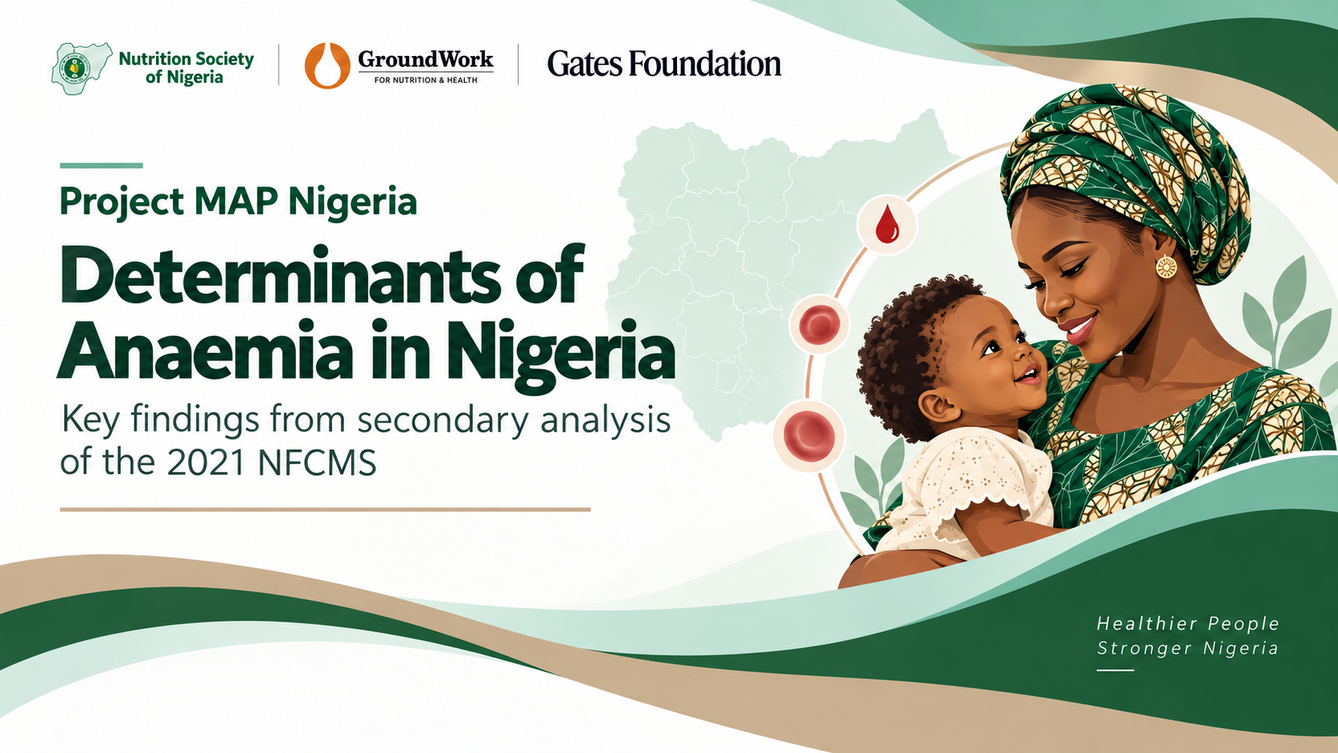

Slide 2
JUSTIFICATION
Why this study? Anaemia is not “just iron deficiency”
1
INFECTION
Malaria, Helminths
Hb
2
INFLAMMATION
CRP/AGP
A low haemoglobin value
is the endpoint with
no explanation
3
MICRONUTRIENTS
Iron, Zinc, Vitamin A, B12, Folate
4
HAEMOGLOBINOPATHY
Sickle cell disease
5
CONTEXT
Age, Wealth, Geography
In many surveys fewer biological
determinants are measured together
1 Which factors are DOMINANT?
2 How large is each calculated PAF?
3 Does the pattern change by group and geography?
3 QUESTIONS

Slide 3
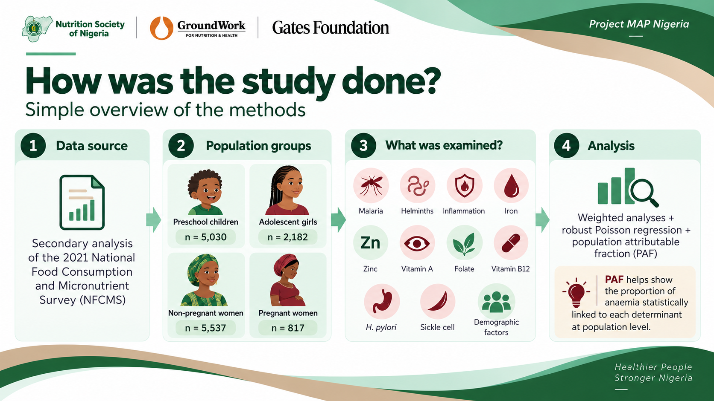

Slide 4
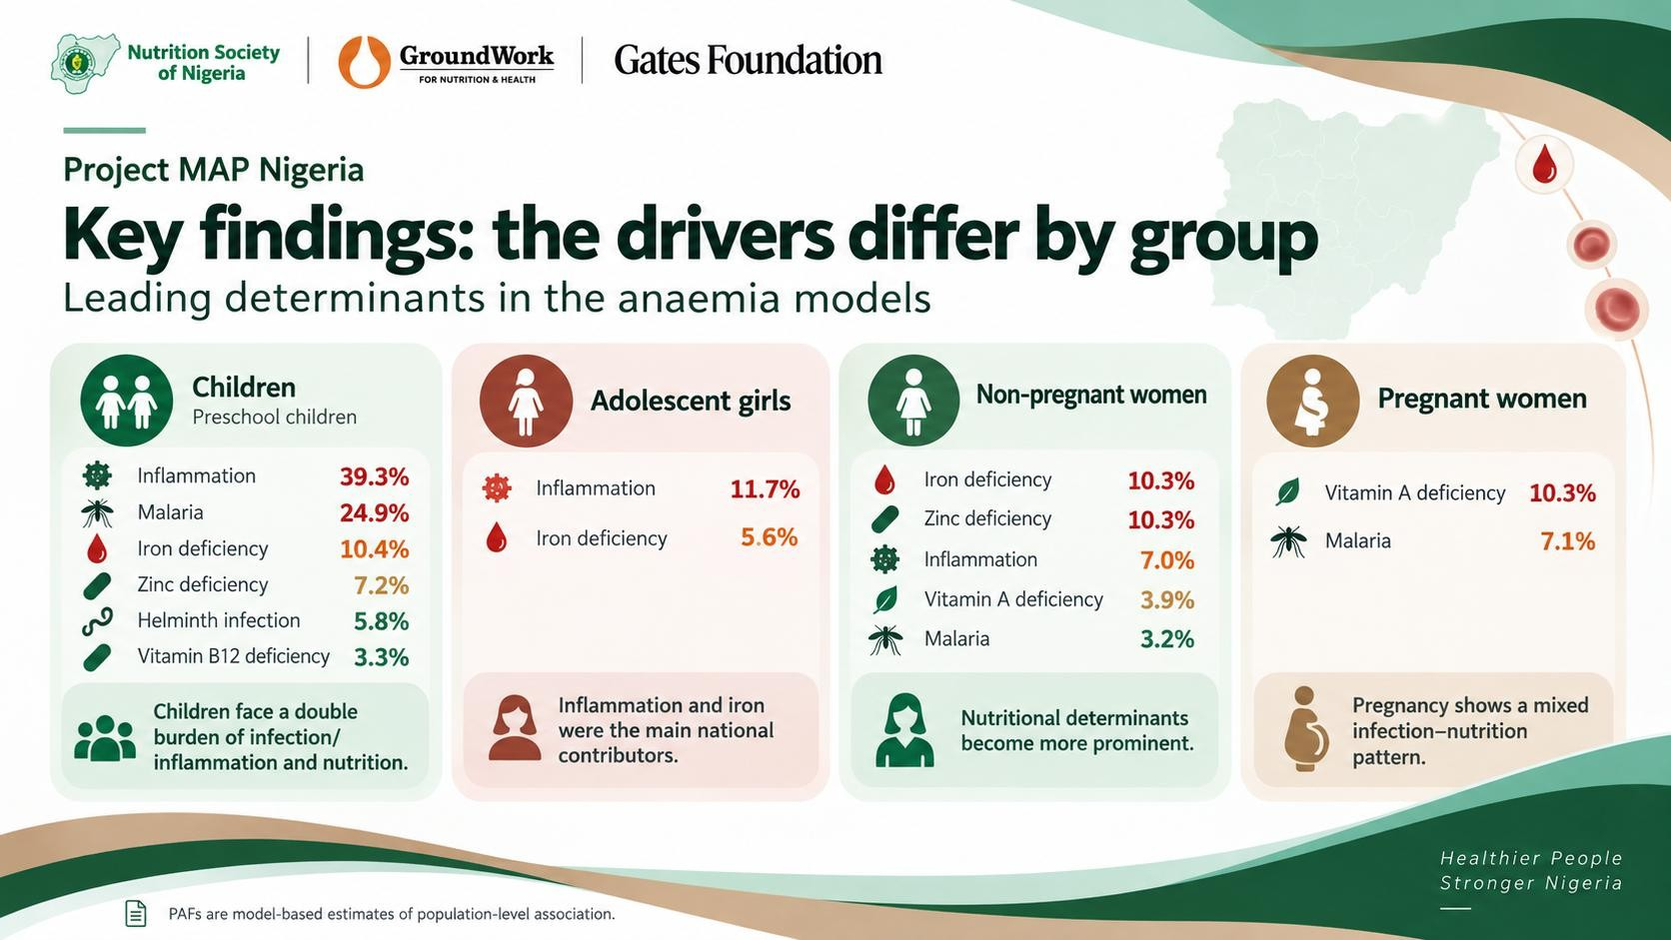

Slide 5
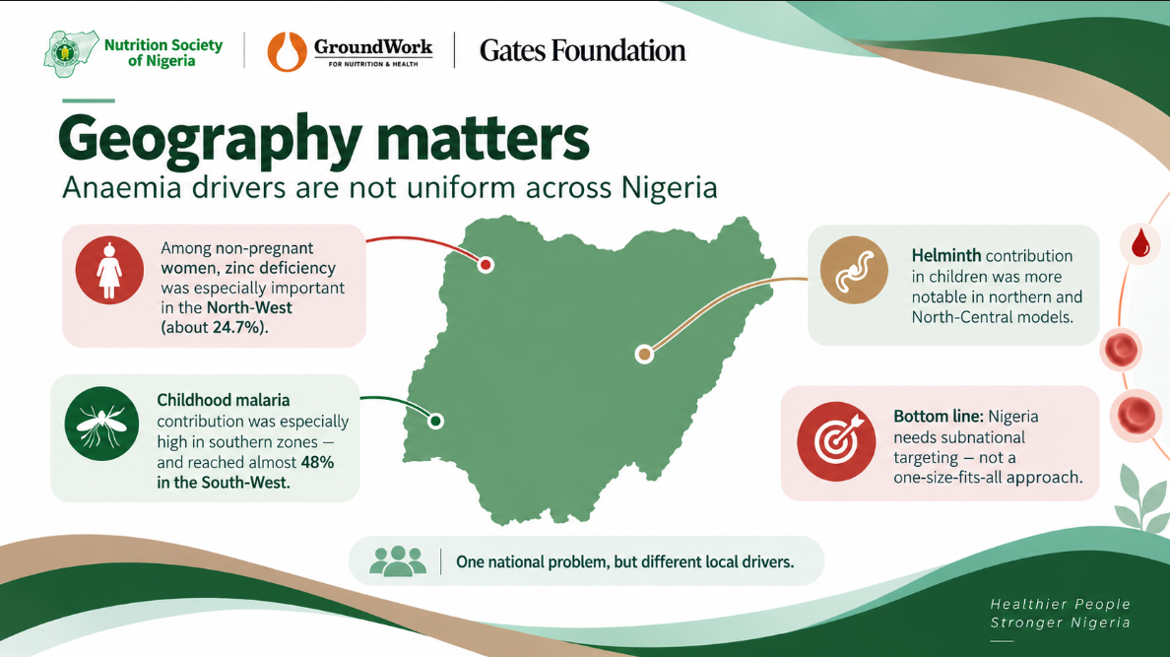

Slide 6
Recommendations
What could programmes/programming do differently?
TARGET GROUP
DOMINANT SIGNAL
PUSH HARDER NOW
NEW
Malaria prevention + prompt diagnosis/treatment
MNP/ improved complementary feeding,
Deworming
WASH
Preschool
children
Inflammation, malaria
then iron, zinc, helminths
Find the causes behind inflammation
Tailor child packages by zone
Adolescent
girls
Adolescent iron/folate delivery
Diet quality
Malaria services where relevant
Reach girls beyond ANC: schools + out-of-school platforms
Investigate inflammatory drivers
Inflammation, iron
Non-pregnant
women
Fortification compliance
Dietary diversity
Preconception/reproductive-health platforms
Iron, zinc, inflammation
smaller VAD signal
North-West zinc deserves closer targeting
Match fortification vehicles to local diets
Pregnant
women
ANC malaria control
Routine iron-containing supplements
Diet + compliant fortification
Build vitamin A stores before pregnancy
Avoid indiscriminate high-dose vitamin A; investigate southern inflammation
Vitamin A, malaria
ONE NATIONAL GOAL WITH MULTIPLE DELIVERY PACKAGES

