Slide 1

BRIDGING THE MALNUTRITION GAP: Nurturing Multisectoral Commitments for Sustainable Nutrition in Nigeria
Keynote Address at The 52nd Annual General Meeting & Scientific Conference
Nutrition Society Of Nigeria
By
K.M. ANIGO

Slide 2
Introduction
Nutrition is a critical part of health and development
Malnutrition continues to be one of the world's most critical health and human development challenges
Cause high-burden nations to lose approximately 2-3 percent of GDP
Threatening countries' achievement of the Sustainable Development Goals (SDGs).
Malnutrition represent critical public health concerns in Nigeria
Investing in nutrition significantly multiplies the positive outcomes for maternal and child health, cognitive function and educability, human capital, economic growth and poverty reduction

Slide 3
Malnutrition
UNDERNUTRITION
MICRONUTRIENT DEFICIENCY
OVERNUTRITION
MALNUTRITION
Malnutrition in every form, presents significant threats to human health
88% of countries face a serious burden of either two or three forms of malnutrition
Causes of malnutrition are complex and multilayered

Slide 4
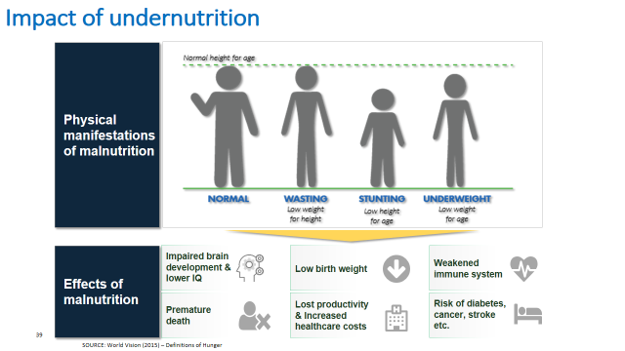
IMPACT OF nutrition

Slide 5
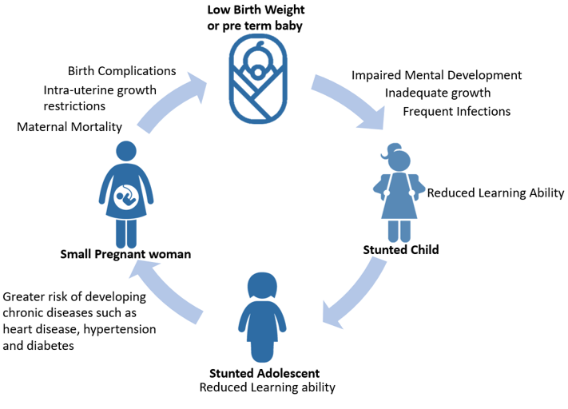
Intergenerational Effect of Malnutrition
Image source: Strengthening Integration of Nutrition…commissioned by the EC (May,2018)

Slide 6
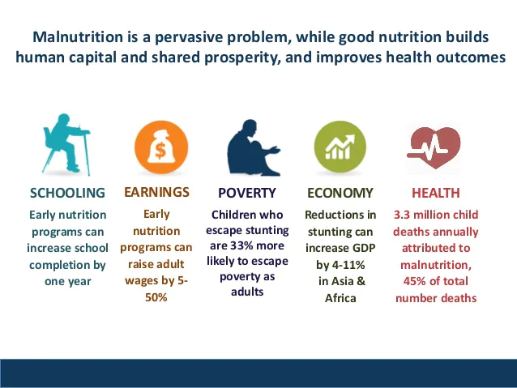
The Consequences of Malnutrition
The Human Capital Index Project, has attempted to quantify the contribution of health, including nutrition, and education to the next generation of workers.
Nigeria ranks 152 out of 157 countries, indicating a low human capital index that calls for serious concern and actions.

Slide 7
Prevalence of Malnutrition
Child Nutrition
Nigeria ranked #1 in Africa and #2 in the world in terms of number of children malnourished
  ~35 M Children U5 years of age
  ~14 M Stunted
  ~3 M Wasted
  ~24 M Anaemic
The average annual rate of reduction for stunting is only 0.4 per cent points per year
25 million people are hungry
9.3 million people suffer from Acute Food Insecurity
Source: Nigeria Population Commission: Population Projection
Data source: NDHS 2018

Slide 8
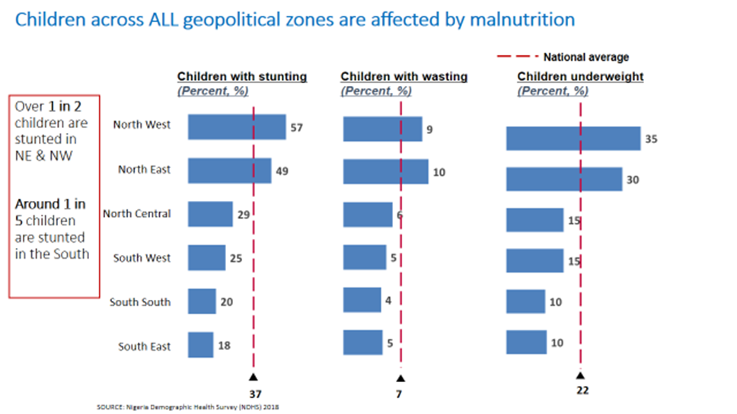

Slide 9

Malnutrition Gap

Slide 10
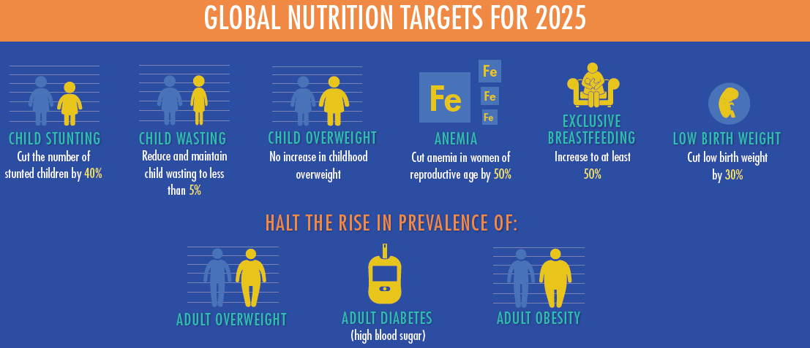
NATIONAL TARGETS
Reduce stunting rate among under-five children from 37% in 2013 to 18%
Reduce child wasting including Severe Acute Malnutrition from 18% in 2013 to 10%
Reduction in anaemia among pregnant women from 67% in 2003 to 33%
Increase exclusive breastfeeding rate from 17% in 2013 to 65%
To halt the increase in obesity prevalence in adolescents and adults

Slide 11
Issues of Nutrition Concern in Nigeria
Minimum Acceptable Diet
Percent of children age 6-23 months
The average annual rate of reduction for stunting is only 0.4 per cent points per year
<20% of children 6-24 months receive adequate diet
Inadequate Nutrition contributes 45% of child morbidity and mortality
Leading causes of child mortality are Malaria, Diarrhoea and Pneumonia which can all be addressed by Nutrition
25 million people are hungry

Slide 12
Fundamental Challenges
Accountability & Coordination
  Limited political will and visibility for nutrition
  Lack of delineation of roles and responsibilities and accountability
Funding
  Inadequate/lack of Budget line for nutrition at all levels
  Funding commitments are not in sync with Global nutrition efforts
Service Delivery and SBCC
  Fragmentation and verticalization of nutrition programs and interventions
  Health facilities are not equipped with essential nutrition materials e.g. Vita. A, Iron, Zinc/ORS, Deworming tablets, MUAC tapes, Weighing scale
  Poor knowledge, attitude and practices of infant and young child feeding
  Not focused on Nutritious foods
  Heavy marketing of low nutrient foods
  Agric commodities processed into foods with low fiber, high salt, fat and sugar.
Food System
  Non engagement of nutrition workers – availability?
  Poor training of health workers to effectively provide nutrition services
Human Resources
Notes:
Policies in place that need to be enforced and implemented to address malnutrition are:National Policy on food and nutrition in Nigeria- MBNP 2016
National Social and Behavioural Change Communication (SBCC) strategy for infant and young child feeding (IYCF) in Nigeria (2016-2020)
Food Fortification Policy- NAFDAC

Slide 13
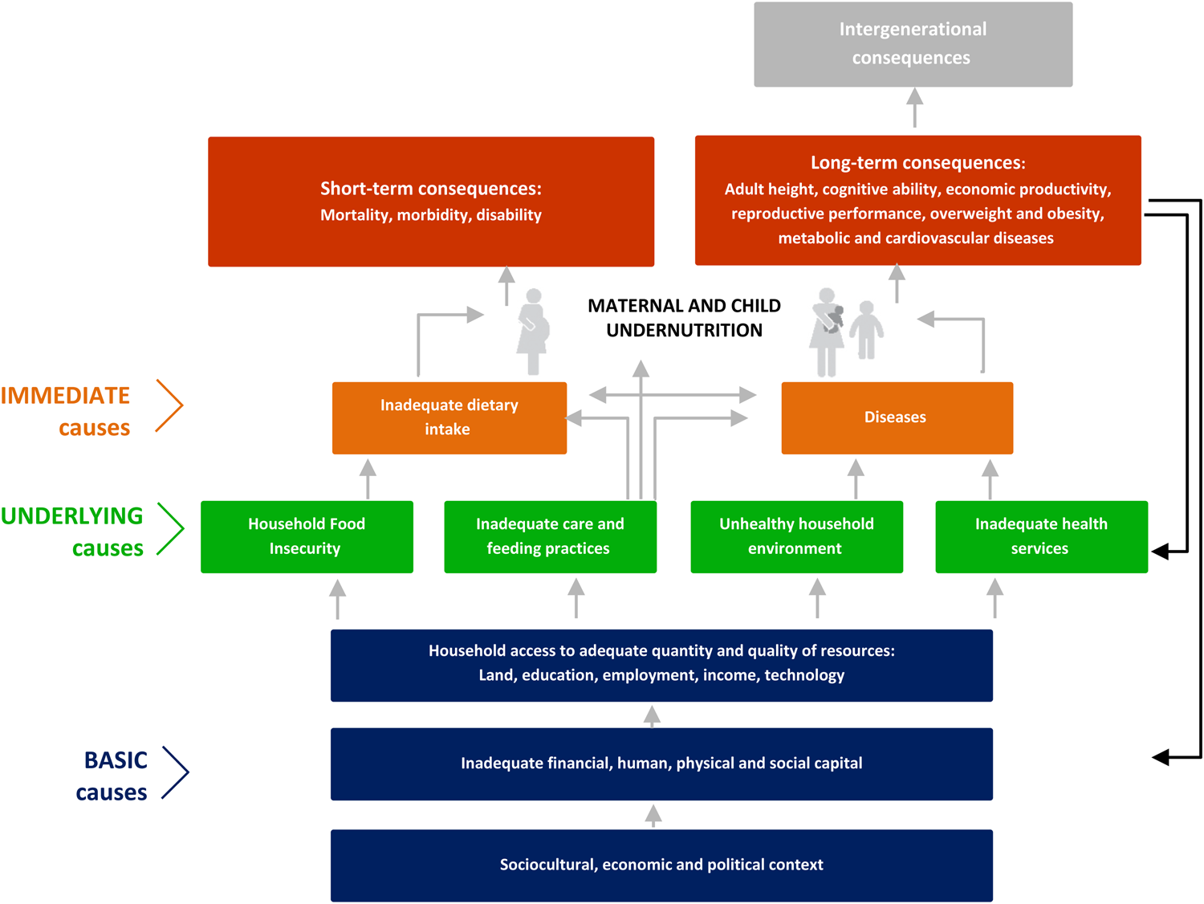
Multisectoral, Multifactorial causes of Malnutrition
UNICEF Nutrition Conceptual Framework (UNICEF 1990)

Slide 14
Sectoral Efforts – Does it work alone?
NSPAN, FMARD, HUMANITARIAN, EDUCATION EFFORTS

Slide 15
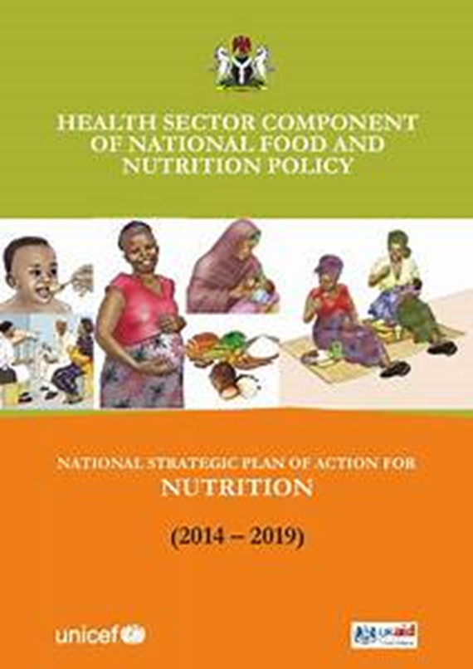


MANY POLICIES AND PROGRAMMES BUT POOR IMPLEMENTATION!!!

Slide 16
Agricultural sector
Food System excessive focus on agriculture and food security
Resulted in unintended consequence of creating a less diverse food environment
Unable to provide an adequate variety and affordable, safe, and nutrient dense food.
Food systems in Nigeria are vulnerable to shocks, stresses, and disruptions like climate change, the COVID-19 pandemic, and conflict.
Poverty, unemployment, and insufficient food reserves limit the capacity of our food systems to cope with shocks and stresses.

Slide 17
Health System is failing to deliver essential nutrition services
Antenatal Care
Nutrition counseling
Weight gain tracking
IFA supplementation
Calcium supplementation
Infection control
Intermittent presumptive treatment of malaria
Continued
Breastfeeding
12-23M
Delivery
Delayed cord clamping
Initiation of breastfeeding within one hour
Skin-to-skin contact
Vitamin A
Supplementation
ANC4+
Skilled Attendance
at Birth
DPT3
Measles Vaccine
Coverage 1
Post Natal Care
Counseling:
  Maternal nutrition
  Breastfeeding
  Complementary feeding
Vitamin A supplementation
Screening and referral for acute malnutrition
Zinc supplementation and diarrhea management
Full
Immunization
Coverage*
Early Initiation
of Breastfeeding
Minimum
Dietary Diversity
Iron-Folic Acid
Supplementation
Exclusive
Breastfeeding
Pregnancy
Birth
0 – 6 Months
6 – 12 Months
12 – 24 Months
Sources: UNICEF Global Database, August 2018; Countdown to 2030, December 2017
*Full immunization coverage: BCG, DPT3, MCV1, OPV3
Notes:
Speaking of learning, one learning is clear that the health system on which we rely as a primary lever for nutrition specific interventions is failing to deliver essential nutrition services. If we take a look at Iron Folic Acid supplementation which women get during their ante natal care visits, we see that while ANC coverage is at 50%, IFA supplementation is only at 20%. This is both a gap and an opportunity.

Slide 18
Financing Gap………
Perfectly logical to think and plan in a multisectoral manner, actions must follow sector by sector, tailored to the specific context, objectives, and operating environment of each sector.
Gaps in nutrition spending across relevant MDAs
Fragmented and poor funding of nutrition-related activities by the government across relevant sectors with resultant poor nutritional indices
This calls for collaborative efforts to enhance nutritional financing in Nigeria
Budget allocations in institutions, as well as at country level, are made by sectors or ministries
Governance and accountability structures follow similar sectoral limitations with sectors holding themselves accountable for results within their own domains.
These gaps need urgent attention by stakeholders

Slide 19
Multisectoral Efforts in Nigeria

Slide 20
Multi‐Sectoral Approach
Nigeria has shown commitment to eradicating hunger and malnutrition among her citizens
This is in order to lay a strong foundation for improved standard of living for citizens and socioeconomic development of the nation
The urgent need to scale up high impact and cost effective nutrition interventions to reduce the worsening nutrition situation in Nigeria led to signing unto the Scaling up Nutrition (SUN) movement in 2011
This justifies the need for the reviewed policy on food and nutrition published in 2016 and the development of a multi-sectoral plan of action

Slide 21
FOOD AND NUTRITION POLICY PROGRAMME PLANNING AND COORDINATION
National Council on Nutrition (NCN) is the highest decision-making body on food and nutrition in Nigeria
  Technical Advisory Group (TAG) was inaugurated by the NCN to provide Strategic technical advice and make recommendations to the NCN on NMPFAN
  Delivery Unit in the office of VP was set up to focus on supporting the smooth delivery of the National Nutrition Council objectives which include focusing on its key priorities based on the policy document and multisectoral plan.
  Ministry of Finance, Budget and National Planning (MB&NP) serve as national focal point for planning and coordination in the country as secretariat for both the National Committee on Food and Nutrition (NCFN) and NCN

Slide 22
Coordinated efforts across sectors
Addressing malnutrition requires strategies that are comprehensive and multi-sectoral
Malnutrition is a complex issue requiring coordinated efforts across sectors to address its underlying causes
A comprehensive approach to addressing malnutrition requires the engagement of all sectors to deliver both nutrition-specific interventions and nutrition-sensitive interventions
FMOH
FMA&SD
FMWR
FMITI
MBNP
Coordination
Sectors involved in Nutrition issues in Nigeria
FMST
FMARD
FME
FMI&C
SON
NAFDAC
NPHCDA
Academia
FMF

Slide 23
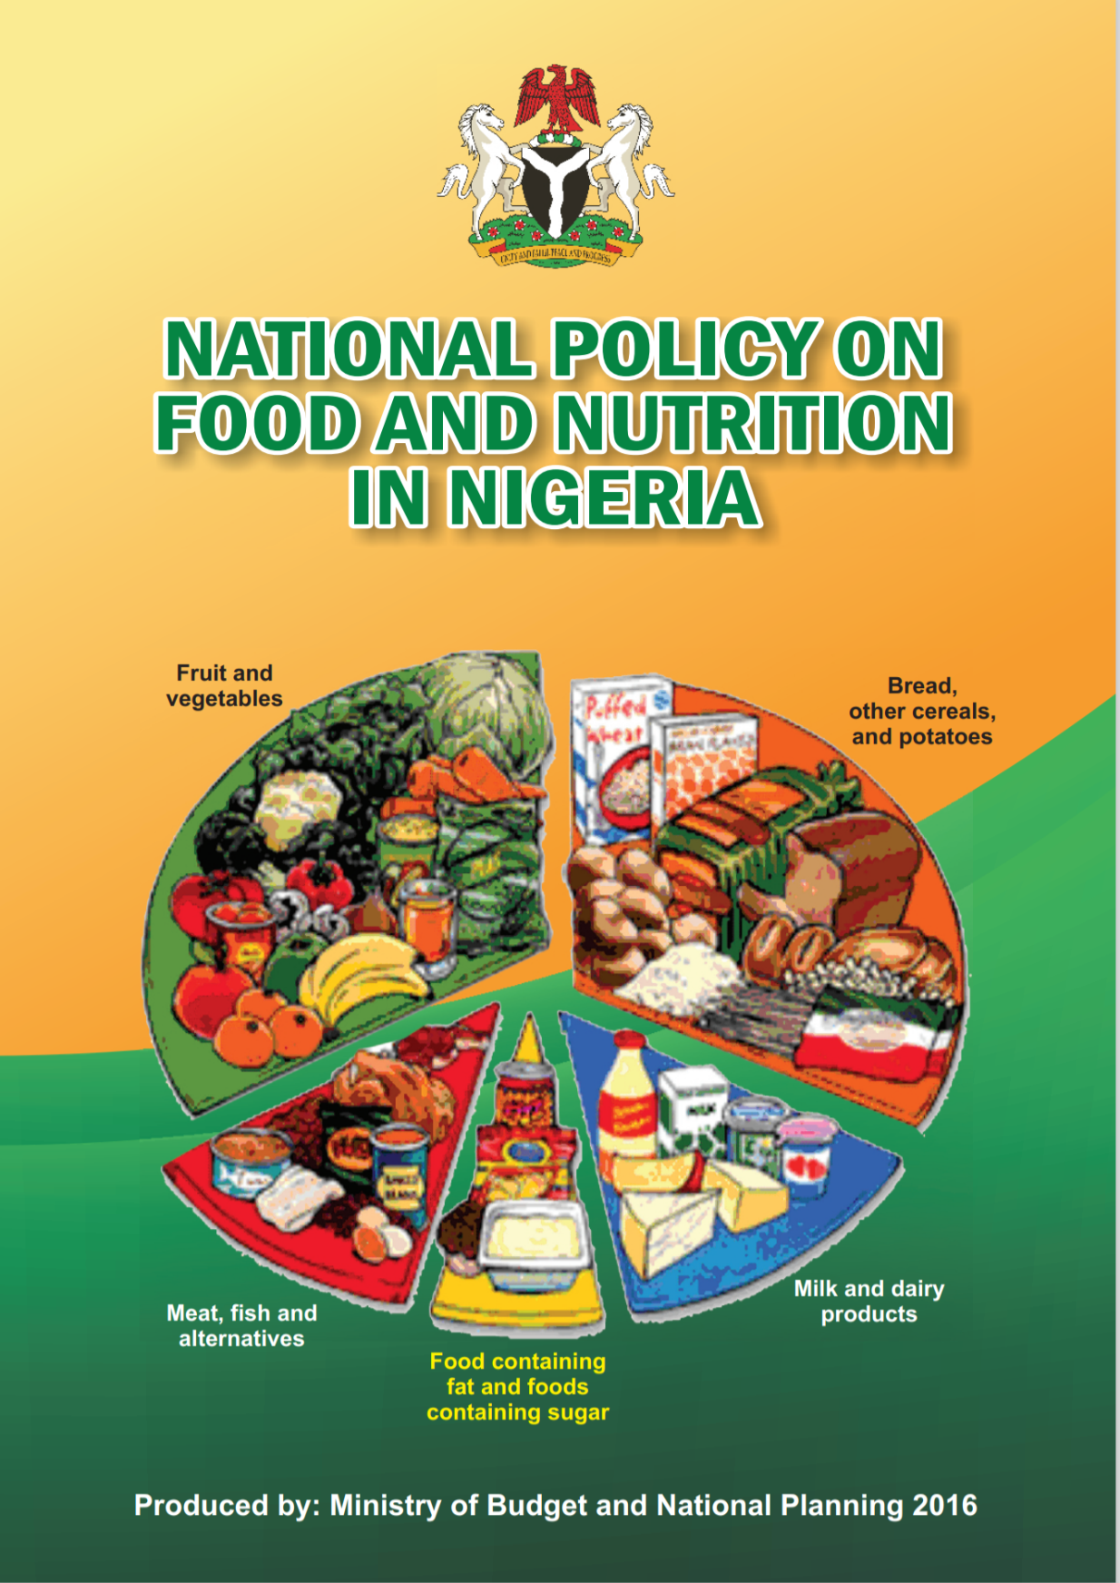
National Policy on Food and Nutrition
Provides the framework for addressing the problems of food and nutrition insecurity in Nigeria, from the individual, household, community and up to the national level.
It guides the identification, design, and implementation of intervention activities across different relevant sectors.
In recognition of the multi-sectoral nature of nutrition, various sectors in Nigeria
  developed policies and strategies to address the nutrition perspectives of their mandates which makes the coordination of food and nutrition activities a challenge

Slide 24
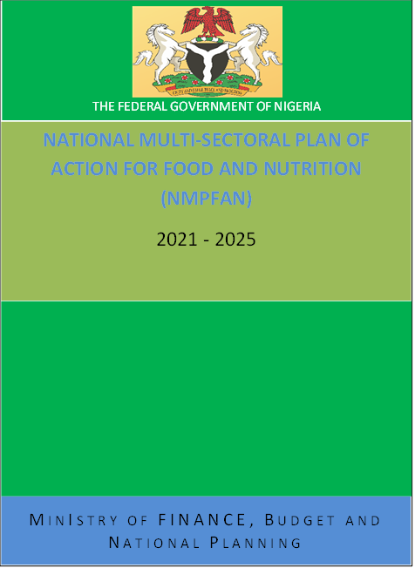
NATIONAL MULTISECTORAL PLAN OF ACTION ON FOOD AND NUTRITION (NMPFAN)
In recognition of the multidisciplinary and multisectoral nature of nutrition, this NMPFAN was developed in line with the National Policy on Food and Nutrition
Collaboration of government sectors, Development Partners, Academia, Civil Society Organizations and Organized Private Sector.
NMPFAN is to serve as a tool to guide the implementation of interventions and programmes to address the problems of hunger and malnutrition across all sectors in Nigeria.
It contains interventions and costed activities with annual and total cost for 2021 -2025
The National Council on Nutrition and Federal Executive Council approved the five-year nutrition action plan (2021 – 2025)

Slide 25
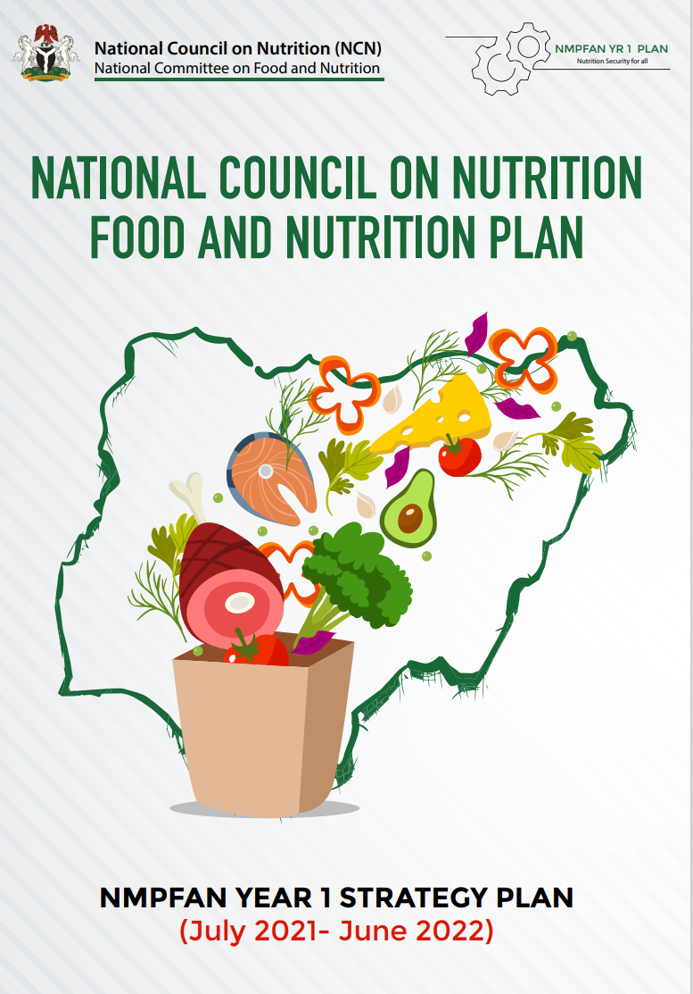
NMPFAN ONE YEAR SYNTHESIZED WORK PLAN
Clearly defined roles of MDAs involved in various nutrition activities across the country and how these roles fit into the implementation of the NMPFAN
Capacity building plans
Communication and advocacy strategy for the first year of implementing the NMPFAN

Slide 26
Scaling Up Nutrition Movement in Nigeria
Goal is to support national efforts to end hunger and malnutrition in all its forms through evidence based, cost-effective food and nutrition interventions.
Strategy is to support national governments through multi-stakeholder networks for collective action to Scale up Nutrition
SUN Movement is a renewed drive for countries to scale up nutrition based on the principle that everyone has a right to good food and nutrition
Focal Point brings people together in a multi-stakeholder platform.
The multi-stakeholder platform includes representatives of the networks:
  government (relevant MDAs)
  civil society – CS-SUNN
  donor and United Nations agencies
  business and
  academia/research community – ARN-SUNN

Slide 27
Nutrition In Human Capital Development (2021-2030)
It is widely recognized that good nutrition is the most important investment in human capital development – Nigerian Development Plan.
To realize its human and economic potential, Nigeria must invest in nutrition - Malnutrition is associated with about 53% of deaths among under-five children (ERGP, 2017-2020).
According to the World Bank Nutrition Country Profile, Nigeria loses US$1.5 billion in GDP annually due to Micronutrient deficiencies.
Low cost high impact nutrition interventions are the most cost-effective development investments, it can save lives, and boost per-capita GDP by up to 11%.
Objectives | Key performance indicators | Baseline | Target
Address Food Shortage Issues | Food security index | 40.1 (as at 2020) | 60.1
Ensure Nutrition Security within vulnerable communities | Reduce prevalence of severe food insecurity Reduce the proportion of people who suffer hunger and malnutrition Reduction in number of children suffering from stunting | 19.6% 7% (as at 2019) 36.8% (as at 2019) | <10% <5% <20%
Enhancing Care Giving Capacity | Increase in number of vulnerable households with access to basic services (including improved sanitation) | 36% (as at 2019) | 60%
Enhance Provision of Health Services to vulnerable communities | Reduce by 25% under 5 mortality rates | 132:1,000 live births (as at 2019) | <100:1,000 live births

Slide 28
Nurturing Multisectoral Commitments for sustainable Nutrition in Nigeria
- Funding , Capacity building, enabling environment , accountability framework

Slide 29
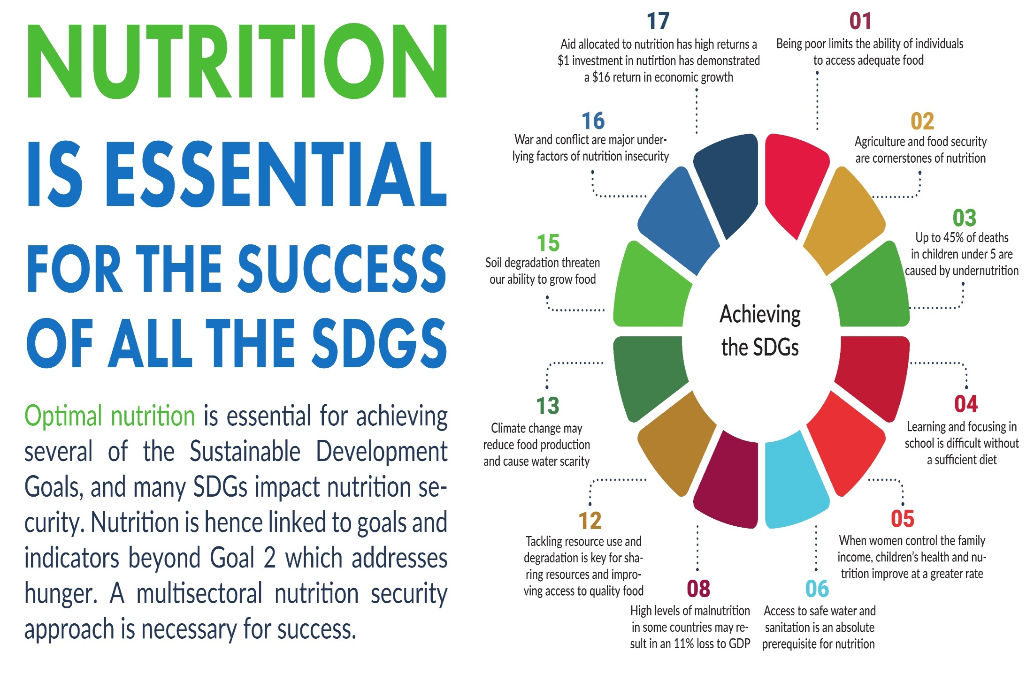

Slide 30
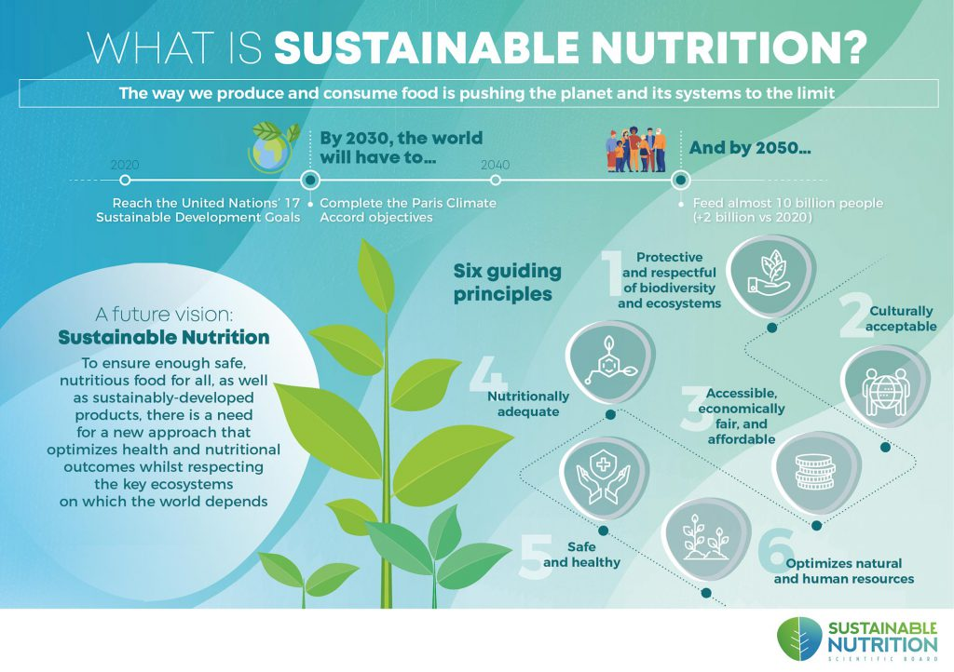

Slide 31
Five Important points to Consider
Increased domestic resources for Nutrition
Generate quality data and ensure appropriate use of such data
Keep Nutrition high in National Agenda
Stay Focused: align with a common framework
Scale up High Impact Interventions

Slide 32
Funding/Finance
Allocation of adequate funding for nutrition interventions
A results-based budgeting process can strengthen the linkages and communication between different sectors
Nutrition budget analysis exercises are instrumental in developing a picture of government investments
Use as an advocacy tool to push for more resources for nutrition
Existence of a costed NMPFAN can have the effect of increasing allocation of resources for nutrition
Private sector can be an important source of financing for nutrition through public-private partnerships, increased tax revenues and tapping into private foundations and donors

Slide 33
Capacity/human resources
Significant gaps in capacity for nutrition and need for more dedicated human resources for nutrition particularly at sub-national level
Building this capacity should be centrally prioritized by both government and donor-funded activities
Capacity-building in nutrition be tailored according to the roles that different sectors play in improving nutrition
Strengthening capacity in monitoring and evaluation (M&E) and
Functional capacities for multisector governance for nutrition is also crucial
Policy-makers need timely, relevant and accurate information
Support on research for evidence-based decision making

Slide 34
Coordination/ collaboration
Increased guidance in programme planning and implementation at the sub-national level will improve outcomes of nutrition
Development partners and donors need to encourage synergy in planning, funding and implementation
Key areas of Coordination include:
  ensuring visibility of high-level, multi-sector nutrition commitments and reaching wide consensus on priorities
  formalisation of coordination mechanisms
  donors’ role in coordination
  establishing platforms for nutrition coordination and
  inclusion of non-traditional partners in coordination
Private sector and NGOs need to be more involved

Slide 35
Accountability/ Recognition
Incentives encourages key stakeholders to adopt multi-sector approaches to nutrition
Reporting on efforts encourages accountability at all levels
  Collaborative efforts of sectors and recognising sectors contribution to the achievement of objectives.
  Increased transparency and improved teamwork
Countries that have been successful in reducing malnutrition have invested more resources in the generation of good-quality nutrition data
Robust M&E component is necessary for multi-sector nutrition plans
Need for a “data revolution” to improve knowledge on how nutrition is improving to increase transparency and accountability.
Establishing a Multi-sector Nutrition Information System is critical

Slide 36
BRIDGING THE MALNUTRITION GAP

Slide 37
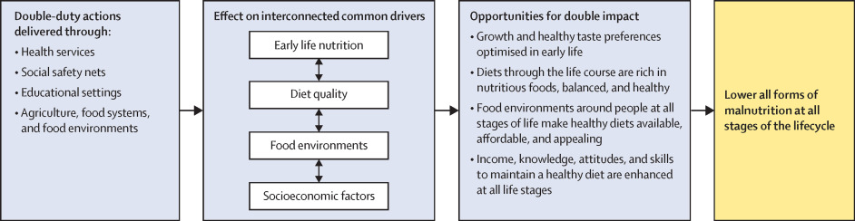
Seizing programme and policy opportunities to address malnutrition in all forms (The Lancet)

Slide 38
1. Improved Food Systems
Sustainable nutrition will require multisector collaboration and coordination at all levels—and new thinking
There is a need to transform agricultural production and food systems as key drivers of economic growth
Ensure that the food system is resilient and can meet the needs for safe, nutritious, and affordable foods.
Implementation of the FSS commitments as part of three priorities for 2022:
  Operation feed Yourself initiative to improve nutrition at household level through dietary diversification
  Establishment of community Hubs and farm settlements to increase input supply, machinery hiring, extension services and market access
  Regularly collect and disseminate (through radio and other platforms) information about weather patterns and soil properties and best practices for crops, livestock, aquaculture and poultry production

Slide 39
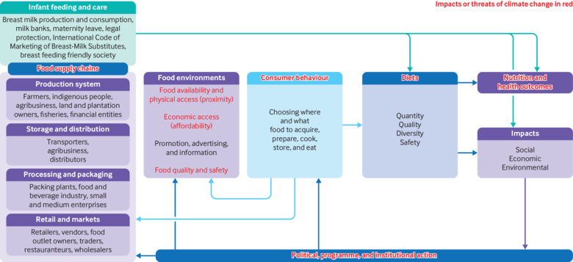
Transforming the food system

Slide 40
2. Social systems and Nutrition
Social and Behavioral change key to Nutrition security
  Strengthened innovative social and behavior change communication, and advocacy in the communities including focused nutrition activities in schools
  Expand education, livelihood, and employment opportunities for both women and youth, especially within food systems
  Education is a key driver for improved livelihood opportunities for youth and particularly young girls
  Education level of mothers is one of the most powerful determinants of nutrition and health of their children
Collaborating, learning, and adapting approach to all multisectoral nutrition programming
Nutrition research and evidence increase to enhance nutrition programming in Nigeria
Incorporate nutrition considerations into social protection programmes to address poverty, malnutrition and health of the vulnerable groups.
Routine integration of WASH services into CMAM and PHC service delivery/cash transfer/food assistance

Slide 41
2. Social systems and Nutrition
Engaging Adolescents for Nutrition and Sustainable Development
Adolescents have unique health concerns and needs, and as a target group they require specific nutrition interventions.
Nutrition programs to become adolescent-responsive, including activities tailored to address malnutrition in adolescents
Understanding how to effectively engage adolescents is essential for assessing how nutrition-specific and nutrition-sensitive interventions can be delivered and best related to other components of the ‘adolescence equation
Government growing concerns include:
  Making interventions accessible, come to us, fit around our lifestyle’
  Practical with real experiences’
  Making interventions delivery or information dissemination entertaining’
  Inclusive
  Participatory
  Economically viable
  Transparent and
  Holistic

Slide 42
3. Nutrition and Health systems
Strengthen the health system including family planning/reproductive health, mental health and WASH
Growth Monitoring- reposition the growth monitoring and promotion to better integrate child growth and development in the first years of life and strengthen the promotion element.
MIYCN counselling
Breastfeeding - strengthening breastfeeding counselling
Baby friendly hospital initiatives
Capacity building of health workers
Operational research, prevalence studies and alternative treatment options

Slide 43
National Council on Nutrition (NCN) Current Efforts
Strong political will for nutrition
State Government involved through NGF
NMPFAN Synthesized work plan: Include Roles of MDAs & Capacity plans
Nutrition department and Creation of budget line approved
NMPFAN M&E Framework developed
Nutrition communication and advocacy strategy to be roll out
National Nutrition Scorecard being developed
Engagement of private sector for nutrition investment plan

Slide 44
NSN Efforts and Contributions
Current effort acknowledged and recognised:
  advocacy and capacity building in addressing nutrition problems in the country
  Prominent roles at the highest level of government to address nutrition issues
  Active in M&E for programme implementation
More visibility in addressing nutrition problems
  Strengthen coordination and collaboration with MDAs
  Continuous Partnership with ARN-SUNN
  Evidence generation
New Thinking
  Linkages & Support; Skill Acquisition; Mentoring; Global food & nutrition investment opportunities

Slide 45
Summary
We need the right system, right environment and right information
As policies are made there is need to roll out funds for implementation in line with the magnitude of nutrition problems both at national and sub-national levels
Issues on inclusiveness and equity
Need to move from technical issues to political priority for nutrition agenda to move forward
Support for evidence generation for decision making
Partnership and collaboration
The success of Nigeria on nutrition issues will determine achievement of Africa Nutrition priorities.

Slide 46

Tackling malnutrition - Quotes
“The forces that create malnutrition are very powerful, to overcome malnutrition we need equally powerful alliances and forces”. Lawrence Haddad, Senior Research Fellow, the Institute of Development Studies
"Without good data, we're flying blind. If you can't see it, you can't solve it" Kofi Annan
“This issue affects everything about child development. And it even affects everything about education and economic development,” said Gates. He went on to say that if he had one magic power to solve the world’s challenges, nutrition would be that power. “Nutrition belongs at the top of the list.” (April 2016)

Slide 47

Conclusion
A multisectoral approach is a deliberate collaboration among various stakeholders and sectors
Have common vision and perspective to jointly achieve the desired nutrition outcome.
Strengthen efforts to address malnutrition through implementation of both nutrition specific and nutrition sensitive pathways in order to achieve sustainable nutrition for Nigerians
There is need for optimization of usage of resources by avoiding duplication of inputs and activities which can tremendously improve program effectiveness and efficiency.
We need to move fast….

Slide 48
Thank you

Slide 49
References
FMFBNP (Federal Ministry of Finance, Budget and National Planning). 2021. National Multi-Sectoral Plan of Action for Food and Nutrition (NMPFAN) 2021-2025. Abuja, Nigeria: Federal Ministry of Finance, Budget and National Planning.
Ministry of Budget and Planning. 2016. National Policy on Food and Nutrition in Nigeria. Abuja, Nigeria: Ministry of Budget and Planning.
NPC (National Population Commission) [Nigeria] and ICF. 2019. Nigeria Demographic and Health Survey 2018. Abuja, Nigeria, and Rockville, MD: NPC and ICF
Multi-sectoral Nutrition Programming A review of current literature and evidence. UKaid and Emergency Nutrition Network ENN

