Slide 1
Using “Fish for Food – A high impact strategy to provide layered health services to hard-to-reach communities in Akwa Ibom state, Nigeria. Doreen Magaji¹ , Selya Tyav ² , Peters Adekoya ², Christopher Aruku ²

Slide 2
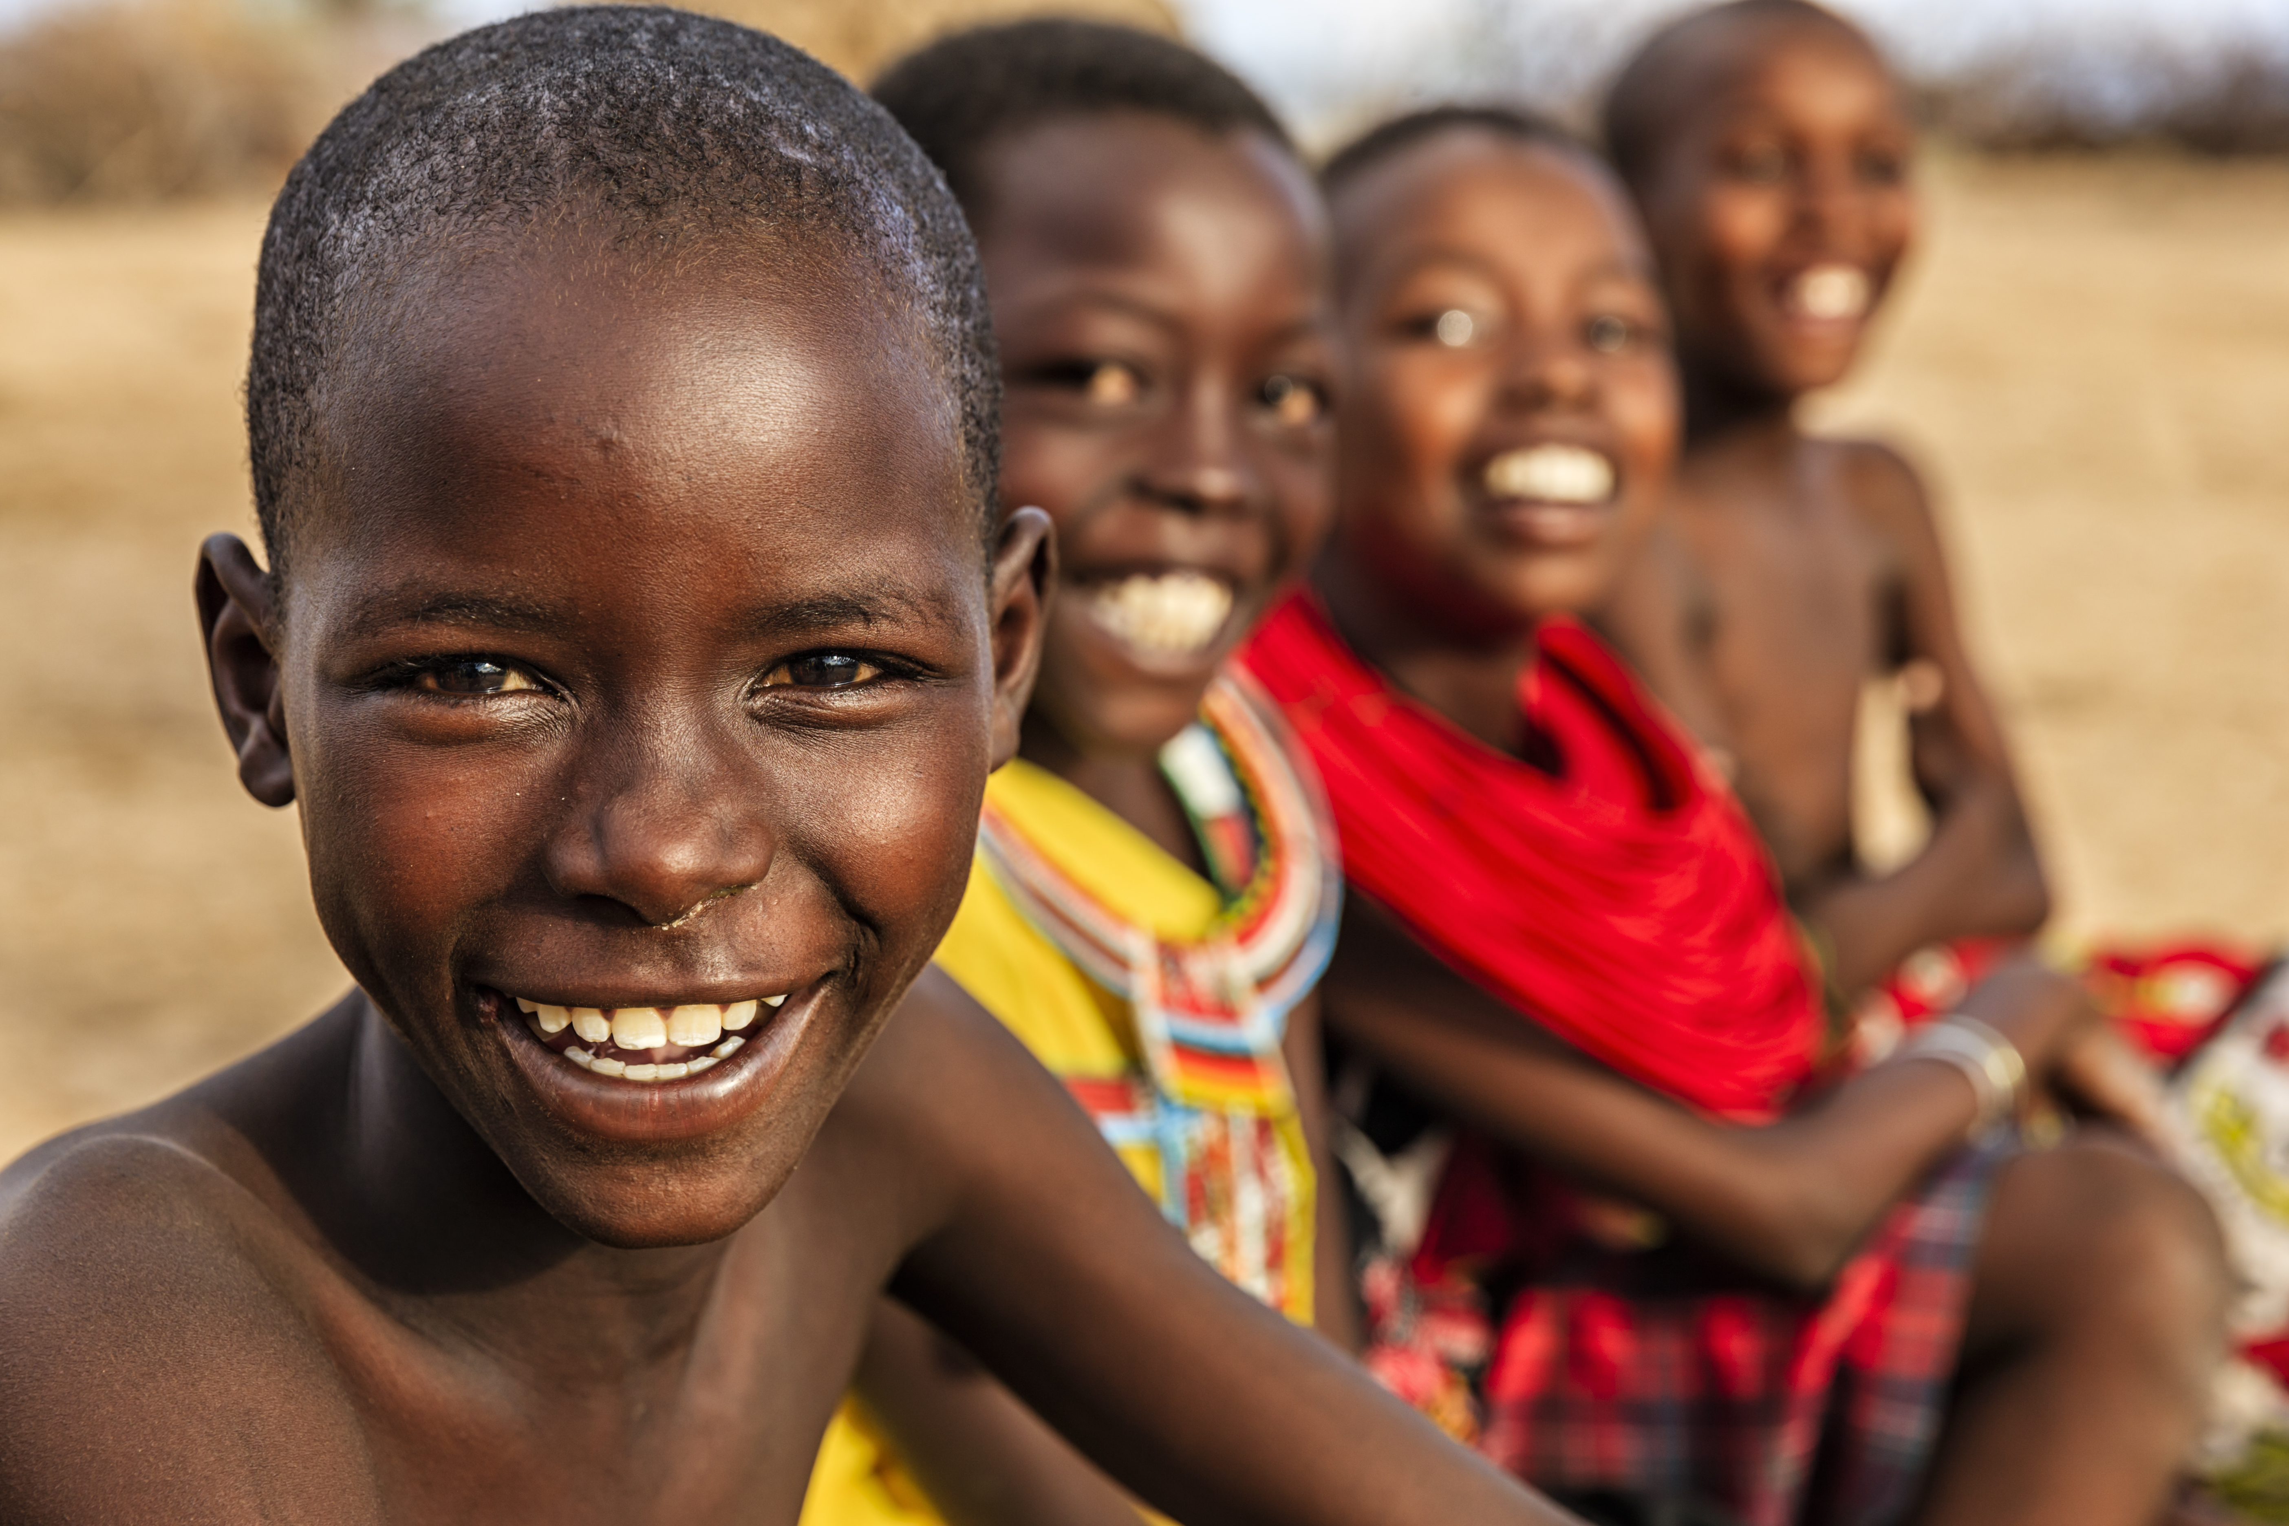
Outline
Background and context
Programming Approach
Findings
Conclusion

Slide 3
Background and Context
The prevalence of SAM is 7.6%; only 31.1% of children met minimum requirement for dietary diversity, 32% lack access to toilet and practice open defecation
Due to the isolation of these areas, there are long distances to health facility and high rates of self-medication.
In the creek areas there is a surprising intersection of fishing as a primary occupation and poor parental care and nutrition for children.
Income derived from fish sales are used for burial parties, paying for transactional sex. Barely used for securing household wellbeing or addressing health needs.
Notes:
(Bush: 57.5%, Gutter: 1.3% and waterside: 26.3%), 37% are out of school

Slide 4
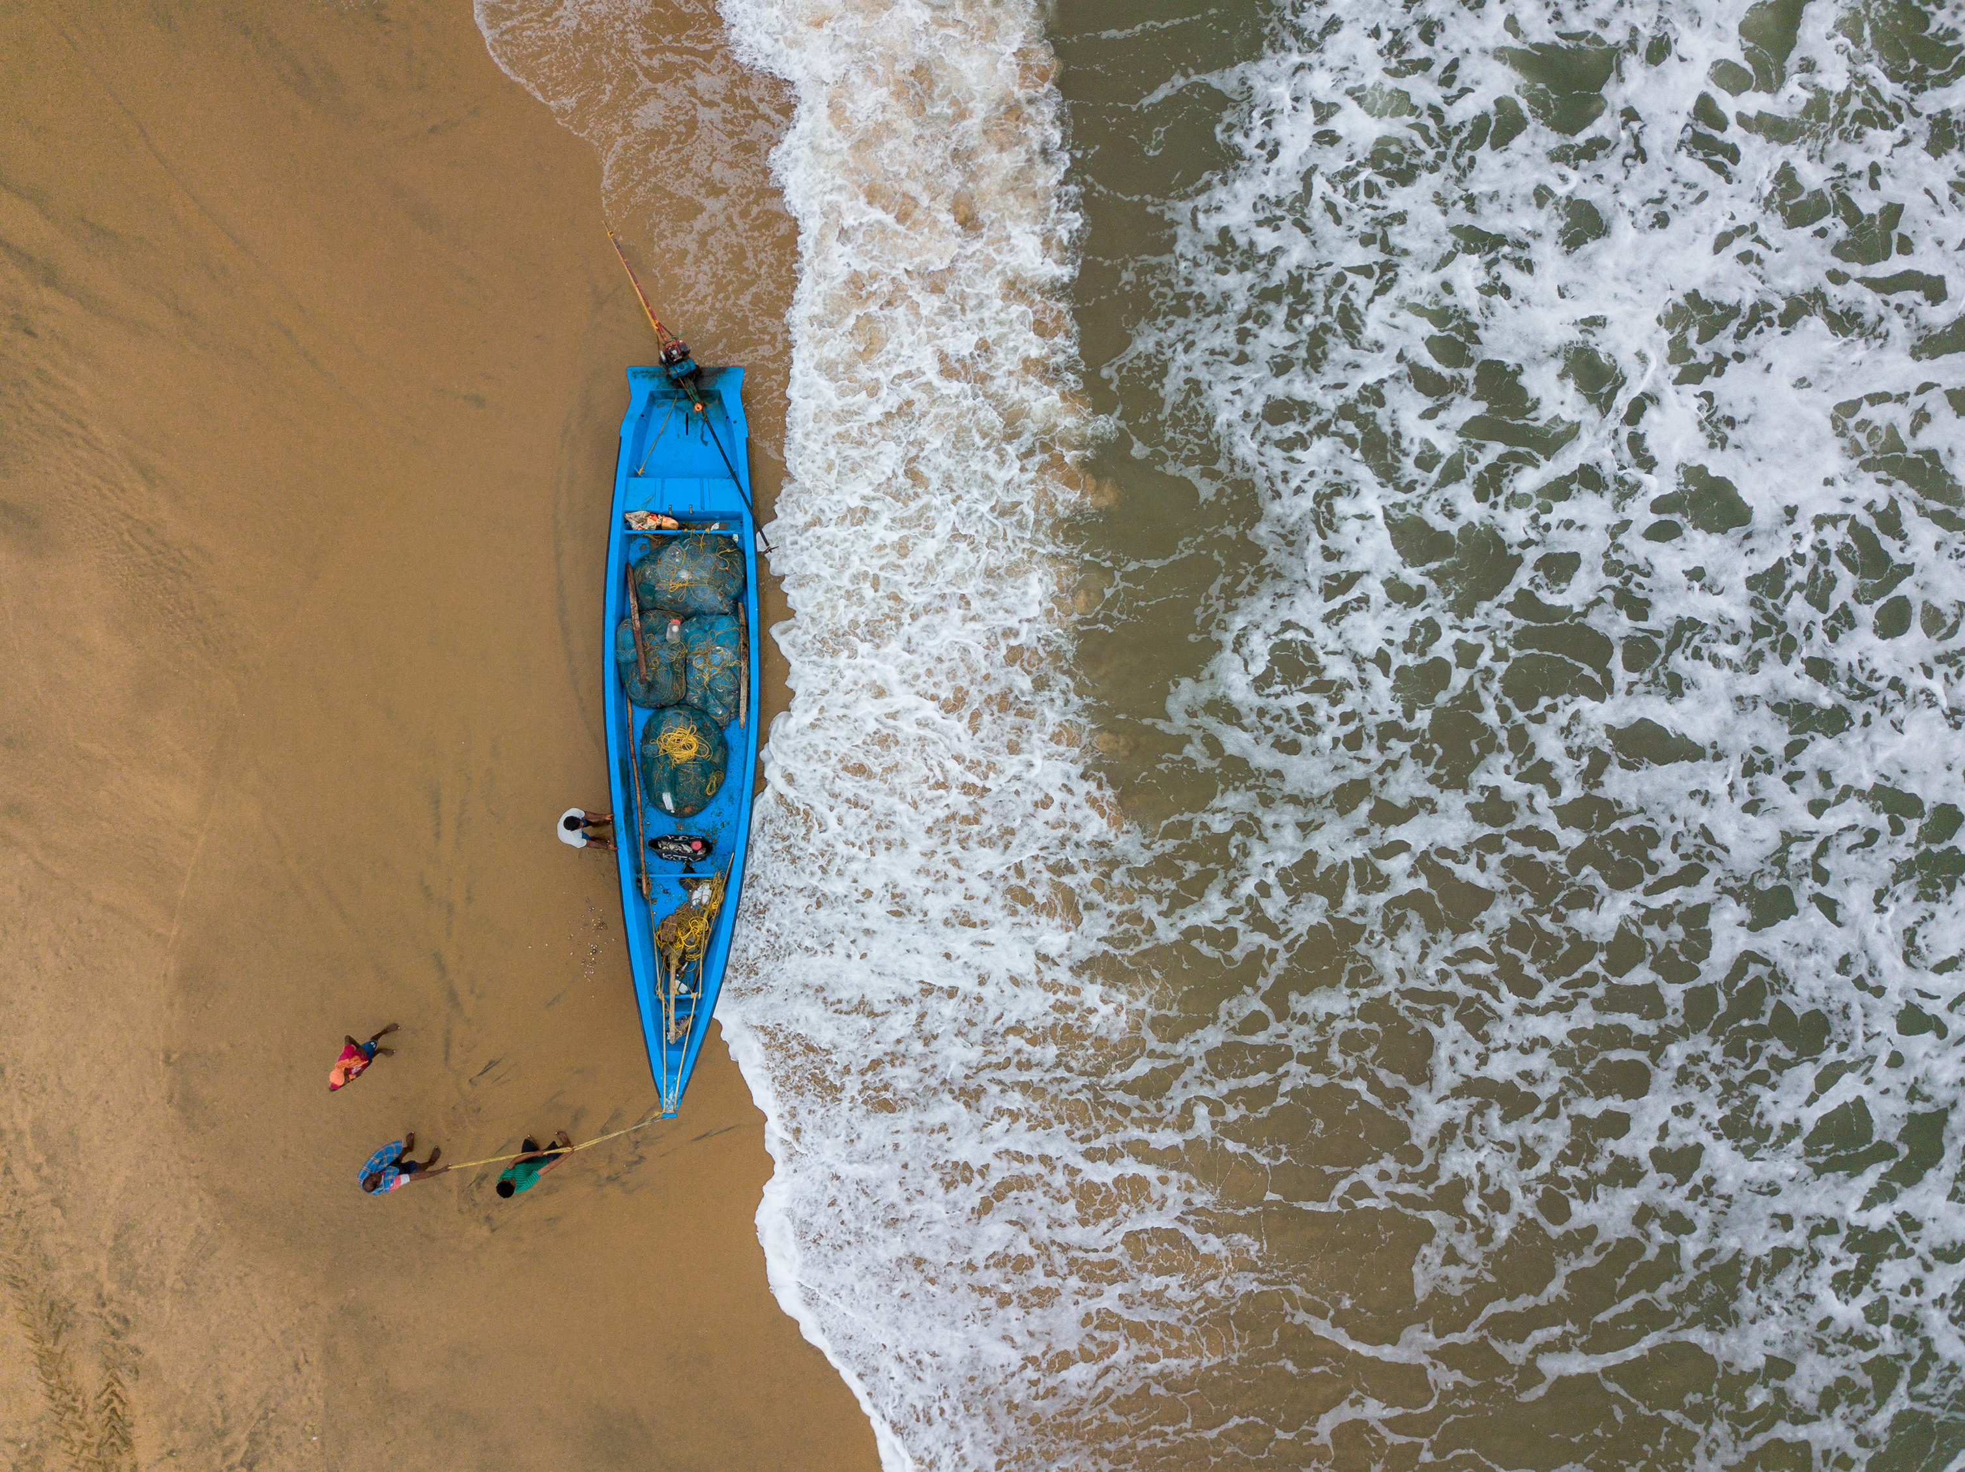
Programming Approach
Integrated community outreach aimed at providing a one-stop-shop for case finding for HIV/AIDS and other related health issues
Mobile testing teams with multi-disciplinary team members mobilized and secured health commodities to be used to target clients.
Provide medical consultations, Free health talks, offered nutritional assessment and counseling services, practical food demonstration, deworming, support for SAM cases , micronutrient supplementation
Provided anti-malarial drugs, mosquito nets and referral to health centres

Slide 5
Programming Approach 2
In addressing the malnutrition issue and the poor use of fish proceeds, it required presenting a strong case of childhood malnutrition based on the findings.
Community dialogue to elevate the issue and agree on solutions
This approach indirectly helped parents make better decisions on how family income was spent.

Slide 6
Findings
A total of 250 clients were reached
Of the 50 children reached 12(24%) tested positive for HIV but already knew they were positive and had never disclosed their status
3 new cases were identified
All the HIV+ children were malnourished
32(66%) of the children had stunted growth and 118 people (47.2%) of the participants tested positive for malaria using a rapid diagnostic test

Slide 7
Conclusion
To promote access to quality, integrated health services in isolated, remote or hard to reach areas, an integrated programming approach involving multi disciplinary resources is essential.
This approach has the potential to impact on addressing other key issues which impact on peoples quality of life

Slide 8
Thank you
Ese ! Dalu ! Nagode !

