Slide 1
Social Media for
Research & Policy
#PolicyComm
Notes:
In this presentation we’ll talk about a different communication platform – social media – and the skills you need to effectively harness social media to disseminate research and engage with policy and influential audiences.

Slide 2
What Is Social Media?
Notes:
First, when we say “Social Media” – what comes to mind? Generate responses.
Probe to gather responses that address platforms (Facebook, Twitter, LinkedIn) and activity (sharing updates, photos, commenting, liking, disseminating information)

Slide 3
What Is Social Media?
Social media include websites and applications that enable users to create and share content or to participate in social networking.
Notes:
Here’s a simple definition that we use for social media.
Read definition.
It’s pretty simple - social networking is interacting with other users (individuals or organizations) online as a way to share ideas, thoughts, and opinions.

Slide 4
Social Media and Policy
Social media for personal
Life updates
Photos, videos
Social media for policy
Disseminating research
Building advocacy networks
Engaging with influential people and organizations
Notes:
When we think of social media, we often think of it in the personal sense – networking with friends and families to share life updates, photos, videos, etc.
But in addition, social media has become an important medium for disseminating research, building advocacy networks, and engaging with policy and other types of influential audiences.
More and more, we see that Ministries or individual policymakers have social media profiles. Some are active, while others might engage rarely. Donors, NGOs, research institutions, civil society organizations, and journalists are active. At the same time, we see that individuals who might not otherwise be seen as an influential individual can start to build a social media presence, and assert him or herself as an authority or opinion leader within the social media sphere.

Slide 5
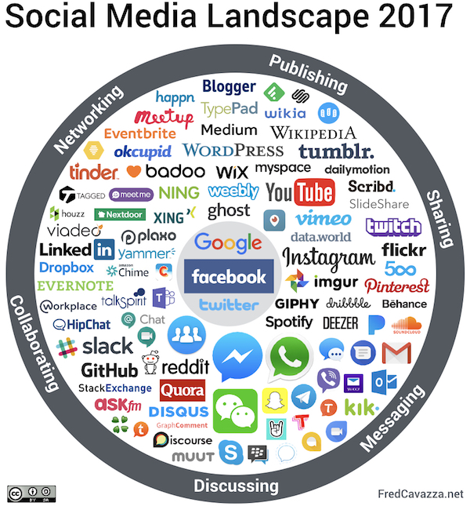
Social Media Landscape
Source: Fred Cavazza 2017
Notes:
You’re probably all familiar with at least some social media tools and sites, but the landscape of social media is really diverse.
This graphic shows the six main categories of social media.
Sharing: Sharing platforms are focused on sharing content – videos, photos, information. Here you see YouTube, Pinterest, Instagram.
Messaging: Platforms with messaging allow users to send direct messages to individuals or groups, think of email, texting, or chatting online. This includes platforms like WhatsApp and Gmail.
Discussing: These platforms are focused on engaging –Having dialogue about current events, articles, etc. This would be things like Reddit or Snapchat.
Collaborating: Platforms for collaboration allow users to share professional content for workplace cooperation. Think of Dropbox or Slack.
Networking: Making connections with people, building relationships. For example – LinkedIn
Publishing: Social publishing allows anyone to publish individually developed content in a publicly accessible medium to disseminate and receive feedback. Here we tend to think of blogs, but also Wikipedia.
And then there are certain platforms that cut across, and achieve several of these purposes. Facebook, Twitter, and Google are the big ones here.

Slide 6
Our Focus for Research and Policy
Notes:
In this presentation, and for the general purposes of using social media for disseminating research and communicating policy messages, we’ll be focusing on Facebook, Twitter, and LinkedIn.

Slide 7
Why Is Social Media Important?
Notes:
And you may be wondering, why is social media important today?

Slide 8
Social Media Today
As of 2018, there are more than 3 billion social media users
Each day in 2018, almost 1 million people started using social media for the first time, meaning there were 11 new users every second
Social media can help you disseminate research and interact with policymakers and leaders
Social media allows you to gain name recognition and build a following
Source: “Global Digital Report 2018” We Are Social and Hootsuite
Most popular social networks worldwide as of April 2018
Ranked by number of active users
(in millions)
Statista 2018
Notes:
The bar graph on the right shows the most popular social media networks worldwide ranked by the number of active users. As you can see, Facebook leads with 2.2 billion, Twitter is further down with 330 million, and LinkedIn at 260 million. But how many total people are using social media? [Generate responses]
[Click] As of 2018, 3.2 billion individuals are using social media each month. As demographers or researchers, you know that means in 2018 more than 1/3 of the people on this planet are using social media.
[Click] The reach of social media is global—it reaches every continent and every country. In 2018, almost 1 million people started using social media for the first time every day—that’s more than 11 new users every second! There are variations by region, but the growth in using social media stretches around the world.
[Click] And as we stated up front, social media has broken out of the purely “social” sphere – increasingly it can aide in disseminating research and connecting with leaders in your field.
[Click] Social media is a pretty unique platform in that it can enable you to gain name recognition and build a following for your work. IF you invest the time and effort in growing that presence.
10 years ago, we never would have considered including information about Facebook or Twitter in training about communicating data to policy audiences. But now, we can’t do this training WITHOUT including this piece. The world of social media is growing quickly and changing often, but it is clear that this medium of communication is here to stay.

Slide 9
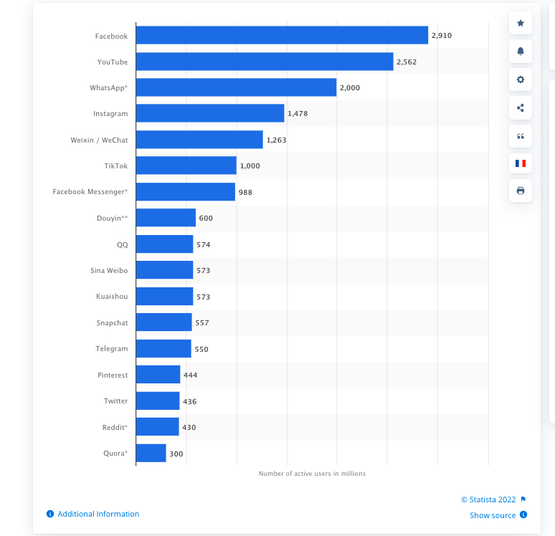
Most popular social networks worldwide as of January 2022, ranked by number of monthly active users (in millions)
Source: Statista Viewed online at https://www.statista.com/statistics/272014/global-social-networks-ranked-by-number-of-users/ on July 5, 2022
Notes:
In January 2022, Facebook, YouTube and WhatsApp were the top three most popular social networks globally.
Social media use increased during the height of the COVID-19 pandemic.

Slide 10
Social Media Basics
Notes:
So, how do we use social media? We’ll take you through some basics and best practices for our three focus platforms – Facebook, Twitter, and LinkedIn.

Slide 11
How can you use Facebook—professionally?
Sharing news and research results
Learning about various organizations or groups
Advocating for issues related to your research
Engaging with topics and work in a more informal manner
Notes:
How many of you have personal Facebook accounts?
Facebook is a social networking website that makes it easy for you to connect and share with your family and friends online. However, it can also be used professionally!
You can use Facebook in a professional manner by:
Sharing exciting professional news and research results. Your biggest supporters—your friends and family—are likely also your Facebook friends!
Learning about various organizations, groups, or high-profile individuals that have Facebook pages.
Advocating for social issues related to your research (or issues you personally care about).
And lastly, you can engage with topics and work in a manner that is less formal than in a workplace or on a strictly professional platform like LinkedIn.
Most of your posts on Facebook can only be seen by your “friends”, depending on your profile privacy settings. When you do post items that are relevant to your professional work, you can consider setting those individual posts to “public”. That way, if professional connections do see your Facebook profile, they’ll also see your professional and relevant posts.

Slide 12
Tips for Writing an Engaging Facebook Post
Keep it short
Ideal post should be about 100-200 characters
Facebook allows for longer posts
Consider your audience
Ask questions
Be visual—images are engaging
Create variety in your posts
Be timely and relevant
Notes:
Here are some guidelines to begin to engage on Facebook, by posting to your page or by posting to a group.
[Click] Keep it short: The shorter, the better. Posts of 100-200 characters are typically the most engaging, and easy to skim as your followers cruise through their Facebook newsfeed. Learn to edit your posts so that they make sense in less words. At the same time, though, Facebook is a platform that allows for longer posting (unlike Twitter, as you’ll learn in a moment), so don’t be afraid to take advantage of that flexibility when it makes sense.
[Click] Consider your audience: If you are just posting for your own followers, you may take a different tone than if you are posting into a group of strangers who share a common interest. Think about what the audience knows about your issue, and how you can begin to engage them positively.
[Click[ Ask questions: Questions are a great way to get comments. Try to make your questions clear and direct.
[Click] Be Visual: Images are the most engaging on Facebook. Adding a good image will attract readers.
[Click] Keep variety in your posts, but stay consistent within your overall theme.
[Click] Timely & Relevant: Your posts should be written for immediate action – write your posts so they can be read and engaged with right now.

Slide 13
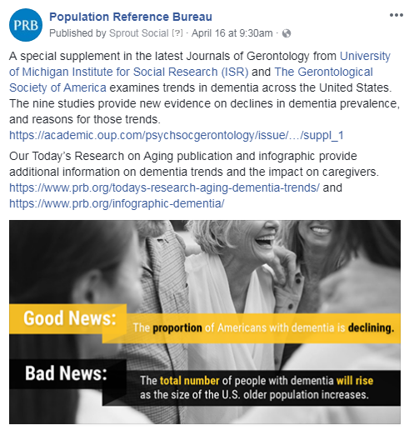
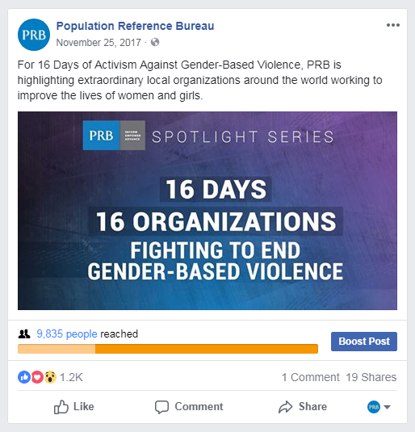
Notes:
Here are two examples of PRB posts.
The example post on the left reached 873 people and generated 5 shares, including shares from Data Sharing for Demographic Research, ICPSR, and the tagged University of Michigan Institute for Social Research. You can tag organizations in posts to make sure that they see content that is related to them. In this post, we also snuck in some of our related research content.
In the example post on the right, you can see PRB’s post reached 9,835 people, generated 1,200 reactions, and was shared 19 times. This post was part of a campaign, or series of posts, that highlighted organizations for the 16 Days of Activism Against Gender-Based Violence. The campaign was hugely successful, reaching over 77,000 users during the 16 days.
You can also see that this post has an option at the bottom to “Boost Post.” This is an option that organizations have, to pay to promote their posts in the newsfeeds of users that might be interested in this content. Individual users don’t have this option.
On Facebook and other platforms, it’s always important to remember the social part of social media. You shouldn’t just be sharing your research and accomplishments, but also actively supporting your community and networks.

Slide 14
How can you use Twitter?
Sharing your research findings and updates (and getting feedback)
Keeping up-to-date on news in your field
Interacting with the media and policymakers
Alerting others to and participating in conferences, events, talks, seminars, etc.
Engaging with students and the general public
Notes:
Now we’ll discuss Twitter. Twitter is a free social networking microblogging service that allows registered members to broadcast short posts called Tweets. Twitter members can broadcast tweets and follow other users' tweets.
Twitter encourages more discussion and requires shorter messages than Facebook. Posts on Twitter are NOT controlled by algorithms like other social networking sites, so any posts will be seen in real time. Journalists and the media use Twitter to share breaking stories because it is the quickest of the social media platforms.
However, you might wonder how can such short messages have relevance to universities and academia, where journal articles are 3,000 to 8,000 words long? Well, Twitter can be used for:
Sharing your research – ideally with a link to full-length articles, blogs, or reports about the research.
Keeping up to date on news in your field
Interacting with media and policymakers
Alerting others to and participating in conferences, events, talks, seminars, etc.
Engaging with students, non-academics, and the general public

Slide 15
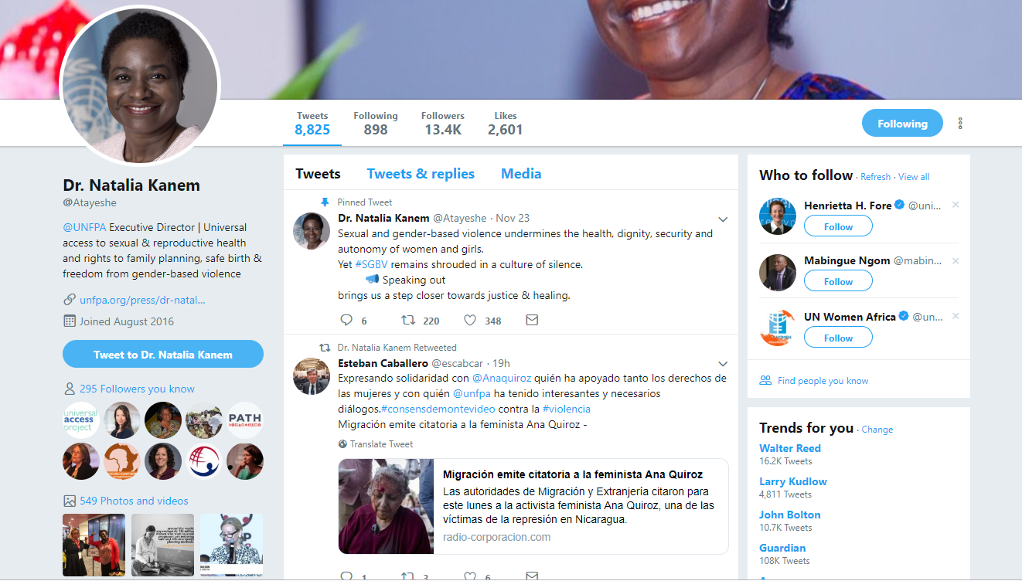
Notes:
Here’s an example of someone’s profile on Twitter. This is Natalia Kanem, executive director of UNFPA with over 13K followers. She’s a very influential policy maker and tweets/retweets/comments on relevant information.
Her profile is well constructed because it is clear, professional and well curated, with a concise bio and a link to her organization.
You can see on her page that she has Tweeted over 8,000 times, that she follows 898 people, has over 13k followers, and has liked 2,601 tweets. Each of those numbers is a link, so if you were curious to see who else follows her or who she is following, you can click on the sections at the top of the profile.

Slide 16
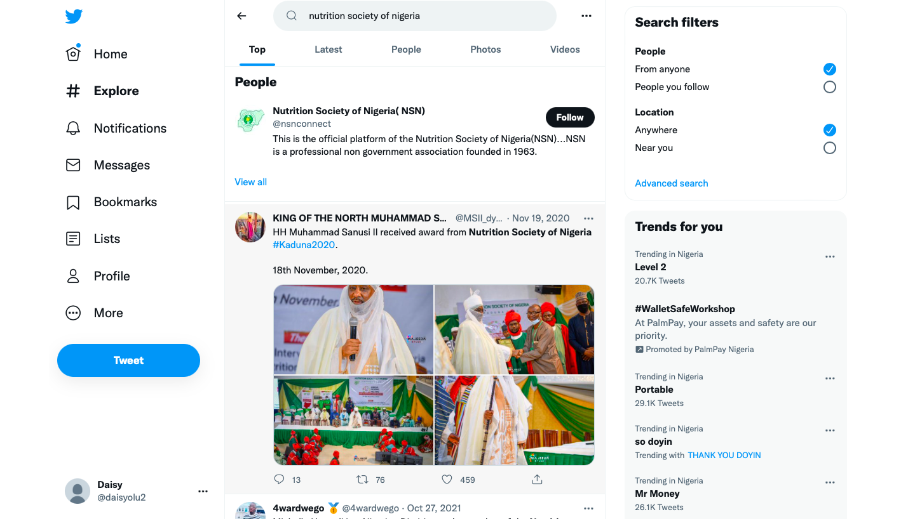
What is the hashtag for the NSN conference?

Slide 17
Tips for Writing an Engaging Tweet
Keep it short—280 characters
Consider your audience
Encourage action
Ask questions
Use visuals
Create variety in your posts
Be timely and relevant
Re-use your content
Give credit when sharing and check your sources!
Notes:
Considerations for an engaging Tweet are similar to Facebook!
[Click] A key factor on Twitter is that posts are limited to 280 characters. Learn to edit your posts so that they make sense in less words. There are several resources online (and linked at the end of this presentation) that will help you to identify commonly used acronyms that help you stay within that 280 character limit.
[Click] Consider your audience – what do they already know about the topic? Why is this post important to share with them?
[Click] Ask questions: Questions are a great way to generate engagement with your audience. Try to ask questions that are easy to answer, since responses are also limited to 280 characters.
[Click] Be Visual: Images are the most engaging on Twitter. Adding a good image will stand out in a busy Twitter feed and attract readers
[Click] Keep variety in your posts: while you need to stay consistent in your general theme, post a variety of types of content, such as links to articles and blog posts. Share other people’s content as well as your own.
[Click] Timely & Relevant: Your posts should be written for immediate action – write your posts so they can be read and engaged with right now.
[Click] At the same time, however, don’t be afraid to re-use your content. Remember, Twitter is in real time and there are many people tweeting, so you should post several times a day to try to reach different people and audiences. You might want to post two or three different tweets on a similar topic. You can also retweet your own tweets for as many times as you like, which will make that tweet appear again in people’s feeds.
[Click] When sharing other’s information, make sure you give credit. It’s a great way to engage and amplify other’s voices and research, while also promoting conversation and discussion. You can do this by already retweeting an already existing post with or without a comment, or you can create a new tweet with the information, but always make sure to tag the source of the information. As researchers, you should also know to check your sources before sharing information to make sure that it is evidence-based and not fake.

Slide 18
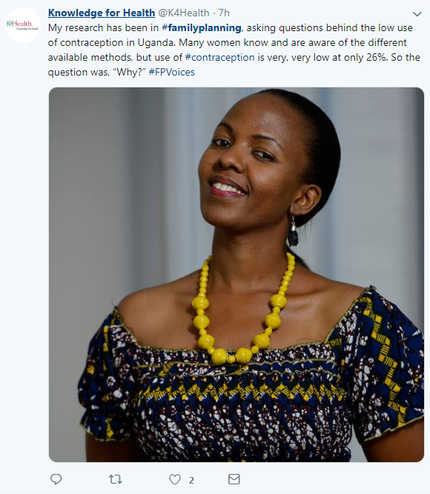
#HASHTAGS
Keep it relevant and simple
No spaces or punctuation allowed
Check out hashtags in your network
Confirm hashtags before you use them
Only public accounts are visible
No more than 2-3 hashtags in a post
Notes:
On Twitter, hashtags allow your posts to be indexed or searchable for other users to see.
A hashtag is a phrase, abbreviation, or word preceded by the pound/hash sign which will then be searchable by other users. It’s a clever way to follow conversations, engage with specific communities, and identify new users to follow. On the left side of your Twitter feed, you can see trending hashtags that highlight the most popular conversations of the day. By clicking on a hashtag, you will be able to search all public posts that have that hashtag included.
Searching hashtags is a useful way to identify additional influential leaders relevant to your topics of interest. In this example, #familyplanning is in bold because that is the hashtag we used to find this post. This is a good example because K4Health used two general topic hashtags (#familyplanning and #contraception) that make the post discoverable and one specific hashtag (#FPVoices) that will link to all of their Family Planning Voices project posts.
Fun fact: The woman in the photo was a Policy Communication Fellow in 2013!
A few rules for hashtags:
-Post relevant and simple hashtags. The fewer the characters, the better.
-Hashtags will not link to your post if you add in a space or punctuation. Focus on a word or a simple phrase.
-Check out what hashtags people and organizations in your network or influential leaders are using. By using the same hashtag for similar content, you can join in on their conversation.
-Before you use a hashtag, do a quick search to make sure others use it in the same way. An acronym in your field might be completely different in another, and may or may not be a hashtag on social media.
-Keep in mind your hashtags will only be visible to other users if your account privacy settings are public (which is the Twitter default).
-Do not use more than 2-3 hashtags in a post or it will come across as crowded and unreadable.

Slide 19
What is the conference #hashtag?

Slide 20
How to use LinkedIn?
Keeping your CV up-to-date
Sharing research or projects
Networking for job opportunities
Learning about various organizations or groups
Following the work of experts in your field
Notes:
LinkedIn is a social media site for professional networking, including employers posting jobs and job seekers posting their resumes. It offers a way to engage with a particular organization or individual on a platform designed for professional interactions or keep a public record of your professional accomplishments.
LinkedIn can be used for:
Keeping your CV up-to-date. There will be no CV formatting issues because you enter the information directly into their website form.
Sharing research or projects. In addition to posting an update, you can also upload full documents or visuals under specific job titles. This is a great way to highlight your research across different companies.
Networking for job opportunities. You can sign up for job notifications on LinkedIn and their platform algorithms will learn what you are interested in based on which postings you click on. This means the more you use LinkedIn to search for jobs, the more it will share relevant jobs with you.
Learning about various organizations or groups. Like Facebook, LinkedIn also has a groups function where you can join groups centered on a particular topic. This is a great way to find out about grants or partnerships relevant to your field.
Following the work of experts in your field. You can connect with individuals or follow organizations whose work you find relevant.
LinkedIn users generate connections by engaging with others and requesting that they "connect with you." LinkedIn is different from other social media platforms because it is professionally based and it requires that you tell the platform exactly how/where you know the person you are looking to connect with on a professional level before you can connect with them. Once someone becomes a connection, you can see their professional information such as promotions, new positions in other companies, as well as changes in geographical location.
LinkedIn is also a very good tool for networking. It is a great way to not only search for and apply for jobs, but a way to reach out to an individual or organization that you would like to work for or with and start that conversation in a respectful manner.

Slide 21
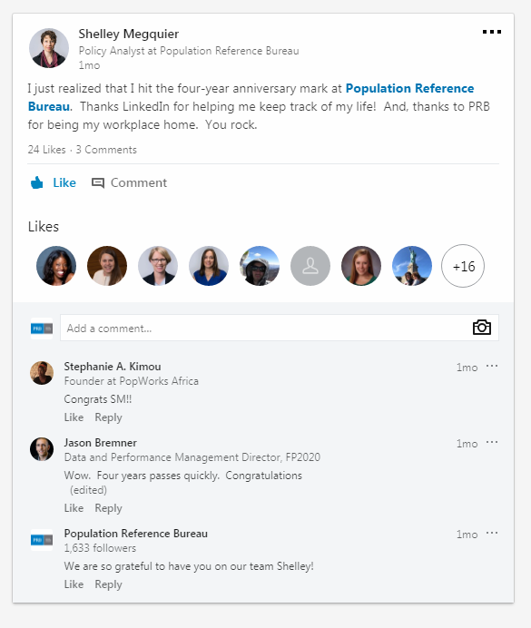
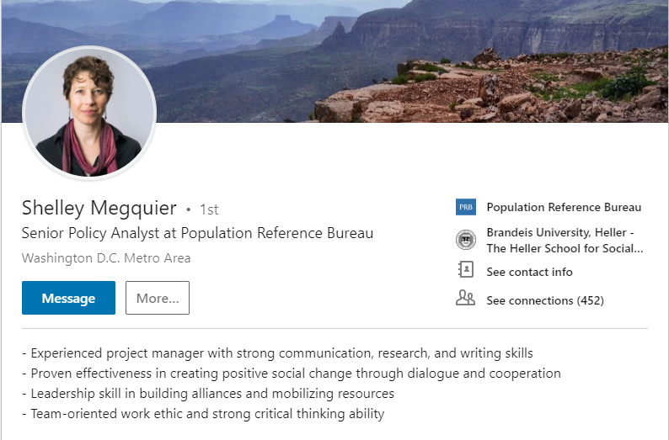
Notes:
This is an example of an individual's page for LinkedIn. Shelley Megquier is a Senior Policy Analyst at PRB. She has over 400 connections, which indicates that she is an avid user and that many people in her field that are interested in connecting with her on a professional level. She also has a concise bio that gives viewers an idea of the type of professional she is, and what her skill sets are.
In the example on the right, Shelley has posted about her four-year anniversary with PRB. She tagged PRB in the post, and you can see we responded in the comments. Many individuals in her professional network also commented or liked the post, congratulating Shelley on this professional milestone. LinkedIn can be used for sharing speaking engagements, interesting articles, or research publications, but it also can be used for simply sharing professional updates and achievements.

Slide 22
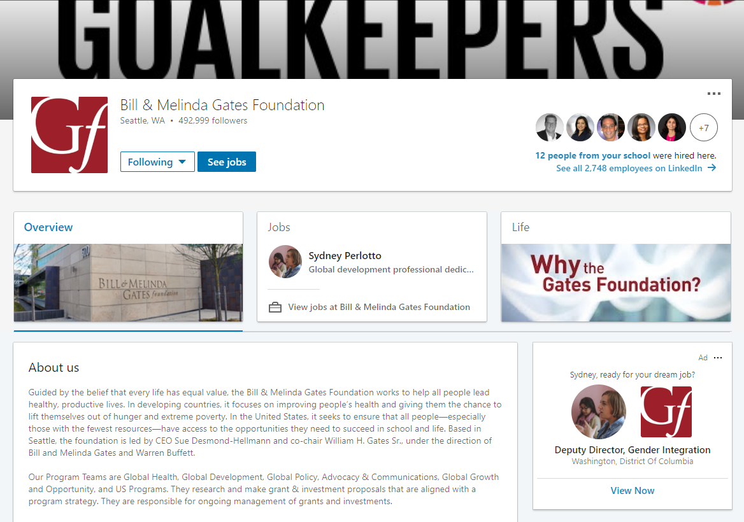
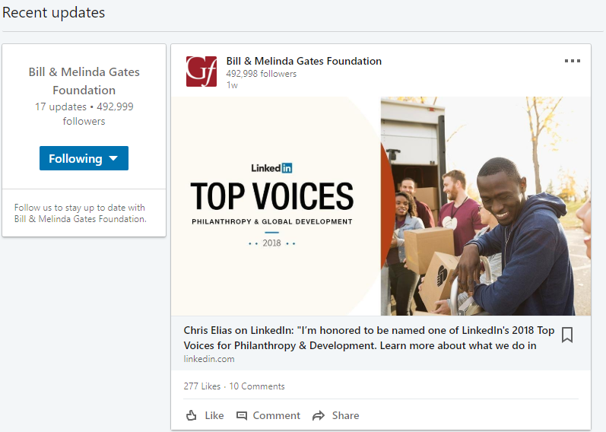
Notes:
The Gates Foundation is a good example of an organizational page on LinkedIn. You can see that they have over 492,000 followers. There’s a description of the organization, links to more information on the foundation, and recent updates, such as job descriptions for open positions or current employee accomplishments.

Slide 23
Engagement & Influence
Notes:
Now that we’ve reviewed the basics of the platforms, we’ll talk about how to engage and grow influence.

Slide 24
Who Is an Influencer?
Influencers are people who are active on social media and blogs. They also are brand advocates and niche promoters.
Source: https://blog.kissmetrics.com/guide-to-influencer-targeting/
Notes:
One of the goals for these best practices, and for using social media in general, is that you can use the platforms to assert yourself in your field or area of expertise, and demonstrate that you are influential.
Read slide.
The power of social media is that it gives anyone a voice – it’s up to you how you use it. The people who’ve harnessed their social media voice and established themselves as topical experts on social media are not necessarily the same people we think of as particularly influential or expert in other dimensions of the field. While the directors of large NGOs, high-level donors, members of the media, and particularly esteemed researchers tend to have large followings, YOU can also generate a following without those credentials.

Slide 25
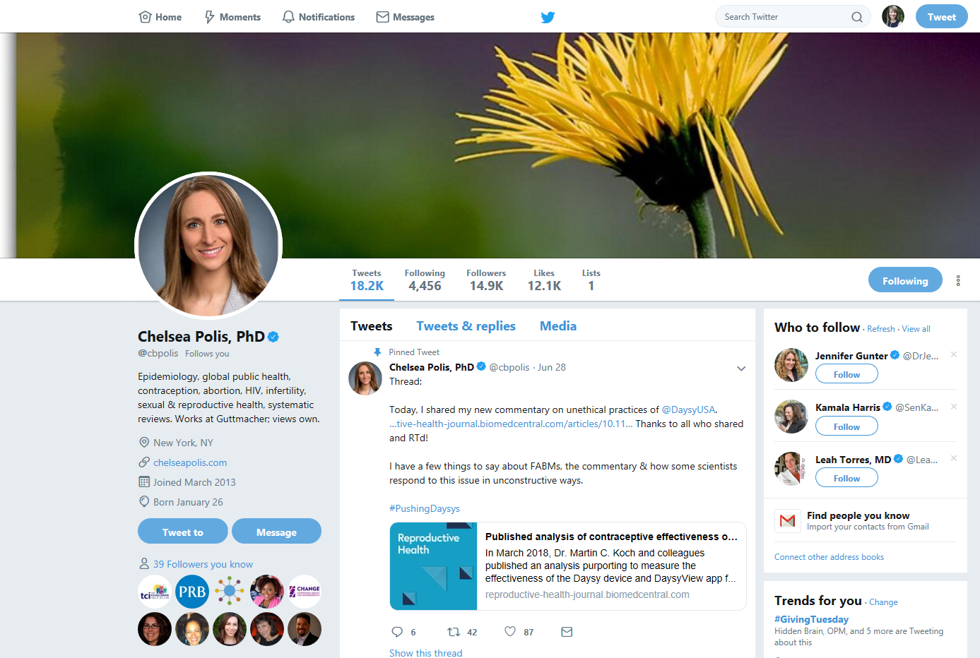
Notes:
Chelsea Polis is an example of a person that is not famous, but has created a niche for herself on social media and has built a following of over 4,000 individuals. Chelsea uses her platform to discuss matters related to contraception and women’s health. It creates a space for her to be seen as an expert in her area and it draws others to want to follow her because she has a trusted voice in the space and they know when they follow her she is on brand and on topic.
Through actively engaging with others in her field on social media – including critics – and reaching out to journalists who cover health issues, she has created a platform for herself. That generates returns as others look to her as an expert, and journalists come to her to comment on stories.

Slide 26
Identifying Influencers
Relevant to you and your topic
Start with known entities
Connect with their followers
Active on social media
Have a large following
Search hashtags to see who else posts on your niche area
Create a Twitter list to keep track of who you want to connect with
Notes:
To identify influencers, you need to know something about your field. Influencers are relevant to you and your topic. On Twitter in particular, it’s possible to connect with individuals who have the same niche interests as you. So instead of everyone who is interested in Family Planning, you can probably identify the people talking about the particular facet of your field that you are an expert in.
Start with known entities – the large NGOs, donors, or officials in your field. Follow them, and then pay attention to who else is following them.
Influencers are active on social media, and have typically built a large following.
Leverage the power of hashtags to determine who posts in your arena. This might take some experimenting or playing around on social media to determine, but as you follow the known entities and try out different hashtags, you’ll begin to discern which hashtags have active conversations.
Put the influencers you want to connect with on a Twitter list so that you can keep track of them all in one place, or center them around particular topics.

Slide 27
Reaching Out to Influencers
Be mindful of your first approach
Use @ or direct message
Follow social media etiquette and best practices
Do your research about them
Don't follow up more than once
Don't mass Tweet pitches
Don’t forget to say thank you!
Notes:
If you want to reach out to an influencer, think carefully about how to approach the person and what you’ll say. You can either use the @ symbol in addition to their Twitter handle or you can utilize a direct message. Be sure to use the etiquette tips from the previous slides in order to be polite when speaking. Be friendly and keep it short and sweet. Do your research on who it is that you are speaking with so that you are informed to engage in a conversation with them.
However, it’s more effective to build a connection with an influencer first, rather than just cold DMing them. Follow them, retweet them, tweet at them. Then, put in your request. Use the same practices you would for face to face networking.
If you don’t get a response, don’t follow up more than once – at least in the short term.
Do not “mass tweet” by sending the same generic message out to many people, donors, or organizations at once – it can be perceived as spam and removes the personal element of the engagement. ‘
Lastly, Thank you’s go a long way. Thank them if they’ve shared your work, ask for feedback, offer to send them advance notice of your next similar publication. Build the connection so that you yourself can become an influencer!

Slide 28
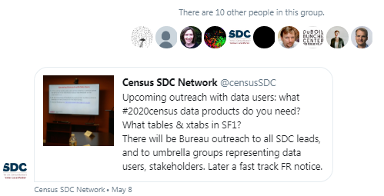
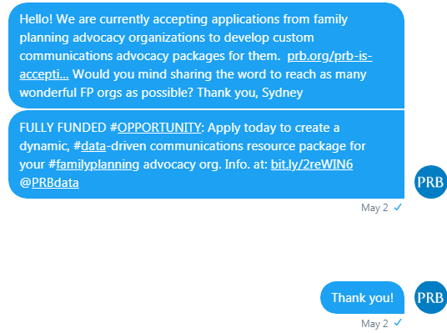
Direct Messaging Influencers
Example of a Good DM
Example of a Not-So-Great DM
Notes:
Direct messages allow you to privately connect with other users. They are a useful forum for when you want to ask a question or request assistance and don’t want it to be public. If you are DMing, make sure you do it in a polite manner, especially if the message is to someone you do not know personally.
In the examples on the slide, you can see a mass message with no explanation is not a good way to get people to share your research. Take the time to reach out to individuals, provide context, have a call to action, and say thanks! You’ll get results that way.

Slide 29
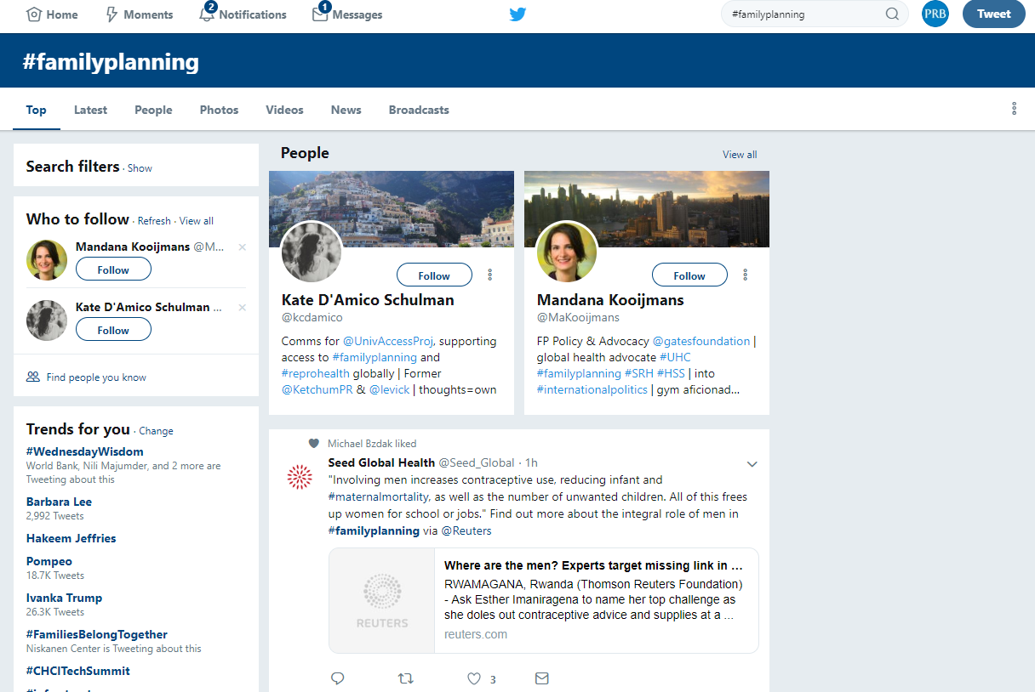
Notes:
Here’s an example of a hashtag search, which as we mentioned is quite valuable in identifying who is active in your area, and which influencers you might want to reach out to.
In the search bar on the upper right, we typed #FamilyPlanning to locate other twitter users that are tweeting about family planning. This practice allows you to find other material on your topic of interest by pulling up relevant and up-to-date material on the subject of interest.
Here are the top results from our search. You can see people who Tweet about the hashtag, and also top posts with the hashtag. If you choose “Latest” instead of “Top,” you’ll see up-to-the-minute latest Tweets using that hashtag.
You want to select some of these individuals to follow. As you see more of their content, you may then want to reach out and begin to engage with them.

Slide 30
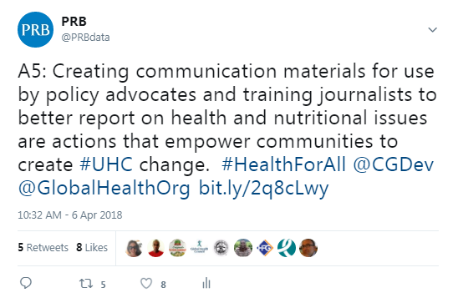
Live Tweeting
Notes:
It is now commonplace, and often encouraged, for individuals attending events to post about the event in real time. If you attend events – such as the launch of a new report, a conference, or a policy community meeting – Tweet about it! “Live Tweeting” typically includes sharing statements and announcements in real time, more or less, to engage with interested followers who can’t be present in person. You can see this in the example on the right.
If you’re attending a noteworthy event, do some social media research in advance. Make a list of the profiles for organizations sponsoring the events, and see if the speakers are active on social media. Check the event invitation, or materials handed out on arrival, to see if the event has a specific hashtag. Post during the event – see if you can get some retweets from the sponsor organizations! Search the relevant hashtags for the event, and follow others who are also posting. You can see from the example on the right, even a simple tweet with a photo of the room can generate a lot of engagement!
Twitter Chats are another platform to host a specific conversation exclusively on social media. The visual on the left is from a live Twitter chat hosted by Center for Global Development and Global Health Council. You’ll often see these notations of using the letters Q or A, and numbers, to denote questions, answers, and connected responses.
Anyone can participate in a tweet chat, but their success depends on engagement with the audience. Respond to questions, ask questions, retweet, and see who else is active. Seek out others to follow and see if you can grow your own following through this type of opportunity for engagement.
Live tweeting and participating in Twitter chats are extremely effective ways to generate new connections because people are online at the same time centered around discussing the same topic.

Slide 31
Stay Connected
Monitor influential leaders’ posts
Look for opportunities to collaborate
Attend web events
Twitter chats, Google Hangout
Join online communities of practice
Sign up for weekly updates
Connect in-person
Notes:
Above all remember - social media is about staying connected. Many of these platforms make it easy to meet like-minded users and draw new connections. You might be surprised just how accessible social media can be for maintaining or strengthening connections.
Consider these strategies to identify and stay connected with influential leaders and your peers:
-Stay abreast of new posts by influential leaders. If they host a website or blog, it’s a good idea to occasionally check out their personal site for new content.
-Social media is a great space for collaboration. Look out for users with similar research interests or overlapping content to your research focus. If you think you might make a worthwhile collaboration, propose a few tangible opportunities.
-Attend web events related to your topic of interest. A web event is the perfect opportunity to gain direct access to your influential leader. Often there will be an opportunity to chat with the host and other participants as well as participate in a Q&A session. Maximize this opportunity to connect with the chat leader or potential influential leader by directly participating in the web event and later following-up. So the web event host can remember who you are, it’s useful to reference your contribution to the discussion.
-There are many online communities of practice or networks. Seek out a few that align with your research interests or policy goals and stay active in the group. Often, these groups will post worthwhile updates, discussion topics, and events exclusively to members. You may come across a few influential leaders in these spaces.
-Some websites will circulate daily, weekly or monthly newsletters or email blasts. Sign up for a few that interest you. It’s a great way to keep up with news and updates from your field.
-Finally, don’t restrict yourself to online connections. When appropriate, take online conversations offline. You might attend an in-person event hosted by your influential leader and make a personal connection there that can boost your engagement online, or translate that social media connection into new opportunities in person and in your work.

Slide 32
Social Media Can Sometimes Go Badly
Social media content can leave users vulnerable to online attacks
Certain users are more vulnerable to attacks than others
Organizations vs. individuals
The best defense is not offense
PRB’s approach
Blocking the user
Notes:
With all this in mind, we also need to acknowledge that sometimes social media goes badly. It is important to remember that active users and those with a huge following must monitor how people react to their postings to make sure posts are not misinterpreted and to manage any offensive reaction. Online we also see issues with “internet trolls”.
Have you heard of the term “troll”? Trolling is defined as creating discord on the Internet by starting fights or upsetting people by posting inflammatory or off-topic messages in an online community. A social media “troll” is someone who purposely says something controversial in order to get a rise out of other users.
Certain words bring trolls out of the woodwork, even if the post is a relatively tame and factually accurate one. We recommend that you just ignore these posts. They go away.
Most people don’t attack an institution because, often, institutions won’t engage, so they have no fuel for their fire.
But what do you do when a message you post goes south? You meant one thing, but either stepped into an unknown landmine or your message wasn't received as intended?
The best defense is to not engage. Don’t go on the offensive. If the post has truly been misinterpreted, take it down immediately and apologize sincerely. Take a break from social media for a week while it blows over.
From an institutional perspective, PRB’s approach to negative comments is to ignore it and not engage if it is one-off. There are instances, however, when we decide to respond to the feedback personally. For example, this year people were upset by the world pop data graphics that showed an outline of India because it did not include Kashmir. This is an issue that arises every year and our team who worked on the world pop data decided to respond but only via email.
If you do feel personally attacked or unsafe, you can also block the user from engaging with you, and you can report the user to the platform for harassment or violating the terms of use.
The social media world is harsh, but its tides ebb and flow hourly. As long as you don't continue to offend, you and the rest of the world CAN move on.

Slide 33
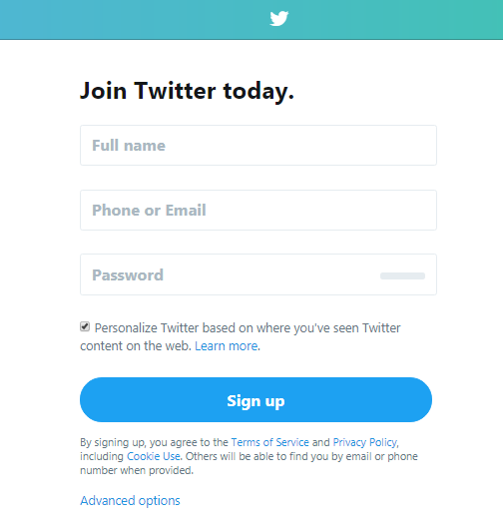
Ten Best Practices for Social Media
Be yourself
Make social media a habit
Think before you post
Build a targeted profile
Have meaningful conversations
Visuals! Visuals! Visuals!
Share anecdotes
Write for anyone
Engage and respond
Look at the data (analytics)
Notes:
Before wrapping up today’s presentation, we are going to go over 10 best practices that can be applied to any form of social media. These are great ideas to keep in mind as you become a more deliberate user of social media for research and policy.
The Ten Best Practices for Social Media are:
Be yourself: You can have a personality on social media! No one wants to be social with a robot. This is why individuals often can garner more followers than organization profiles, because the connections feel more personal and genuine.
Make social media a habit: Checking in twice a day, for 10 minutes a day is easier and much more effective than spending an hour at the end of the week trying to figure out everything you missed.
Think before you post: You might be able to delete a post, but the internet lives forever, and people often screenshot. What would your tweet look like on the front page of NYT? Not good? Don’t post it.
Build a targeted profile: If you follow everyone and everything, you are going to be overwhelmed. Decide what your professional goals are for using social, pursue them and mix in other interesting content along the way.
Have meaningful conversations: Don’t just shout meaningless information. Actually engage on topics you are passionate about.
Visuals! Visuals! Visuals! Pictures, graphs, videos, etc. Visuals do better on social media than plain text. Don’t just tell people what they need to know, also show them.
Share anecdotes: In addition to being yourself on social media, don’t be afraid to share life anecdotes. The connection feels more personal when you aren’t just a demographer, but also a dog-lover, a runner, a sports enthusiast, or whatever other part of your like you’d like to share.
Write for anyone: Social media is free! You don’t need a journal subscription or a college degree to use it. As a researcher, distilling your ideas in ways that anyone can understand is important for facilitating a well-informed public and giving them the quality, data-driven information to advocate for critical issues.
Engage and respond: Don’t set up a profile and then abandon it or share only your own content. That comes across as worse than not having a profile at all. Remember, social media is about being social! So make sure to treat those online as if you were engaging with them in person. If someone asks you a question in real life, you wouldn’t just walk away. That being said it is well within your rights to ignore/block harassment and aggression.
Look at the data (Twitter analytics): One of the best things about Twitter is that you don’t have to have a specific kind of account to look at your analytics. Take advantage of this access. You can see what posts do well, which ones don’t and adjust from there.

Slide 34
Useful Resources
Getting Started With Twitter
Twitter Basics (NYT)
Beginners Guide to Twitter (Mashable)
Guide to Twitter Lingo (Business Insider)
10 Commandments of Twitter for Academics (CHE)
10 Things about Twitter for Academics
How Academics… (Harvard Business Review)
Notes:
Here is a list of resources that might be useful with some more in-depth information and tips about how to begin to engage, and engage constructively, on social media.
Note to Facilitators: These hyperlinks only function when the presentation is in slideshow mode. Alternatively, you can right-click on each link to open them from other modes.

