Slide 1
Harnessing Traditional Food Markets as Sustainable Source of Safe, Nutritious Foods: EatSafe in Nigeria Approach
Presentation at the USAID Plenary Session, Nutrition Society of Nigeria 52nd Conference,
September 21, 2022, Abeokuta, Nigeria
Dr Augustine Okoruwa, Head of EatSafe Country Programmes, Global Alliance for Improved Nutrition

Slide 2
EatSafe: Evidence and Action Towards Safe, Nutritious Food
Global Food Safety Project: Funded by USAID
Duration: 31 July 2019 –July 30, 2024
Aim: To enable lasting improvements in the safety of nutritious foods in
traditional markets by focusing on the consumer.
Lead Implementing Partners:
Global Alliance for Improved Nutrition (GAIN)-Lead
International Livestock Research Institute (ILRI), Nairobi, Kenya
Pierce Mill Entertainment & Education (PM), USA
Busara Center for Behavioral Economics, Nairobi, Kenya
Implementing States: Kebbi and Sokoto
Focus Commodities: Rice, Maize, Cowpea, Soybean, Aquaculture,
Vegetables and Meat (Beef)
Target Beneficiaries: Consumers, vendors, and other market actors in
traditional food markets in Kebbi and Sokoto States

Slide 3
EATSAFE IN NIGERIA PROGRAM : OBJECTIVES AND EXPECTED RESULTS
PHASE I
Formative Research
Consolidate and Generate Knowledge and Evidence​ about consumer values and perceptions related to food safety; gender roles and norms that may influence food-related behavior among consumers, vendors and other actors; and quantify food safety risks in traditional markets.
OBJECTIVE
1
EXPECTED RESULT
Increased and consolidated knowledge and evidence of food safety risks in traditional markets​
PHASE II
Intervention Implementation and Learning
Develop and Test Consumer and Vendor Tools to Communicate and/or Reduce Food Safety Risks to Consumers
2
OBJECTIVE
EXPECTED RESULT
Novel tools and approaches developed to engage consumers and vendors on food safety risks
Generate Evidence of How to Engage and Empower Consumers to Demand Safe, Nutritious Food
3
OBJECTIVE
EXPECTED RESULT
Increased evidence of the impact of consumer-driven interventions on food safety-related behaviors

Slide 4
PHASE I
Formative Research
FORMATIVE RESEARCH ACTIVITIES
PURPOSE
Increased and consolidated knowledge and evidence generation of food safety risks in traditional markets
Ethnographic Assessment of Food Safety Values, Knowledge, and Practices
Quantitative Assessment to Understand Food Safety Values, Knowledge, and practices
Risk Assessment
Stakeholder Mapping and Policy Analysis
Story Sourcing Among Supply Side Stakeholders
Targeted Behavioral Research
To understand knowledge, attitudes, practices, behaviors and beliefs of consumers and vendors around food safety
To learn the real vs perceived risk in traditional markets
To understand the enabling environment and key stakeholders for food safety
To inform the design of behavior change interventions that empower consumers and traditional market vendors to communicate about and/or reduce food safety risks

Slide 5
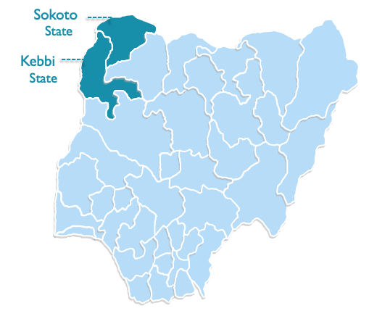
PHASE II: INTERVENTIONS DESIGN AND IMPLEMENTATION
Based on findings and learnings from Phase I, EatSafe designed and is now testing four food safety interventions with the aim to enable lasting improvements in the safety of nutritious foods in two markets in two Kebbi & Sokoto states: Central Market in Kebbi and Dankure Market in Sokoto.
Safe Food
Stand
Radio
Show
Association for Promotion of Food Safety and Improved Nutrition
Safe Food
Brand Initiative

Slide 6
PHASE II ACTIVITIES UPDATE-I
Training of Trainers (ToT) on Food Safety for 36 participants in Kebbi and Sokoto States completed.
Training of Vendors from the target markets on food safety best practices for the target seven commodities completed in Kebbi and Sokoto-160 Vendors
Association for Promotion of Food Safety and Improved Nutrition (APFSAN) formed and registered with Corporate Affairs Commission on 27th May 2022: >700 members already registered
APFSAN Kebbi and Sokoto State Chapters Launched in Birnin Kebbi on Sept. 8 2022 and Sokoto on Sept 15, respectively.
Pioneer 5-Member State Management Team (SMT) Members elected for both States
Over 250 participants attended the Launch in each State
The Safe Food Stand at Central Market Birnin Kebbi launched on September 9, 2022. Test running this week.

Slide 7
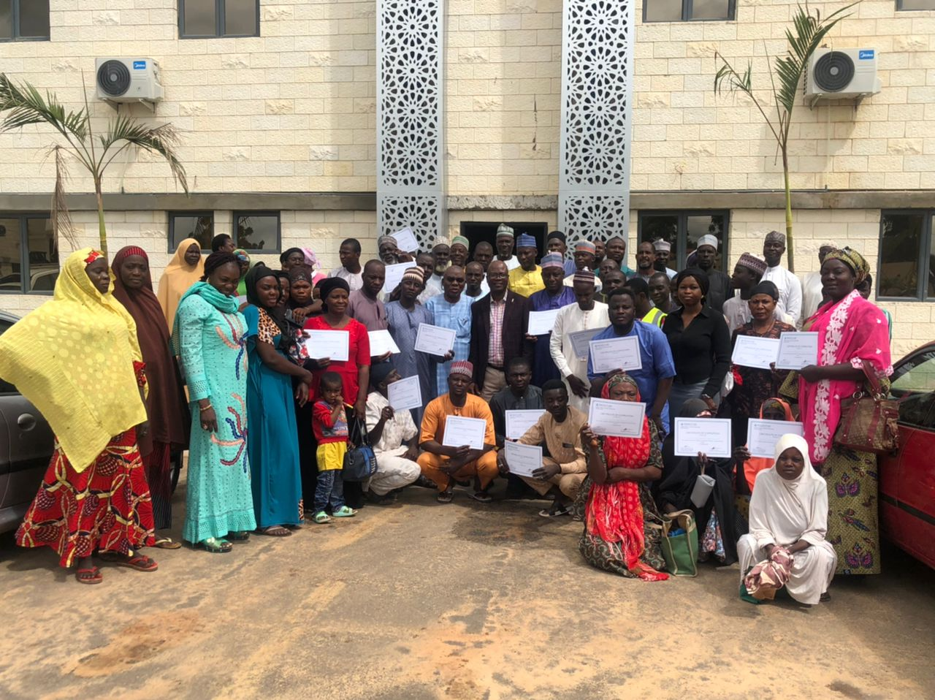
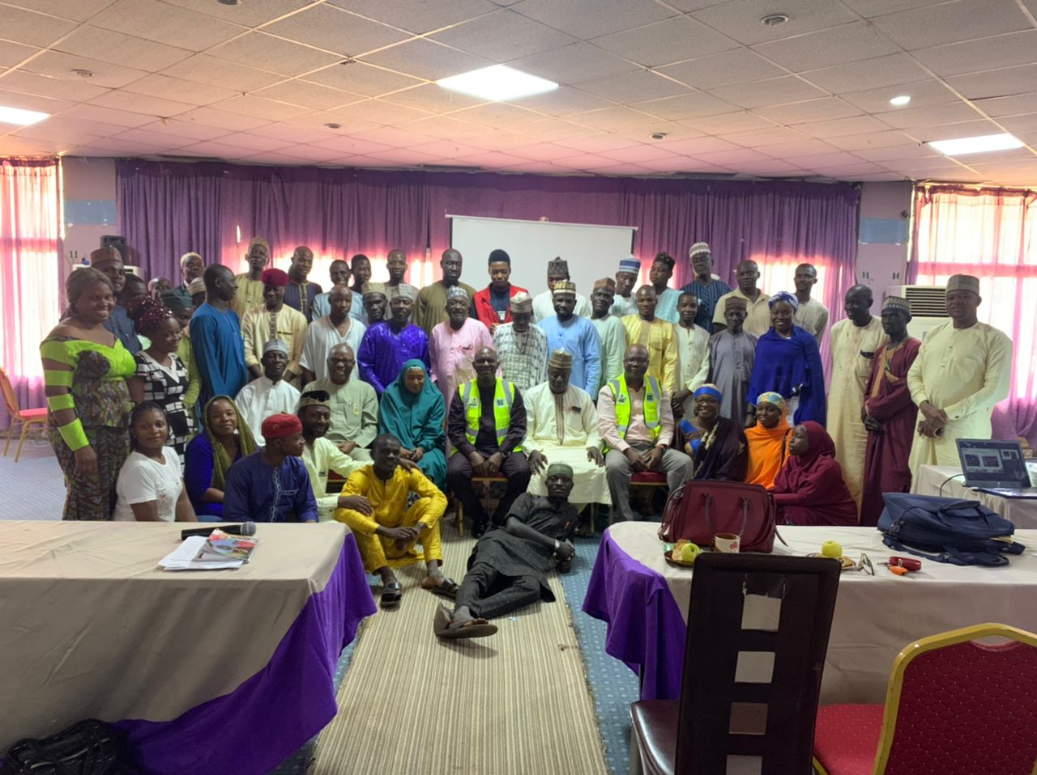
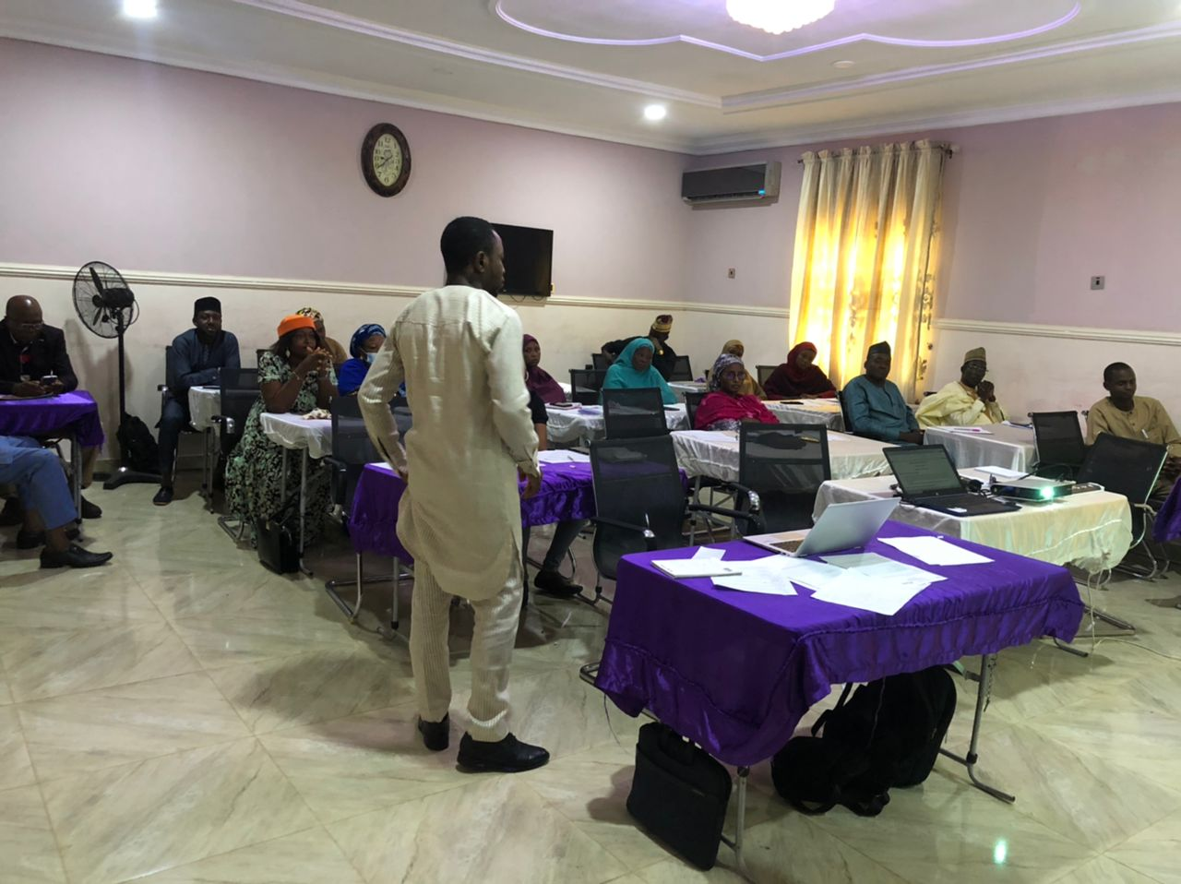
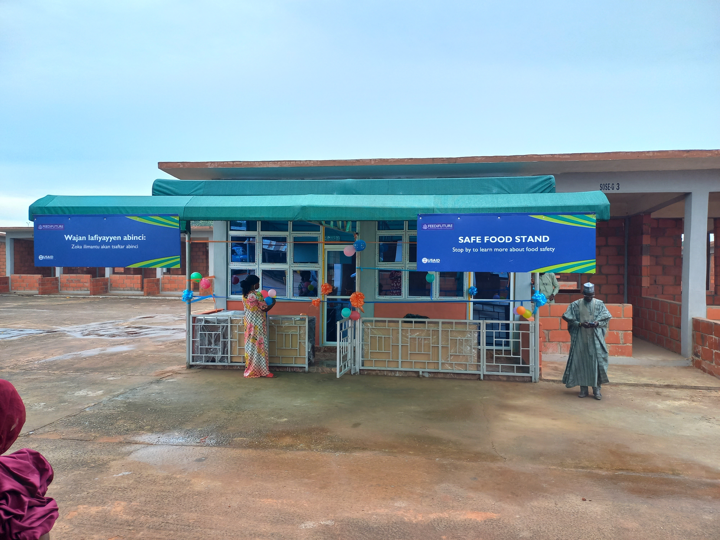
PHASE II ACTIVITIES UPDATE-II : TRAINING ON FOOD SAFETY AND SAFE FOOD STAND
Training of Vendors - Sokoto
Training of Vendors - Sokoto
Training of Vendors - Kebbi
Training of Trainers (ToT
Safe Food Stand - Central Market Birnin Kebbi

Slide 8
Key LEARNINGS
Mapping of Stakeholders and their engagement during project planning, inception and implementation results in better buy-in and collaboration
Consumers in Nigeria expressed less satisfaction in government activities at ensuring food and water safety, compared to global averages.
Consumers’ risk perception of food safety does not always align with risk reality. Microbial pathogens are most responsible for FBD, but toxins and pesticides are top of mind for consumers.
National food safety policy and legislation often focus mostly on the formal food sector, overlooking street foods stalls & traditional markets
The law-making process in Nigeria is slow. The Food Safety and Quality Bill produced in 2016 is yet to be enacted into law.
Collaboration with co-located projects/programs in the same State, Region or location provides mutual understanding and enhances shared learning, adaptation & collective impact

Slide 9
NEXT STEPS
APFSAN-Association work planning and membership drive
Safe Food Stand at Central Market Birnin Kebbi-test running
Complete of Modelling of Safe Food Stand at Dan Kure Market Sokoto and launch
Safe food brand initiative Launch: ABINCI PES-PES:
Safe Food Radio Launch -26 Episodes planned
Monitoring, Evaluation and Learning from interventions

