Slide 1
Identifying Locally Available Foods through Community Consultations: A sustainable approach to promoting and utilizing safe, nutritious and diverse foods.
Ebenezer Amuwaoluwa Oluloto, Hadiza Joy Marcus, Michael Daniel Eveshoyan, Chukwuma Anene, Kazeem Adebayo, Pauline Adah

Slide 2
Background: Food and Nutrition insecurity has become a major challenge in Nigeria. The need to diversify access to nutritious food is crucial.
Objective:
To identify priority food groups or value chains and identify specific knowledge, capacity, and input gaps affecting their availability and promotion.
Location:
Sokoto, Kebbi and Bauchi State, Nigeria

Slide 3
Methodology
Desk review of existing literature, information and research work
To identify pre-selected value chains
To gain greater understanding of state-specific context in relation to opportunities for production and consumption and improved diets.
To determine the relevant stakeholders for the consultative workshops
To aid in the design of the consultative workshops

Slide 4
Stakeholder Consultation
Two workshops involving 170 (F:66 and M:104) value chain actors including Government of Nigeria line ministries, farmers, wholesalers, food processors, off-takers, and vendors were held.
One day workshop to select priority value chains and food groups with the help of a ranking system to prioritize the food groups using predetermined criteria.
One day workshop to identify motivating and mitigating factors in the promotion and acceptance of these prioritized food groups.

Slide 5
Results
Rice and millet were the highest ranked staple, though a majority of the participants were aware of other bio-fortified crops like Quality protein maize (QPM) and Orange Fleshed Sweet Potatoes (OFSP) but, they do not know how to access them.
Groundnut, watermelon, spinach, moringa, goat, and poultry production were identified and advocated for by all participants as a viable pathway to improving food and nutrition security.
100% of female participants posed that ease of cultivation, maintenance, and processing are critical predetermining factors in the choice of crops cultivated by women.
The stakeholders also considered crops that could increase women’s income generation and economic empowerment opportunities.
Due to limited opportunities for land ownership in Northern Nigeria for women, nutrient-rich crops that require small land space should be considered and smart agriculture promoted.

Slide 6
Conclusion and Recommendation
In summary, the choice and prioritized food crops were similar across the three states however, there were some peculiarities on the basis of the different agro-ecological zones and preferences across the states.
Challenges identified range from insecurity in the region to low access to improved production inputs and postharvest handling practices.
There is need for project to prioritize locally available foods that are acceptable by the people.

Slide 7
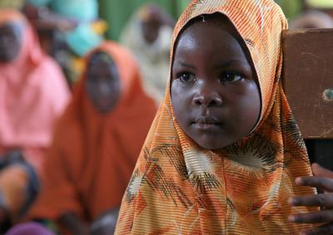
THANK YOU
Photo credit: USAID’s Nigeria’s MARKETS program

