Slide 1
The USAID/Nigeria Nutrition Strategy
Amuwaoluwa Ebenezer Oluloto,
Nutrition Manager,
USAID Mission in Nigeria

Slide 2
Presentation Outline
Health and Economic Growth
Background/Context
Health and Economic Growth
Mission Multisectoral Nutrition Strategy
Health and Economic Growth
Technical Approach and Activities
Notes:
TEAMS HAVE UP TO 20 MINUTES TO PRESENT. THE REMAINING 40 MINUTES IS FOR Q&A

Slide 3
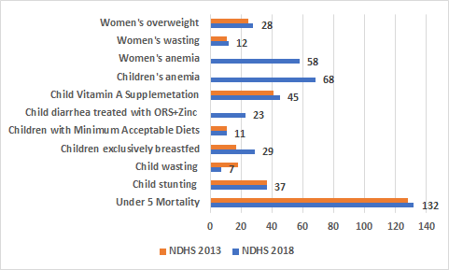
Trends show variable progress on Nutrition indicators between the last 2 NDHS
Some indicators were not reported in NDHS 2013 but were reported in 2018:
Children with anemia
Children with diarrhea treated with ORS & Zinc
Women with anemia
NB: Numbers are in percentages except for the under 5 Mortality which is 132/1000 live births
NDHS: Nigeria Demographic and Health Survey
Notes:
NFCMS 2021 is worse wasting rates at 11.6%
Malnutrition is a direct or indirect cause of 45% of <5 deaths year
The trend from 2013-2018 showed that Nigeria did not fare well with most despite the massive investment. How much of these investments were coordinated?
The situation at sub-national level is worse especially in the NW & NE. (for instance stunting in Kebbi and Sokoto states is 66% and 55% respectively)
LACK/INADEQUATE SYNERGY IN PROGRAMMING
2.5m children under 5 have acute malnutrition annually and 2/3 do not have access to treatment
Rwanda have 87% EBF, and 1% wasting
1 in 5 children are stunted (165 million)
Low birthweight contributes to 3.3% of total child deaths
Nutrition drive economy as $1 invested in Nutrition

Slide 4
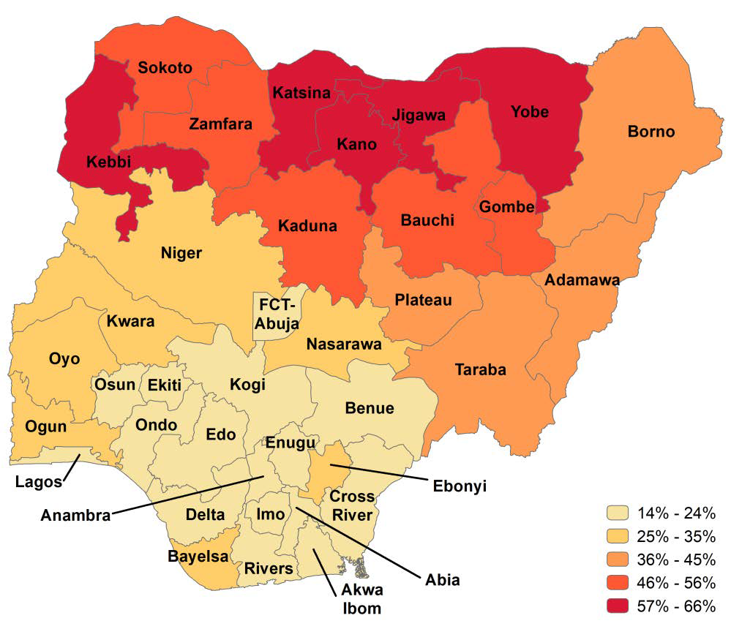
Stunting is high across most Mission-supported states, especially in the North
Mission-supported State | % Stunting- NDHS 2018
Kebbi | 66
Yobe | 57
Sokoto | 55
Bauchi | 55
Kaduna | 48
Gombe | 45
Borno | 45
Adamawa | 40
National | 37
Niger | 28
Ebonyi | 25
Delta | 24
Cross River | 23
Benue | 21
FCT | 21
Source: NDHS 2018
Notes:
The situation at sub-national level is worse especially in the NW & NE. (for instance stunting in Kebbi and Sokoto states is 66% and 55% respectively) Some od the factors may be due to poor maternal infant and young child feeding, gender issues like child marriage, large family sizes, poverty and poor maternal education.
LACK/INADEQUATE SYNERGY IN PROGRAMMING
2.5m children under 5 have acute malnutrition annually and 2/3 do not have access to treatment and 60-80% are in the North
Rwanda have 87% EBF, and 1% wasting
Malnutrition is cause of 45% of <5 deaths - 3.1 child deaths/year
1 in 5 children are stunted (165 million)
Low birthweight contributes to 3.3% of total child deaths
Nutrition drive economy as $1 invested in Nutrition yield $16 ROI.

Slide 5
There is a similar picture with wasting, which is also worse in Northern states
Sokoto
Borno
Mission-supported State | % Wasting-NDHS 2018
Sokoto | 17.9
Borno | 16.0
Yobe | 12.4
Kebbi | 12.3
Benue | 8.0
Bauchi | 8.5
Gombe | 7.8
National | 7.1
Cross River | 5.0
Kaduna | 4.8
Niger | 4.7
Ebonyi | 4.5
Adamawa | 4.2
FCT | 3.0
Delta | 2.0
Kebbi
Katsina
Yobe
Zamfara
Jigawa
Kano
Bauchi
Niger
Kaduna
Gombe
Adamawa
Plateau
Kwara
^{FCT}
Taraba
Oyo
Nasarawa
Kogi
Osun
Ekiti
Benue
Ogun
Ondo
Edo
>15%
Enugu
Cross
River
Lagos
Anambra
Ebonyi
10 – 14.9%
Delta
Imo
Abia
5.0 – 9.9%
Rivers
Akwa Ibom
Baye-
lsa
2.5 – 4.9%
Source: NDHS 2018
<2.5%
Notes:
The situation at sub-national level is worse especially in the NW & NE. respectively) Some od the factors may be due to poor maternal infant and young child feeding, gender issues like child marriage, large family sizes, poverty and poor maternal education.
LACK/INADEQUATE SYNERGY IN PROGRAMMING
2.5m children under 5 have acute malnutrition annually and 2/3 do not have access to treatment and 60-80% are in the North
Rwanda have 87% EBF, and 1% wasting
Malnutrition is cause of 45% of <5 deaths - 3.1 child deaths/year
1 in 5 children are stunted (165 million)
Low birthweight contributes to 3.3% of total child deaths
Nutrition drive economy as $1 invested in Nutrition yield $16 ROI.

Slide 6
In summary, there are clear challenges with nutrition in Nigeria
Malnutrition is a pervasive problem leading to morbidity and mortality
Drivers of malnutrition include poverty, poor health indices, and poor diets
Funds available and capacity for nutrition programming is limited
There are insufficient resources in any single sector to tackle the challenge
Multi-sectoral approaches, including Private Sector Engagement, are needed
Nutrition interventions need to be integrated across sectors to have optimal impact as articulated in the Mission Multi-sectoral Nutrition Strategy
Notes:
To impact stunting rates takes time - impact may not be seen within 5 years of project cycle
Malnutrition is cause of 45% of <5 deaths - 3.1 child deaths/year
1 in 5 children are stunted (165 million)
Low birthweight contributes to 3.3% of total child deaths

Slide 7
CDCS 2020-2025
*
USAID/Nigeria
7
Notes:
7

Slide 9
The Mission’s Multi-Sectoral Nutrition Strategy (MSNS) Results Framework
MSNS Goal:
Improving nutrition for a healthy, productive, and resilient Nigeria
Cross-cutting Results
Multi-sectoral nutrition policies
Education, Social Behaviour Change Communication (SBCC)
IR1 (via EGE):
Improve nutrition through the food system
IR2 (via HPN & HAT):
Improve nutrition through the health system
IR3 (via HART):
Improve nutrition through humanitarian assistance
Gender, female empowerment and youth engagement
The Advancing Nutrition activity is the first
collaboration under this MSNS
Research, innovation, and strategic information
Notes:
Cross-cutting other portfolios including PDG, and EDU

Slide 10
Multi-Sectoral Nutrition Coordination
Nutrition
Health
Family Planning
Agriculture
WASH
Education
Social Protection/Gender/Youth
Humanitarian Assistance
Nutrition Working Group
National Council on Nutrition (NCN) & Technical Advisory Group
Nigeria Governors’ Forum (NGF)
Ministry of Budget and National Planning (MoBNP)
Ministry of Health (MOH) & NPHCDA
Ministry of Agriculture and Development (FMARD)
Ministry of Women Affairs
Scaling-Up Nutrition (SUN)
SUN Business Network
SUN Donor Partners
SUN Civil Society Agriculture Donors Working Group
UN: UNICEF, WFP, FAO, WHO
Banks: World Bank, AfDB, KFW, IFAD
Bilateral: USAID, DfID, GIZ, JICA, AFD, EU
Foundations: BMGF, Dangote, Rockefeller,
Global Alliance for Improved Nutrition (GAIN)
Implementing Partners

Slide 11
USAID Nutrition Engagements and Updates
LOC of the upcoming ECOWAS Nutrition Forum (November 2022)
Co-convener of the National stakeholders dialogue on wasting
Support for the ongoing Food Consumption and Micronutrient Survey
Members of the National Council on Nutrition and Technical Advisory Group
Support for the Launch and dissemination of Nutrition policies and working documents.
Expansion of USAID Advancing Nutrition to additional states of Ebonyi and FCT
USAID/Nigeria Multisectoral Nutrition Strategy
Mission Nutrition Coordination Working Group
Quarterly GFSS Stakeholders’ meetings
Joint field visits with partners and government desk officers
Food systems concepts and approaches within the RFS conceptual framework
Mission and partners joint planning and programming of Ukraine’s funds
USAID- Co-lead with UNICEF the Nutrition Development Partners Group
Joint funding with World Bank for the development of Food and Nutrition advocacy briefs
Exploring options to enhance nutrition intervention within the current activities and new designs
11

Slide 12
Challenges
Key strategies and documents
Need to increase and optimize resources for nutrition across portfolios, especially from government across levels.
Need for capacity for activities to integrate nutrition, and multi-sectoral coordination
Need to increase private sector potential to sustainably improve nutrition
USAID Multi-sectoral Nutrition Strategy
US Government Global Food Security Strategy
US Government Global Water Strategy
USAID/Nigeria CDCS (2020-2025)
Nigeria-National Policy on Food and Nutrition (2015-2019)
Nigeria-National Multisectoral Plan of Action for Food and Nutrition in Nigeria (2021-2025)
12

Slide 13
Notes:
$55 million Ukraine Funds for Nigeria, including
USAID received EXCEPTIONAL approval from GH AA to procure RUTF using Ukraine/Russia funds
Some considerations:
There will be a spotlight on this pilot in particular to asses
Ability to procure locally,
Success leveraging other partner resources (WB) and
Capacity of DRF to sustain the commodity
Lots of support from Global Health; request for support from EGE to ensure multi-sectorial engagement
refine the Multi-sectoral Nutrition Strategy

Slide 14
SOME OF THE CURRENT MISSION NUTRITION INVESTMENTS

Slide 15
Mechanism | Prime | Dates | Total Award | Programmatic Focus | Geographic Focus
Integrated Health Project (IHP) TO1-7 | Palladium International | 2018-2025 | $225m | Facility MNCHN/FP; Health System Strengthening | FMOH, Bauchi, Kebbi, Sokoto, Ebonyi and FCT
Breakthrough Action (BA) | JHCCP | 2017-2022 | $59m | Community MNCHN/FP | Bauchi, Kebbi, Sokoto, Ebonyi, FCT
Breakthrough Research | Population Council | 2018-2022 | $5m | MNCHN research/evaluations | Bauchi, Kebbi, Sokoto, Ebonyi, FCT
Humanitarian and Assistance Response Team (HART) | UN and INGO partners | Ongoing annual awards since 2014 | FY19: $315m FFP:$200m + OFDA:$115m | Full suite of humanitarian support including CMAM, healthcare, food security, WASH, and nutrition-sensitive agriculture | North East(Adamawa, Borno and Yobe) P-North West (Sokoto, Zamfara & Katsina)
Rural Resilience | Mercy Corps | 2019-2024 | $30m | Market systems; microfinance; livelihoods; climate-smart ag; WASH; links to HA/social protection, health, education | Northeast (Adamawa, Borno, Gombe, & Yobe)
Water for Agriculture | CRS | 2020-2023 | $8m | Water mgmt for cultivation & livestock; farmer coops; herder groups | Adamawa, Borno & Yobe
Effective WASH (E-WASH) | RTI | 2018-2022 | $60m | Urban WASH, water systems | Imo, Delta, Niger, Sokoto, Taraba, Abia
North West WASH | UNICEF | 2021-2024 | $9.8m | Improving Sanitation, Hygiene, and Safe Drinking Water in Northwest Nigeria | Sokoto and Kebbi
Notes:
IHP: Facility-level integrated health activity with nutrition components including IYCF, IFA, CMAM, BFHI, Vitamin A, dietary counseling; all LGAs in 5 states + national; 3.5m GHP
BA: Community-level integrated health SBC activity with nutrition components focused on IYCF; select LGAs in 12 states; 1.4m GHP
UNICEF- Brief Activity Description: To build community-centered approaches for delivering, operating, and managing sustainable water, sanitation, and hygiene (WASH) services in rural areas focused on fostering resilience in two of Nigeria’s highest burden states: Sokoto and Kebbi.

Slide 16
Mechanism | Prime | Dates | Total Award | Programmatic Focus | Geographic Focus
West Africa Trade Hub | Creative Associate Int. | 2019-2024 | $90m | Ag prod & trade; PPP grants; food system TA incl post-farm storage, processing; links to Prosper Africa | West Africa incl Senegal, CI, Ghana
Feed the Future Nigeria Integrated Agriculture | International Institute of Tropical Agriculture (IITA) | 2018-2025 | $11m | Market systems; microfinance; livelihoods; climate-smart ag; Nutrition, WASH; links to HA/social protection, health, education | Borno and Adamawa
Feed the Future Nigeria Agricultural Policy | Michigan State University (MSU) / International Food Policy Research Institute (IFPRI | 2015-2020 | $12.5m | Provides trainings, and build institutional capacity, Promote research and evidence-based policy process and impacts on Food security and nutrition | National level
Feed the Future Agricultural extension and advisory services. | Winrock International | 2020-2025 | $17m | The purpose of the activity is to strengthen sustainable agricultural extension and advisory services to reach at least two million smallholder farmers. | Kebbi, Niger, Kaduna, Benue, Cross-River, Delta, & Ebonyi
Agribusiness Investment | CNFA | 2018-2023 | $15.7m | Agribusiness development/finance investment/mgmt. | Benue, Cross River, Delta, Ebonyi, Kaduna, Kebbi, Niger

Slide 17
Mechanism | Prime | Dates | Total Award | Programmatic Focus | Geographic Focus
Evidence and Action Toward Safe and Nutritious Foods (EatSafe) | Global Alliance for Improved Nutrition (GAIN) (core-funding) | 2020-2024 | $2m | Generate evidence and knowledge of the potential of increased consumer demand for safe food to substantially improve the safety of nutritious foods in informal market settings | Kebbi State
Youth-Powered Ecosystem to Advance Urban Adolescent Health and Well-Being | DAI Global Health, | 2020-2025 | $15 Million | Advance Urban Adolescent Health and Well- Being (YPE4AH) activity is to improve the health and well-being of unmarried, out-of-school, urban poor adolescents age 15–19 | Kano and Lagos
Promoting the Quality of Medicines Plus (PQM+) | United States Pharmacopeial Convention, Inc.,IntraHealth IQVIA NEPAD Panagora Group | 2020 - 2024 | $9M | Improve medical product quality through cross-sectoral and systems strengthening approaches and the application of international quality assurance standards across the pharmaceutical system. | Lagos
Global Health Supply Chain - Procurement & Supply Management (PSM) | Chemonics International, Inc, IntraHealth International, McKinsey & Company, University Research Co., LLC | 2016- 2023 | $290 M | Provides health commodity procurement services and systems strengthening technical assistance with (quantification, warehousing, and distribution of commodities) to address all elements of a comprehensive supply chain. | Kebbi, Niger, Kaduna, Benue, Cross-River, Delta, & Ebonyi
Integrated Child Health and Social Services Award (ICHSSA 1-4) | CCCRN ARFH SFH PHI | 2019-2024 | $75m | OVC programming, NACS, CIYCF, Home gardening | Kano Cross Rivers, Akwa-Ibom, Rivers Lagos, Bauchi, Adamawa, Taraba, Edo, Niger, Kwara, Sokoto, Kebbi, Bayelsa, Yobe and Borno.
Notes:
Center for Clinical Care and Clinical Research (CCCRN) (Cross River and Akwa Ibom)
Association for Reproductive & Family Health (ARFH) (Lagos)
Society For Family Health (SFH) (Kano)
ProHealth International (PHI) (Adamawa& Bauchi)
Erin, Maggie, Tim
IHP: Facility-level integrated health activity with nutrition components including IYCF, IFA, CMAM, BFHI, Vitamin A, dietary counseling; all LGAs in 5 states + national; 3.5m GHP
BA: Community-level integrated health SBC activity with nutrition components focused on IYCF; select LGAs in 12 states; 1.4m GHP

Slide 18
Any Questions?
Thank you!
18

