Slide 1
Breakthrough ACTION Nigeria (BA-Nigeria)
Improving Maternal, Infant and Young Child Nutrition (MIYCN) through Innovation and Actions for social behavior change in Nigeria.
Presented by: Samba Angela- MNCH plus Nutrition Advisor BA-Nigeria
Wednesday September 21, 2022

Slide 2
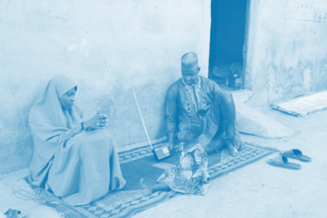
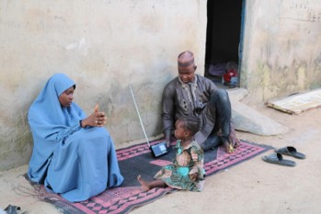
Content
Objective
Project background
Strategy
Result
Challenges
Key learnings
Conclusion

Slide 3
Session objective
To share with participants key learnings from Breakthrough ACTION Nigeria’s integration of community SBC for nutrition with other health areas to facilitate the adoption of Maternal, Infant and Young Child Nutrition behaviors and utilization of services

Slide 4
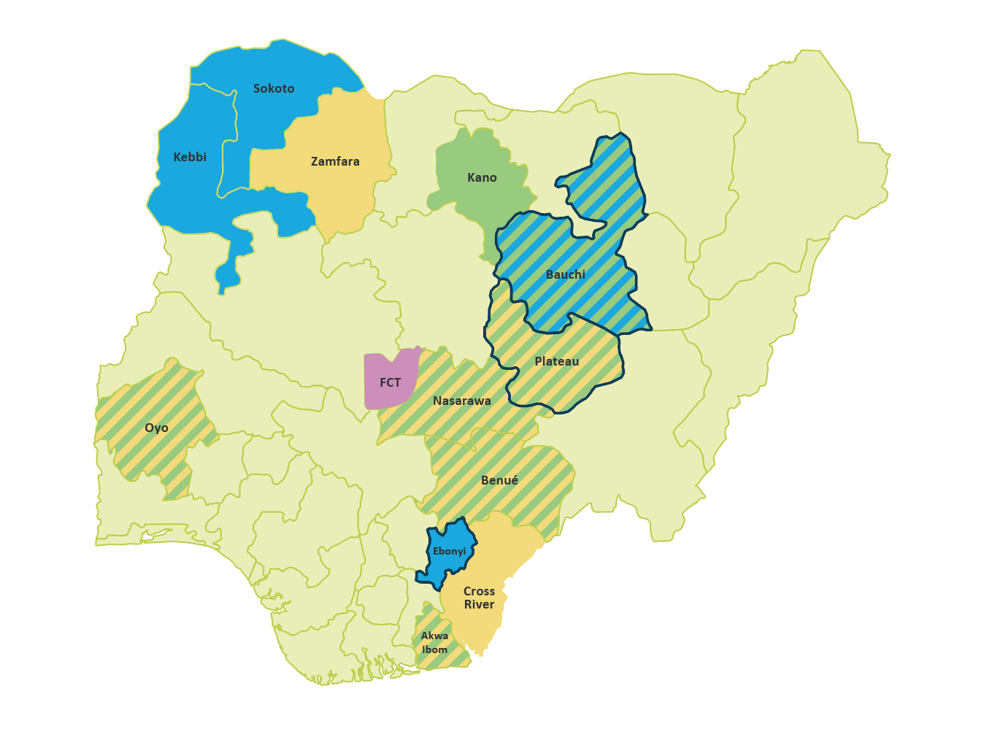
Background
Breakthrough ACTION Nigeria is USAID’s flagship Social and Behavior Change (SBC) project.

Slide 5
To increase the practice of 17 integrated priority behaviors in nutrition and health.
Project goal
To improve individual and social determinants of nutrition and health;
To strengthen SBC across USG investments; and
To strengthen public sector systems for oversight and coordination of SBC at the national and sub-national levels.
Key objectives
Notes:
Talking point.
Talk about the nutrition priority behaviors

Slide 6
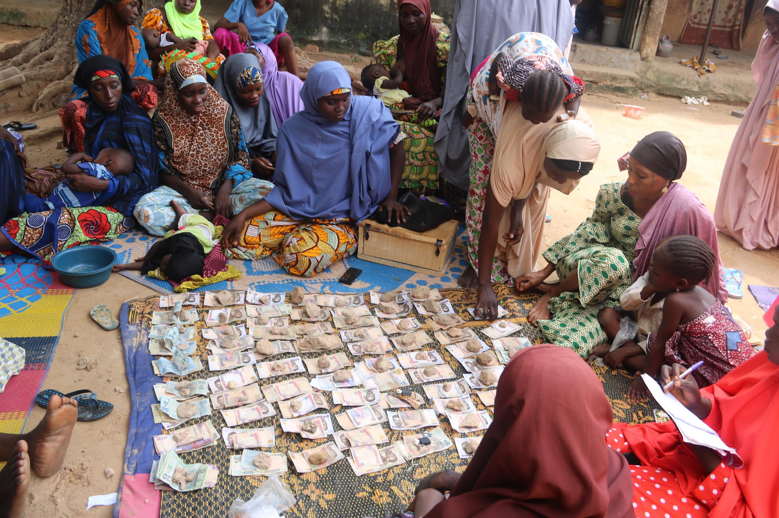
Breakthrough ACTION-Nigeria’s - Strategy
Human-centered design (HCD) to understand and conceptualize the determinants of nutrition and health
Use HCD to design, test, and apply innovations to addressing health and nutrition behaviors
Address priority nutrition and health behaviors in an integrated manner based on identified life stages.
Apply multi-channel SBC interventions to address nutrition and health behaviors at varying levels of influence using the socioecological model
Notes:
Brief. Mention Government and other USG partners

Slide 7
Implementation Approach
Community Mobilization
Community Social Behavior Change (CSBC), Community Capacity & Sustainability (CCS) and Women Empowerment Group (WEG)
Mass Media
Mobile and Digital
Umbrella Theme
Advocacy: Religious, Traditional and Opinion Leaders
Provider Behavior Change
AlbishirinKu! (AK!)
Jide ka I Ji! (JKJ!)
Coordinated Multichannel Approach
Notes:
Talking points.
Discuss how nutrition is integrated into each approach
Highlight the nutrition Interventions ( food demonstration, breastfeeding demonstration, home and community gardening with WDCs, nutrition card game, and other nutrition prototypes)

Slide 8
Results (2019- 2021)
Ward Development Committees (WDC) and Women Empowerment Groups (WEG) continue to support and fund community projects for improved access to information and services
2,458 Community Volunteers (CV), trained
7,608,364 community members reached across implementation states
1,470,305 children under five years and 156,739 pregnant women reached with nutrition messages
Integrated daily radio drama – Albishirin Ku! (AK!) and Jide Ka I Ji (JKJ) with nutrition messages aired across radio stations in implementation States.
766,321 referrals for services, made 287,846 persons completed their referrals. About 25% of referrals were for nutrition services.
Notes:
Trained 2,458 Community Volunteers (CV), who have made 7,608,364 contacts with community members in 806 targeted wards within 90 LGAs to promote malaria, MNCH+N and FP priority behaviors across the intervention states.
BA-N CVs reached 1,470,305 children under five years and 156,739 pregnant women with nutrition messages.
The CVs made 766,321 referrals for services, out of which 287,846 persons completed their referrals. About 25% of these referrals were for nutrition services.
Ward development committees and Women empowerment groups continue to support and fund community projects including ETS and nutrition activities like food demonstrations and home/community gardening

Slide 9
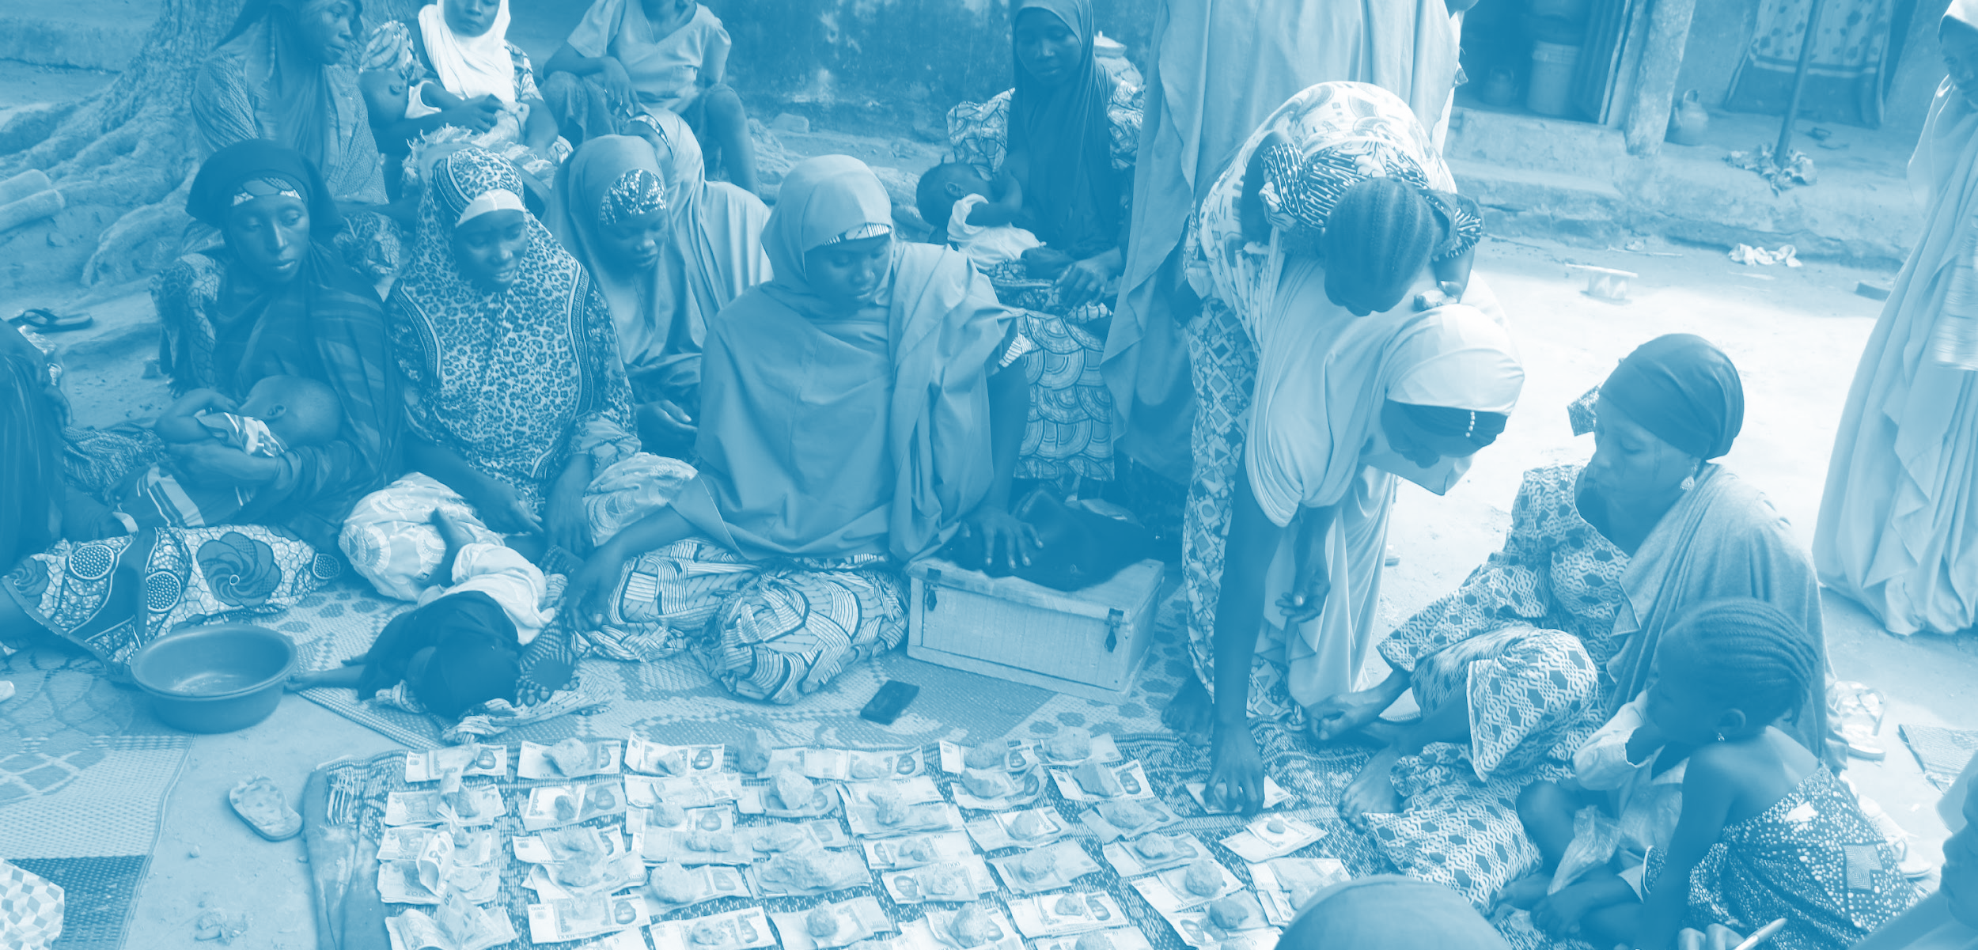
Limited access to services/commodities for treating malnutrition especially at the health facility results to poor referral completion rates
Continuous and intensifying insecurity across implementation states
Challenges
Notes:
BA-Nigeria works with government/community stakeholders and other USAID IPs to ensure clients referred to health facility access care as needed. However, more needs to be done for better nutrition and health outcome
Continuous and intensifying insecurity across implementation states affected planned activities such that some were postponed or canceled. Implementation had to be stopped in some communities.

Slide 10
Learnings
The life stage approach provides an opportunity for targeted messaging in anintegrated intervention, and helps focus nutrition SBC based on client or household needs in the different life stages
Using a human-centered approach for the SBC interventions helped to identify opportunities within the community and maximize same for improved nutrition outcomes
Socio-cultural norms shifting strategies can promote collective change through the involvement of all key family and community actors. Determining the roles and degree of influence of each type of actor is key.

Slide 11
Breakthrough Research’s Behavioural Sentinel Survey (BSS) showed improvement in nutrition and associated behaviours and ideation around nutrition at midline compared to baseline.
Conclusion
Notes:
Talking point.
Talk about the nutrition priority behaviors

Slide 12
Questions
Notes:
Talking point.
Talk about the nutrition priority behaviors

Slide 13
Connect with Breakthrough ACTION- Nigeria
Breakthrough ACTION- Nigeria
@BANigeria
Abuja, Nigeria
Breakthroughactionandresearch.org/tag/Nigeria/
Notes:
Talking point.
Talk about the nutrition priority behaviors

