Slide 1
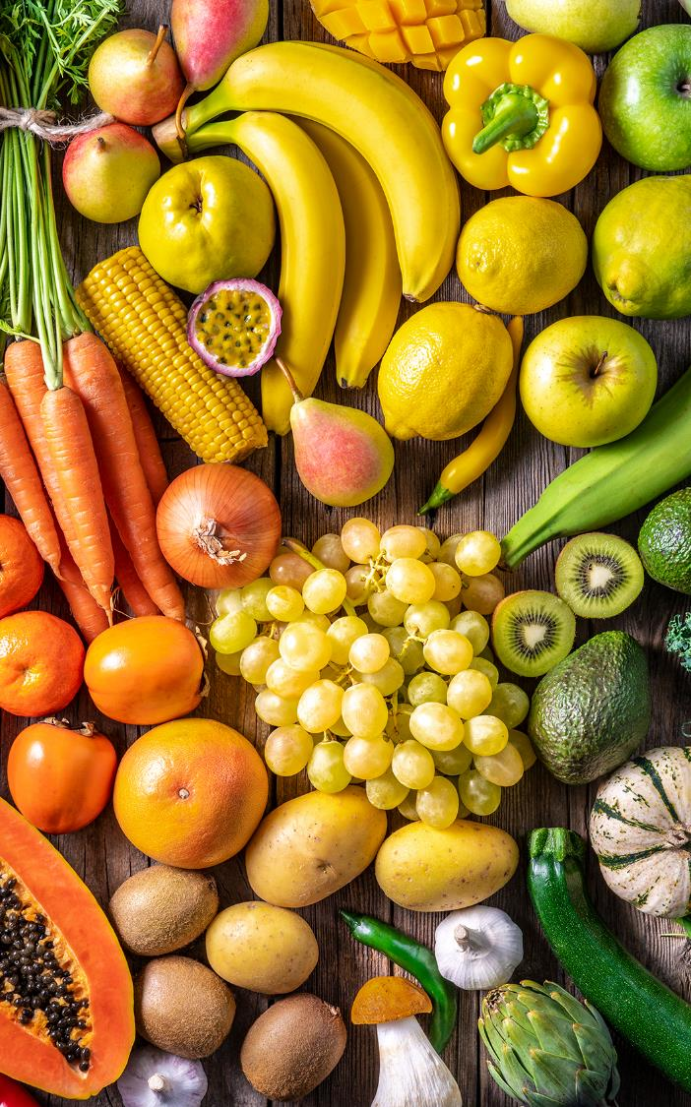
Nurturing Multisectoral Commitments for Sustainable Nutrition in Nigeria
OLUFEMI ADEGOKE
21-Sept-2022
Notes:
Colours, fonts, spacing, image placement, etc. should not be changed in these templates during their use.
In case of accidental changes to the design, you can reset your slide’s design without losing your text and images by going to the slide Layout menu (next to the New Slide button) and reapplying the slide template you were using.
To resize the image without distorting it or moving the image box:
Select the image;
Go to Picture Format;
Select Crop;
Adjust the image using the square adjustment buttons (you will see these around a shaded-out area of your whole image). Hold the Shift key while you adjust the size to prevent the image’s aspect ratio from changing (and so causing distortion).

Slide 3
SUSTAINABLE
NUTRITION

Slide 4
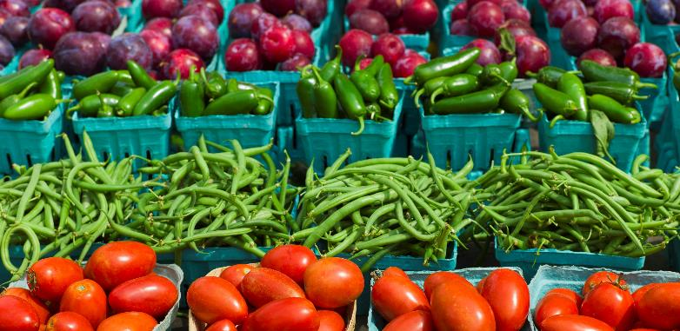
SUSTAINABLE
NUTRITION

Slide 5
SUSTAINABLE
NUTRITION

Slide 6
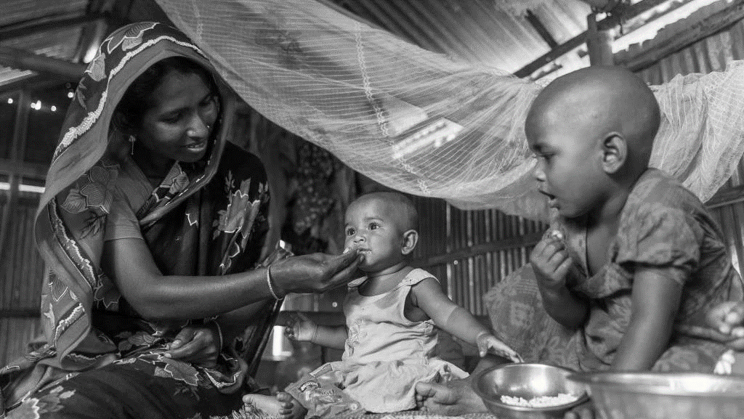
NUTRITION IS CRUCIAL
TO THE ACHIEVEMENT OF ALL
SUSTAINABLE DEVELOPMENT GOALS

Slide 7
NUTRITION IS CRUCIAL
TO THE ACHIEVEMENT OF ALL
SUSTAINABLE DEVELOPMENT GOALS

Slide 8
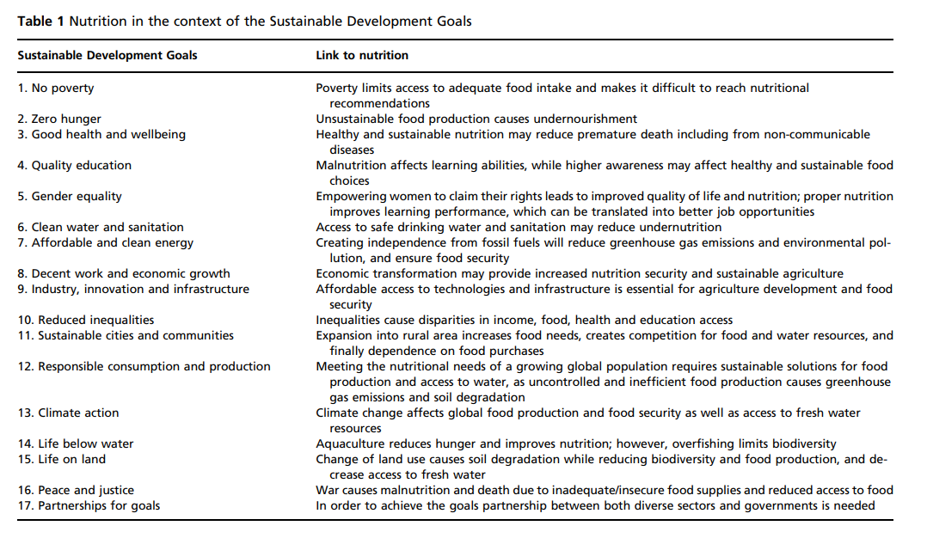
Nutrition in the context of the Sustainable Development Goals – Giuseppe et al. (2018)

Slide 9
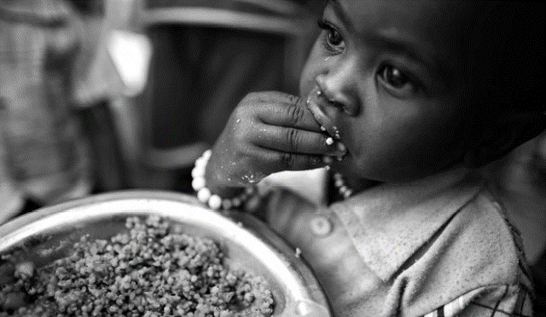
WHERE WE ARE

Slide 10
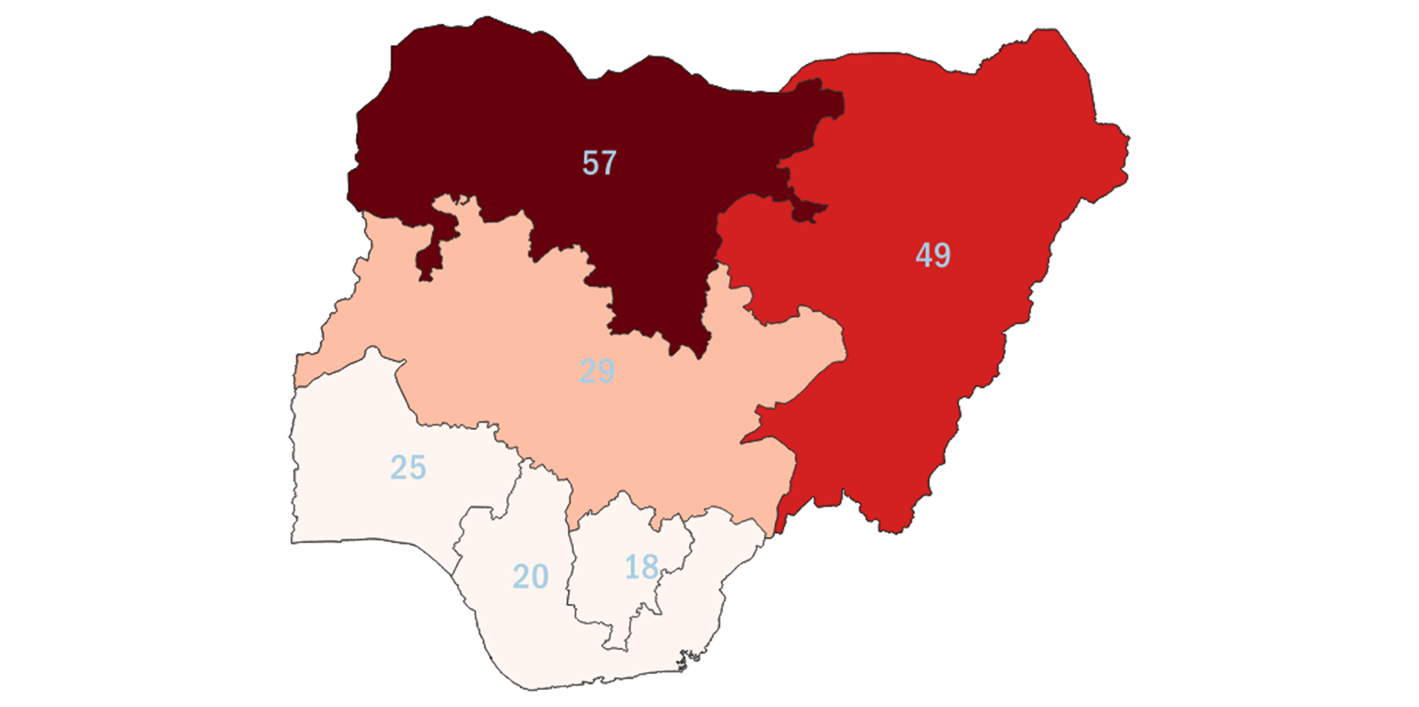
STUNTING
25% or less
25 to 33%
37%
33 to 41%
41 to 50%
Source DHS,2018
51 and above

Slide 11
ACHIEVING SUSTAINABLE
NUTRITION IN NIGERIA
THROUGH MULTISECTORAL APPROACH
NUTRITION

Slide 12
ACHIEVING SUSTAINABLE NUTRITION
IN NIGERIA THROUGH MULTISECTORAL APPROACH
Notes:
Multisectoral engagement and commitment remains the primal means by which sustainable nutrition can be achieved in Nigeria

Slide 13
ACHIEVING SUSTAINABLE NUTRITION
IN NIGERIA THROUGH MULTISECTORAL APPROACH
ACHIEVING SUSTAINABLE NUTRITION
IN NIGERIA THROUGH MULTISECTORAL APPROACH
Notes:
Critical stakeholders include public and private sector as well as civil society organizations and other non-governmental orgs.

Slide 14
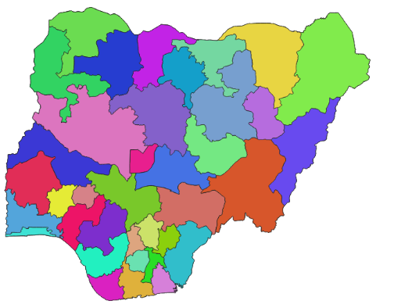
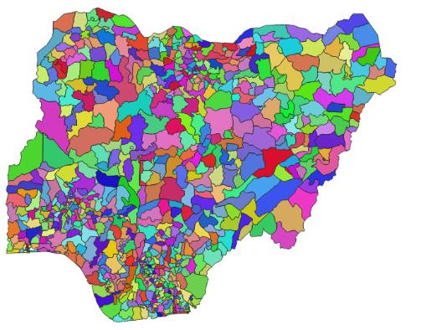
ACHIEVING SUSTAINABLE NUTRITION
IN NIGERIA THROUGH MULTISECTORAL APPROACH
NATIONAL LEVEL
SUB-NATIONAL LEVEL
STATE LEVEL
LOCAL LEVEL
Notes:
Example of leading federal institutions in the nutrition sector

Slide 15
ACHIEVING SUSTAINABLE NUTRITION
IN NIGERIA THROUGH MULTISECTORAL APPROACH
NATIONAL LEVEL
SUB-NATIONAL LEVEL
STATE LEVEL
LOCAL LEVEL
Notes:
These collaborations will be replicated at the subnational levels – state and local levels

Slide 16
Call to Action
1
2
3
4
Notes:
Ways to improve

Slide 17
Call to Action
Strengthened Coordination of Multisectoral interventions
1
2a
2b
3
Notes:
Development of multisectoral interventions with clear institutional coordination mechanism for both national and subnational stakeholders.

Slide 18
1
Call to Action
2a
Secure Funding for the implementation of the National Multisectoral Plan of Action for Food and Nutrition
2b
3
Notes:
Funding and implementation of the National Multisectoral plan of action for food and nutrition (NMPFAN) with keen view on robust national and subnational levels integration.

Slide 19
1
2
Call to Action
2b
Track Expenditure of the National Multisectoral Plan of Action for Food and Nutrition
3
Notes:
Funding and implementation of the National Multisectoral plan of action for food and nutrition (NMPFAN) with keen view on robust national and subnational levels integration.

Slide 20
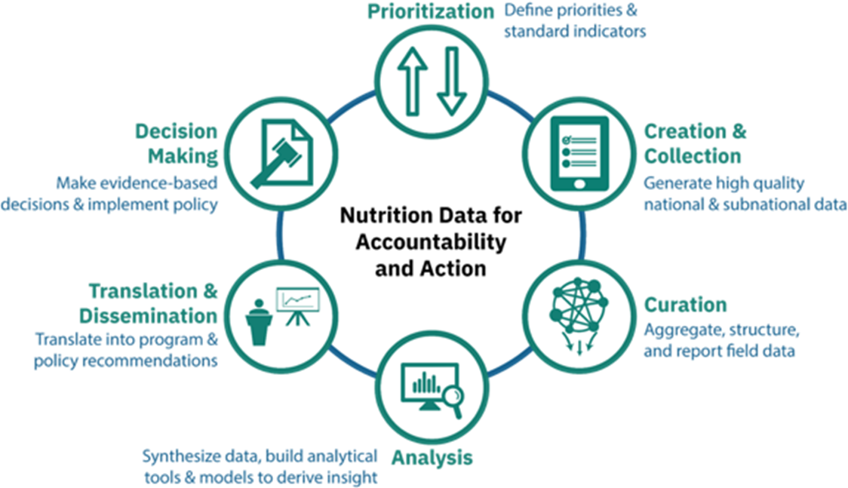
1
3
2
Call to Action
Strengthening of the Data Value Chain for Nutrition’ across all Multisectoral Actors
3
Notes:
Funding and implementation of the National Multisectoral plan of action for food and nutrition (NMPFAN) with keen view on robust national and subnational levels integration.

