Slide 1
Using multi-stakeholder collaboration strategies to improve Vitamin A Supplementation Coverage in 6 states of Nigeria.
SEPTEMBER 2022.

Slide 2
Background
Vitamin A deficiency remain a public health problem affecting about one third of children aged 6 to 59 months, with the highest rates in sub-Saharan Africa 48% and South Asia 44% (UNICEF 2022).
In Nigeria, its prevalence is over 20%.
To address Vitamin A deficiencies in Nigeria, Helen Keller International is implementing a VAS (Vitamin A Supplementation) project using the Maternal, Newborn and Child Health Week (MNCHW) campaign platform, designed along the continuum of care model to strengthen Nigeria’s health system.

Slide 3
Project overview
Project title | Vitamin A Supplementation
Funding | GiveWell
Location | (Nigeria) Adamawa, Akwa Ibom, Benue, Ekiti, Nasarawa, Taraba
Implementation Strategy | Bi-annual MNCHW Implementation Facility based Temporary fix post Mobile teams House-to-house teams
Organization | Helen Keller International Established in 1915, Helen Keller International works to save the sight and lives of the most vulnerable and disadvantaged persons. We combat the cause and consequences of blindness and malnutrition by establishing programs based on evidence and research in vision, health, and nutrition. Headquartered in New York City, Helen Keller Intl’ implements programs in 22 countries in Africa and Asia as well as in the United States. In Nigeria, Helen Keller International is supporting Neglected Tropical Disease (NTD) and Nutrition programs

Slide 4
Helen Keller Model of Implementation
Campaigns/Real-time data entry, collation, validation and post review
Baseline survey
SMART Advocacy
Capacity building
(provision of learning tool kits, job and memory aids, and a comprehensive intervention plan):
Targeted SBCC strategies (compartmentalized for urban and rural mobilization)
Microplanning

Slide 5
Our results (Baseline vs current) results
S/N | States | Baseline Coverage | May/June 2022 Administrative Coverage | Comments
1 | Adamawa | 0% (09/2021) | 96% | There was zero coverage from Jan to June of 2021 there no campaign. Campaign was done in August, however, this could not be validated at the health facility level.
2 | Akwa Ibom | 16.7% (09/2021) | 86% | Poor routine coverage prior to project intervention and accompanying scale up.
3 | Benue | 97% (12/2020) | 91.7% | Outrageous admin coverages which upon validation during Post event Coverage Survey (PECS), stood at 68.1% showing that the minimum effective coverage was not met
4 | Ekiti | 51.2% (01/2022) | 90% | Project intervention led to scale up and the accompanying achievement of the minimum effective coverage.
5 | Nasarawa | 97% (01/2020) | 91% | At baseline, we piloted the VADI strategy, achieving 97% admin coverage which was validated by PECS coverage, which stood at 93%. The project has consistently supported the state to maintain effective coverage since baseline
6 | Taraba | 9.9% (09/2021) | 100% | Consistent poor coverage of VAS. No MNCHW was conducted in the year preceding the year of project entry.
 | Average | 45.3% | 92.45%

Slide 6
Summary
This strategy demonstrates high impact and cost effectiveness in terms of significantly increasing coverage levels from an average coverage of 45.3% - 92.45% of vitamin A supplementation that allow mother and child to thrive and develop through the existing health systems.

Slide 7
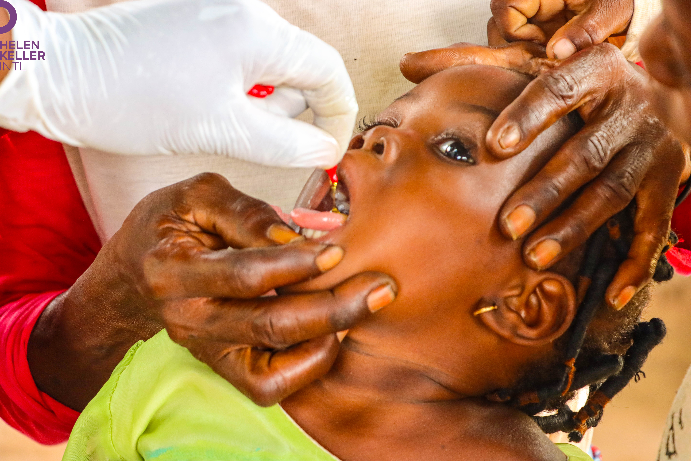
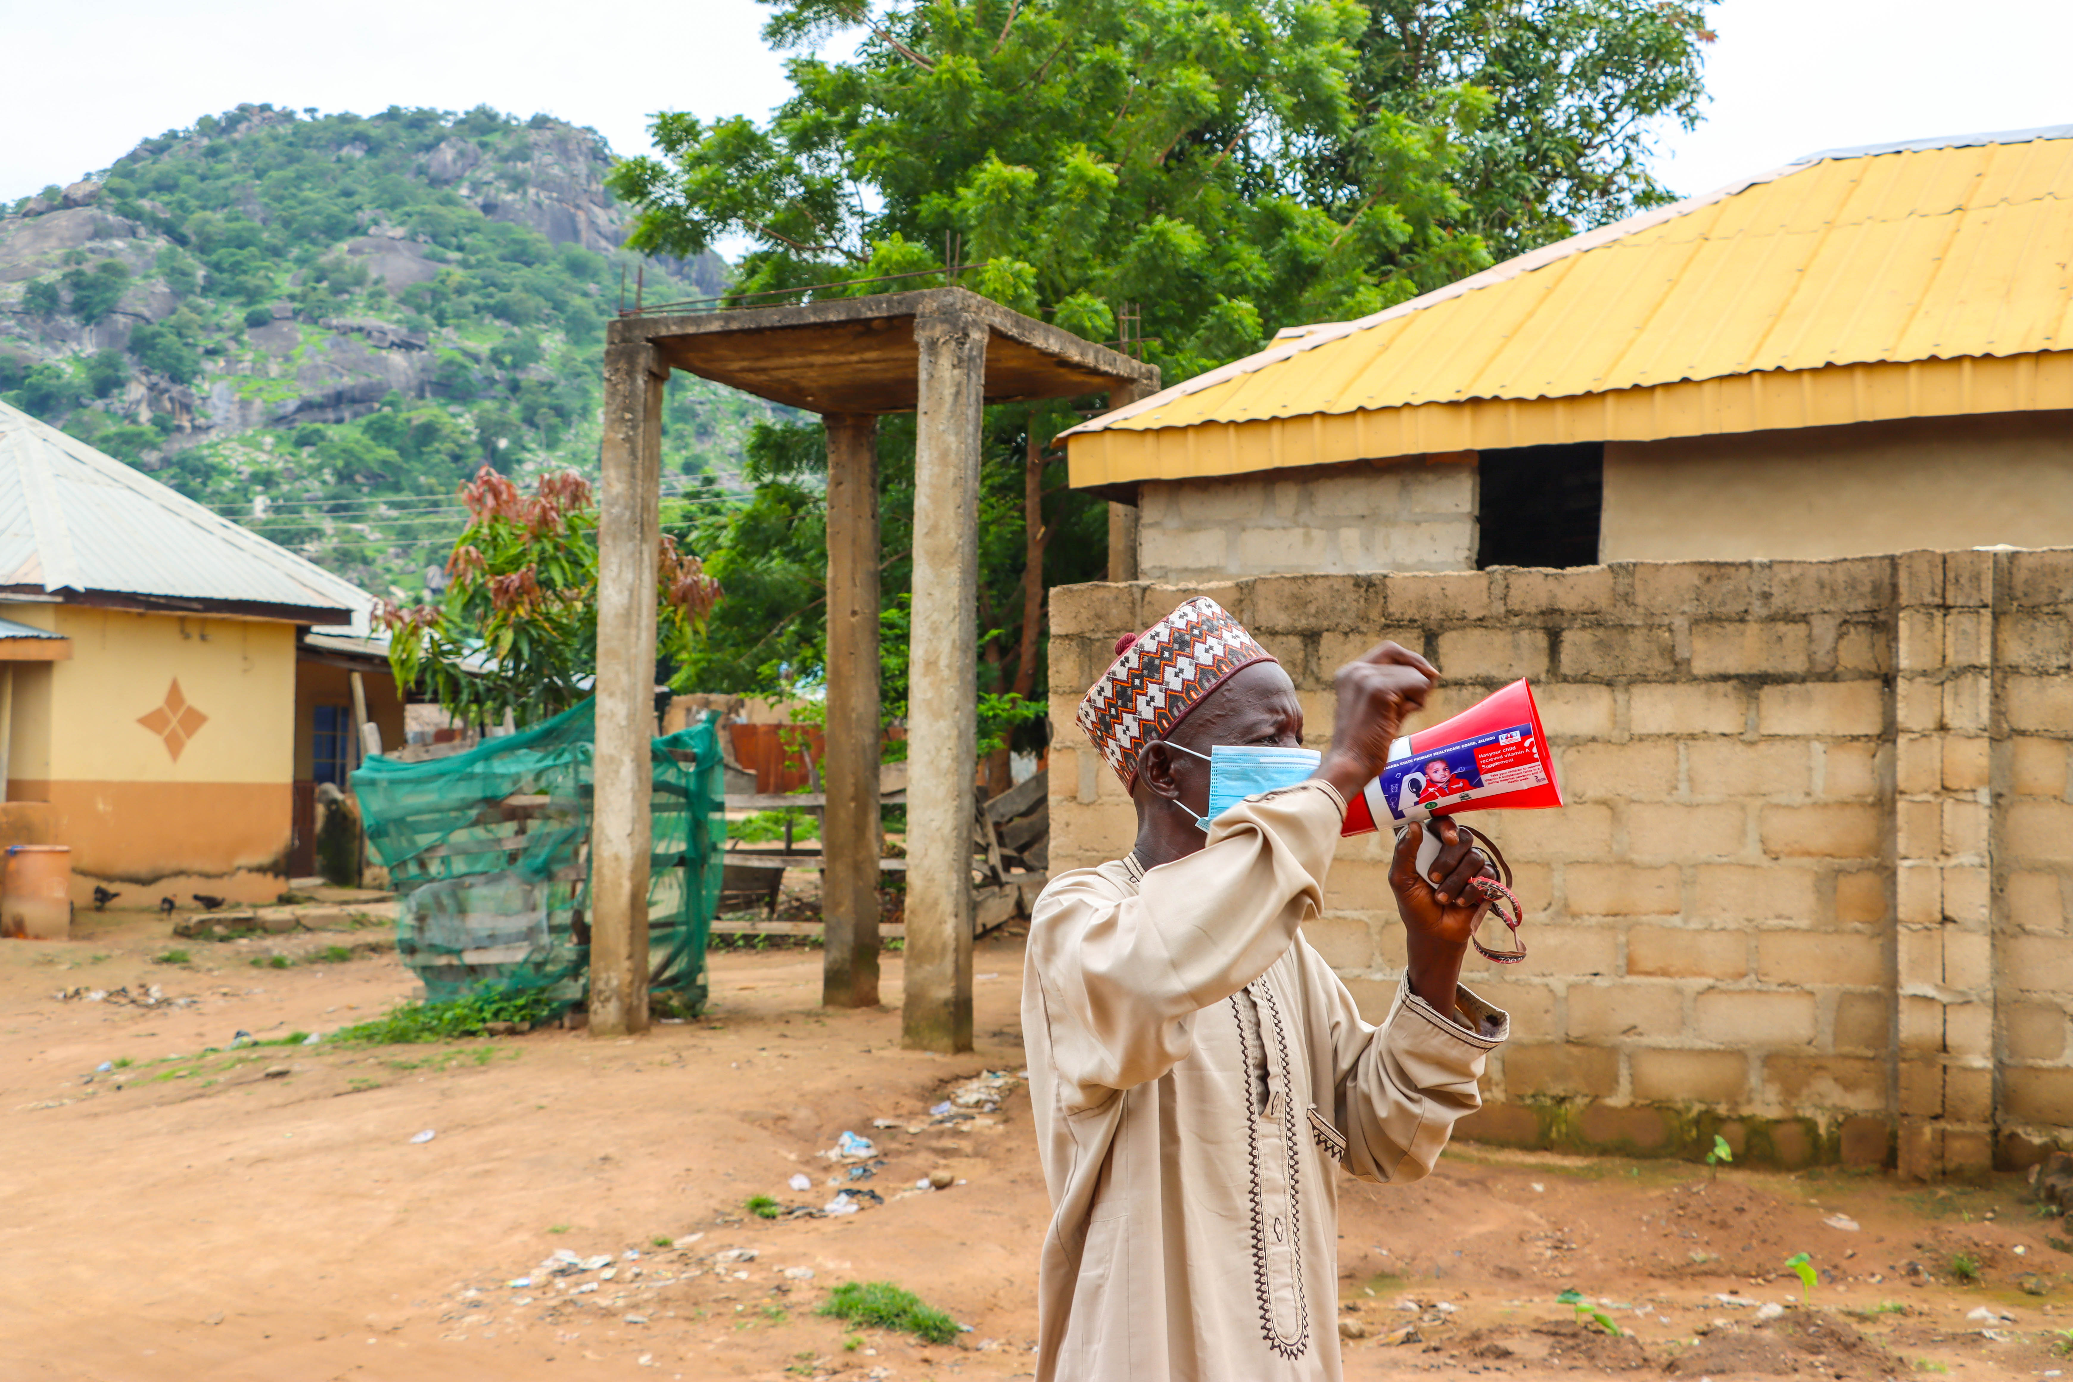
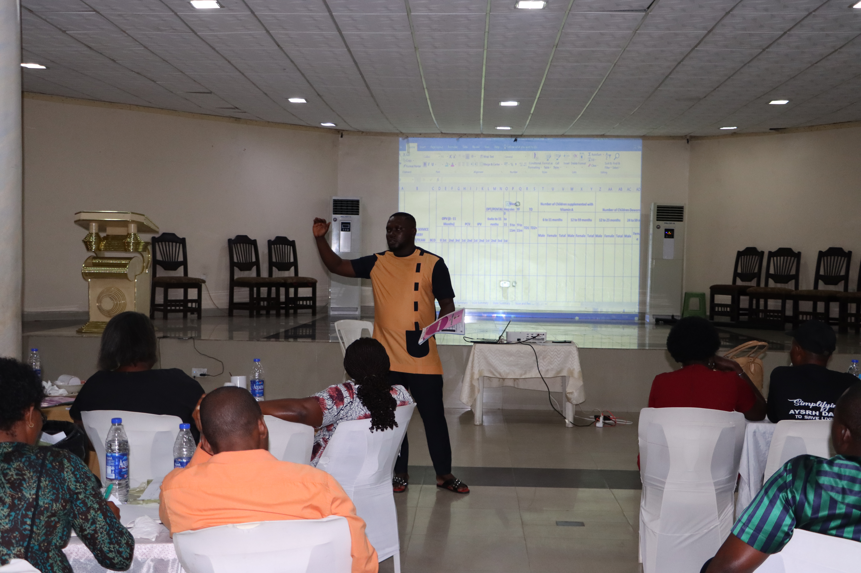
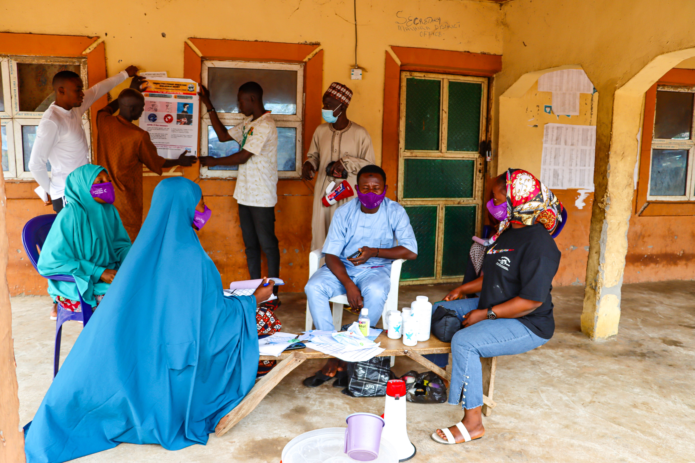
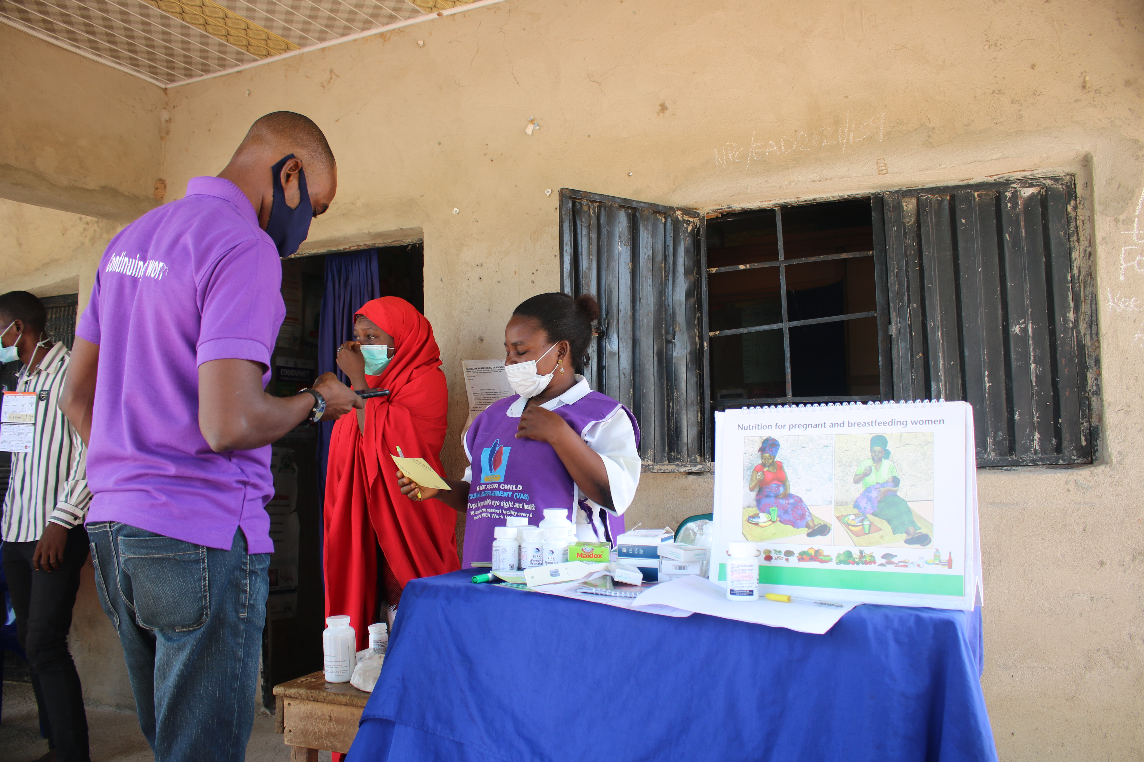
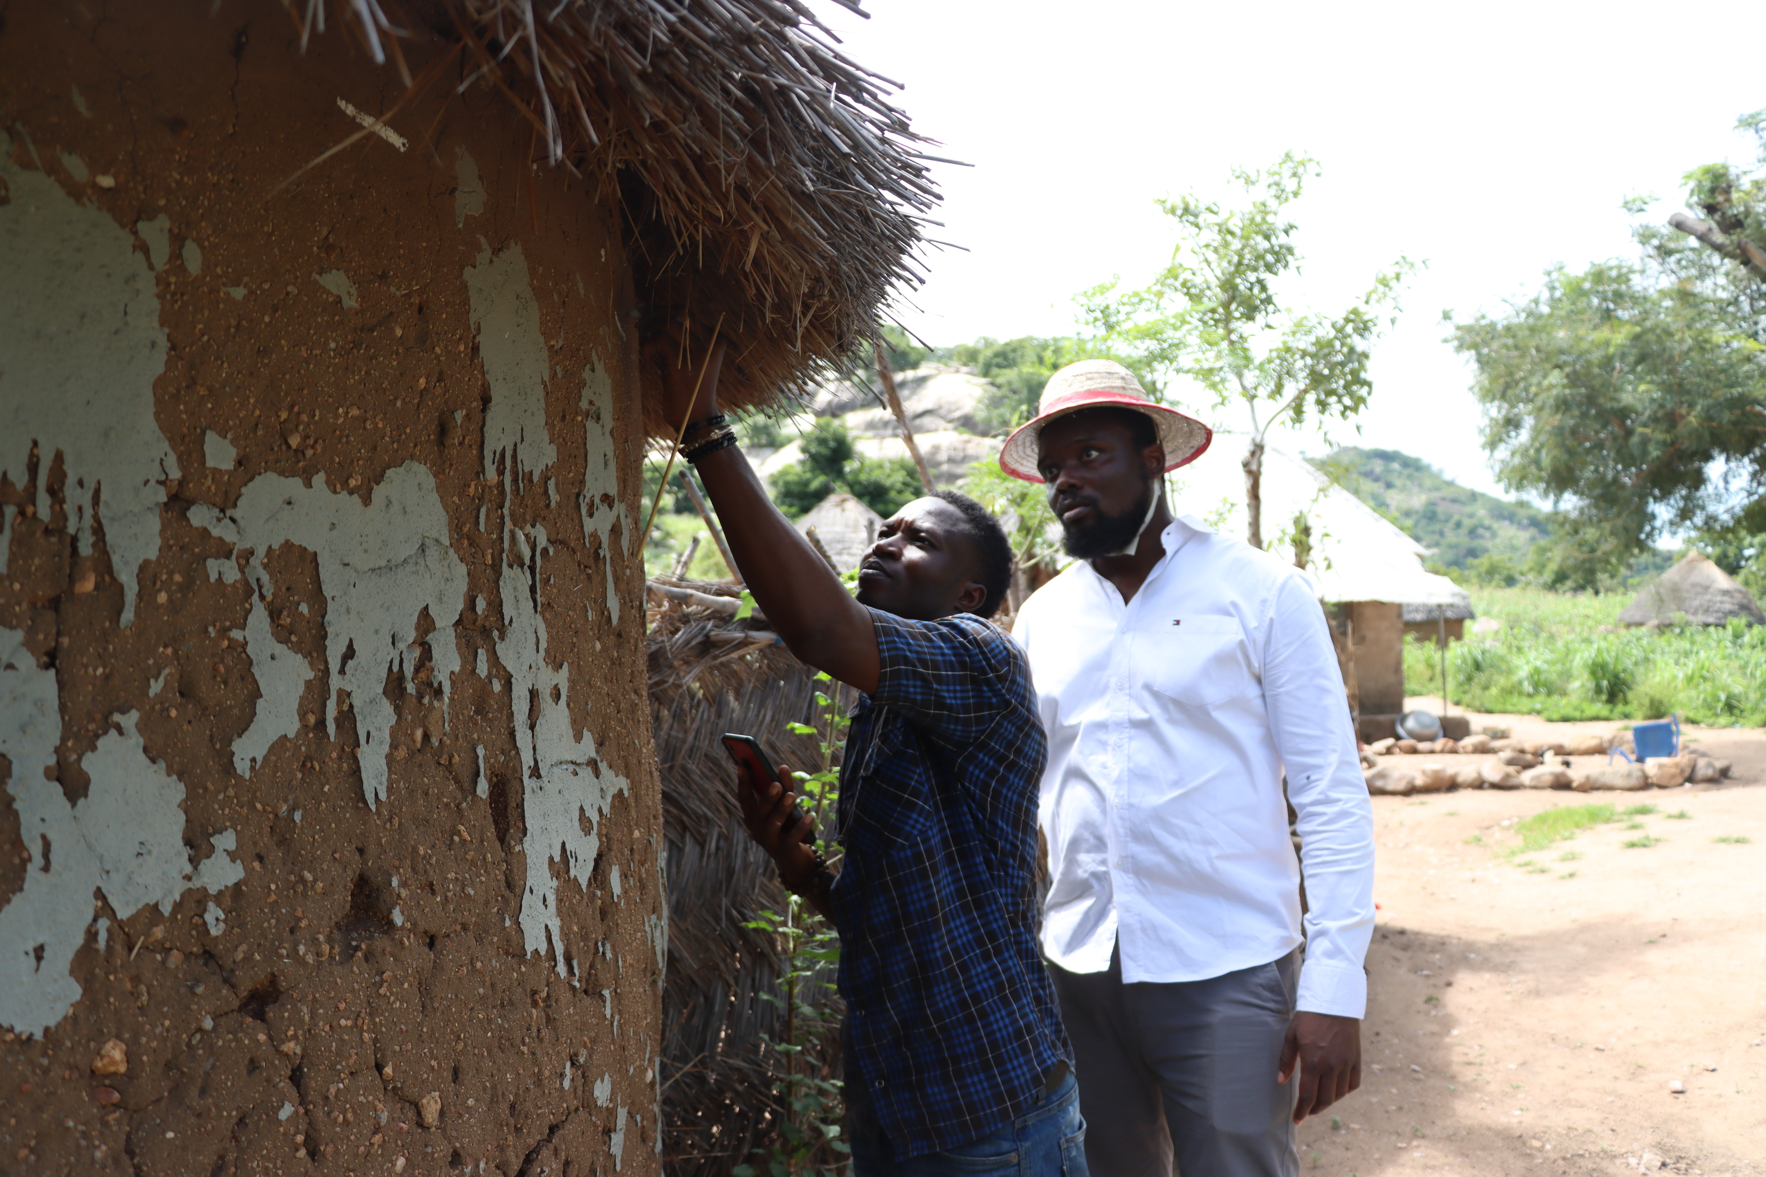

Slide 8
Thank you
Question Please…………..

