Slide 1
Nurturing Multisectoral Commitments for Sustainable Nutrition in Nigeria
Presented at
52nd Annual General Meeting of the Nutrition Society of Nigeria
by
Miracle Owolawi

Slide 2
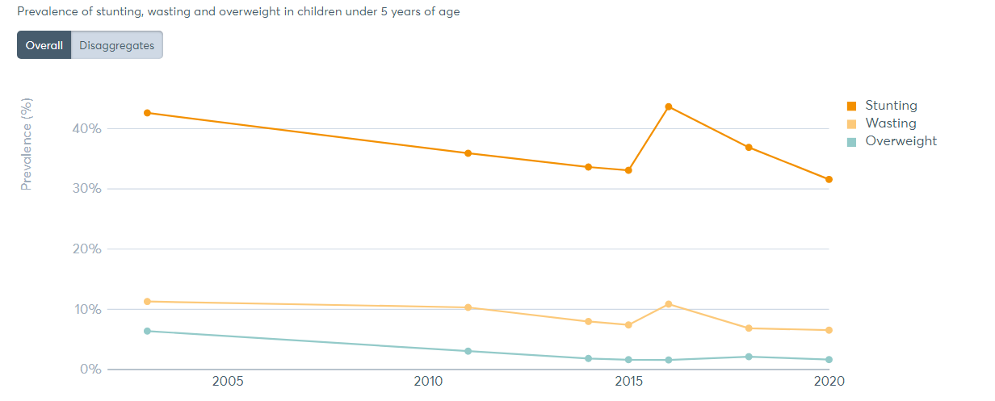
Where Are We?
Source: GNR, 2021

Slide 3
Multi-Sectoral Plan of Action
The Federal Government of Nigeria identified the six priority areas of nutrition for investment reflected in the National Multi-Sectoral Plan of Action for Food and Nutrition 2021-2025
● Food and nutrition security
● Enhancing caregiving capacity
● Enhancing provision of quality health services
● Improving capacity to address food and nutrition insecurity
● Raising awareness and understanding of the nutrition problem in Nigeria
● Resource allocation for food and nutrition security at all levels.

Slide 4
What Role is Each Sector Playing?
Government MDAs (Health, Agriculture, Finance/Budget) – Mandate for relevant MDAs
Private Sector – FrieslandCampina Institute
Academic – Problem solving research, capacity building
NGOs – Non State Actors
CSOs - CS-SUNN
Youth Advocacy – Act4Food Act4Change

Slide 5
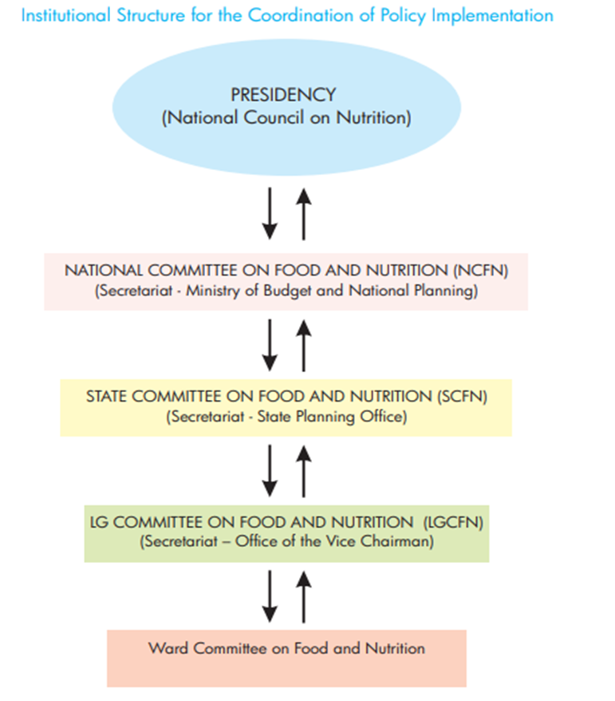
Governmental Structure

Slide 6
How Do They All Come Together?
There is global recognition that food security and nutrition are determined by a complex web of interacting physical, social, and biological determinants¹.
They must be addressed through coordinated multi-sectoral, private, and public sector programming, including agriculture and environment; water, sanitation and hygiene; health; education; and governance²
The Lancet released a series of papers reviewing progress toward improving nutrition around the globe. The authors stated that a multi-sectoral approach is required to achieve global targets for reducing undernutrition, along with scaling up proven nutrition-specific interventions and strengthening nutrition-sensitive interventions that span a variety of sectors

Slide 7
Exemplar Countries
Ghana
One main strategy Ghana adopted in achieving an impactful nutrition multisectoral collaboration is situated planning.
Ghana has all of its multi-sectoral actions situated within a national planning system. All actions and government priorities, including Food and Nutrition Security (FNS) have been situated within this national system.
The multisectoral collaboration also has an FNS Cross Sectoral Planning Group (CSPG) to coordinate actions from government, CSOs, Development Partners/Donors, Research and Academic institutions and Business

Slide 8
Key Recommendations – How do we get there?
Accountability Framework
Strengthening existing structure and situation of the collaborative mechanism
Private Sector Collaboration
Sustainable Funding

Slide 9
Thank you

