Slide 1
Understanding the Policy Landscape
Notes:
To begin this training, we need to understand what policy is and what the policy landscape is for a given issue in a given country.

Slide 2
Outline
Introduction
Understanding the policy landscape
Notes:
Introduction – Definition of policy,

Slide 3
Notes:
Ask the group: “Does anyone know what this place is?” and “What does this picture remind you of?”
Generate responses from the group.
This is the Africa Union building in Addis Ababa, where many policies are made and here it is full of policymakers. Is this place relevant to the work that you do? What are the other “venues” relevant to your policy work?
The word “policy” often makes us think of images of high-level officials – Parliament, the President of Prime Minister, or official documents. Policy can be all of that – but it can also be a lot of other things. And research is critical to informing all of it.

Slide 4
What Is Policy?
A course or principle of action adopted or proposed by a government, party, business, or individual (Oxford English Dictionary)
Law: Compel or prohibit behavior
Policy: Guide actions and laws toward desired outcome
Notes:
Ask the group: So what is POLICY?
Generate responses.
[Click] The dictionary tells us that policy is a principle or rule to guide decisions and achieve rational outcomes. Policies apply to government, institutions, organizations and groups, and individuals. [CLICK] While laws compel or prohibit behaviors (e.g. a law requiring the payment of taxes on income), policy merely guides actions and laws toward those that are most likely to achieve a desired outcome.
We often think of policy in terms of national level legislation – Can anyone give me an example? Generate responses.
One example is a national population policy. But within this definition, policy is actually MUCH broader. It could be a policy or strategy document at a regional or district level; funding decisions; institutional or facility guidelines; or even traditional by-laws for small communities.
4

Slide 5
WHO Defines Health Policy As:
“Decisions, plans, and actions that are undertaken to achieve specific health care goals within a society. An explicit health policy can achieve several things: it defines a vision for the future which in turn helps to establish targets and points of reference for the short and medium term.”
Notes:
Read slide.

Slide 6
Policy is Expressed in Different Ways
Policy documents
Laws
Contracts
Partnerships
Funding priorities
Notes:
This vision for the future, and these policy goals, can be expressed in different ways.
Can anyone give an example of how policy might be communicated or documented? Generate responses. [Click to bring on bulleted list]
Policy documents
Laws
Contracts
Partnerships
The funding
Government direction.
We need to remember that policy can also be organizational or private. For example, the policies for a specific hospital or health facility that direct how it is administered; or the strategic priorities for a private foundation that informs what activities they provide funding for.
6

Slide 7
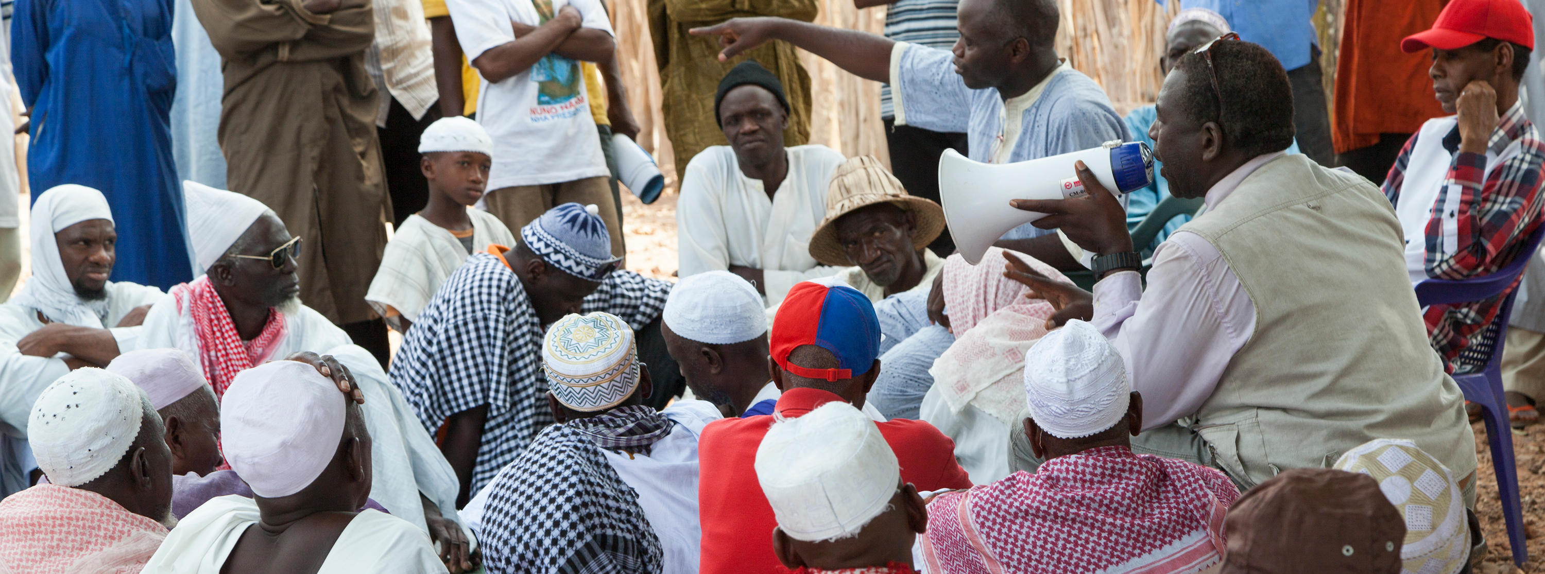
Who Are Policymakers?
Anyone with the authority to create or change a policy
Notes:
With that understanding of “Policy”, a policymaker is anyone who has the authority to create or change a policy – and that policy could be any of those examples we just saw (policies, laws, funding decisions, etc).
As with policy, we often think of policymakers as high-level officials, such as Presidents, Ministers, Parliamentarians, or Council Members. But within our broad definition of policy, we also define policymaker broadly. Policymakers could be government officials, district-level leaders, officials within an organization, or donor representatives.

Slide 8
Why Create Policies?
To give guidance to action on a certain issue
To ensure that things happen
To change what is currently happening
To prioritize and allocate resources AND issues
Notes:
Ask the group: “Why create policies?”
Generate responses.
[CLICK]

Slide 9
Name That Policy
What Policy is This?
Mention various people who could be interested in this policy?
Can researchers be interested in this policy?
Why?
Notes:
Brainstorming Activity
How well do you know this policy?
Mention various people who could be interested in this policy
Can researchers be interested in the policy?
Why
Summary at the end of the discussion: When we think about policy, it’s much broader than a single, national-level policy, and there are likely many audiences to be targeted with the results of research on your topic.
9

Slide 10
One Policy Can Lead to Many More
Implementation: Operational policies
The rules, regulations, codes, guidelines, implementation plans, budgets, and administrative norms that governments use to translate national laws and policies into programs and services
Multisectoral implications
Notes:
Ask the group if they have heard of operational policies.
Ask if someone can provide an example. Generate responses.
Operational Policies are the instruments and practices by which organizations implement larger policies
While national policies provide necessary leadership and guidance, operational policies are the means for implementing those policies. So one major policy can trickle down to affect many other policies at different levels. Operational policies may be more directly related to or impacted by the research you are doing.
[CLICK] In addition, one policy may impact many sectors – Policies about education, gender/women, finance, inheritance, the environment – can all have implications for health. And conversely, many health policies have implications in other sectors, as well. For example, policies on young people accessing contraceptives might have implications for schools or for traditional by-laws. Research is critical to ensure that a given policy doesn’t have unintended consequences in other sectors. Public health is by its nature interdisciplinary; decisions made within these areas often have impacts on a range of other sectors
10

Slide 11
Implementation: Operational policies
Action plans at state, LGA, ward levels
National Policy on Food Safety and its Implementation Strategy
National Policy on Infant and Young Child Feeding (IYCF);

Slide 12
Multi-sectoral
Agriculture
i. The National Agricultural Policy;
iii. The Agricultural Transformation Agenda
Health
Science and Tech
Science, Technology, and Innovation Policy
Security
National Policy on Security
Education
National Policy on Education
Others

Slide 13
Research Findings
Field Observations
Policy
Secondary school students are undernourished

Slide 14
The Policy Landscape
Policies
Stakeholders
Funding
Implementation
Indicators
Notes:
With this broad understanding of policy, we’ll now turn to how you can begin to understand the policy landscape for a given issue in a given country or context.

Slide 15
Understanding the Policy Landscape
Secondary school students are undernourished
WHO are the stakeholders?
WHAT are the policies that are in place?
HOW are policies being funded and implemented?
Notes:
To begin to understand the policy landscape, you first need to know WHO is involved – we call these people the stakeholders, the people and groups who are affected by and who influence your issue.
Then, you need to know WHAT policies are in place. Are there national policies? Government policies at any administrative level? And if so, (perhaps more importantly) what do they say? Are there gaps, or has the government chosen not to act on the topic?
Then, the HOW. How are the mandates of the policies funded? Are there donors funding, and thereby influencing, the programs? What is really happening with implementation of the policy?

Slide 16
Identifying the Stakeholders
Stakeholders are people, groups, or institutions that are likely to be affected by a proposed intervention (either negatively or positively), or those which can affect the outcome of the intervention
Notes:
Ask the group: Who can define “stakeholders?”
Generate responses.
[CLICK] Read definition of stakeholders.
With this definition, identifying the stakeholders begins with a brainstorm about who these people are.

Slide 17
Identifying the Stakeholders
Beneficiaries | Implementers | Influencers
Users/Beneficiaries (men, women, youth, children, elderly, etc) | Local authorities Traditional authorities NGO and development projects Businesses and suppliers Decentralized government services Research institutions Schools and universities Service providers | Financial institutions and donors National authorities Opinion leaders Civil society Foreign cooperation agencies Media
Consider “mapping” results by interest level, influence, or importance to your issue
Notes:
Prepare a flip chart with three column headings: Beneficiaries; Implementers; Influencers. Write the name of each group listed above clearly on an index card. Mix up the cards, and pass them out.
As you brainstorm, this simple three-part framework can help you to think through the different types of groups to list.
Ask the group to take the prepared index cards and place each stakeholder group under the proper heading: Beneficiaries, Implementers, and Influencers.
Explain that by Beneficiaries are the users or individuals directly impacted by the policy or issue; Implementers are those groups and institutions who administer or directly implement policies and programs; and Influencers are the groups such as opinion leaders, funders, etc. who can shape what secondary stakeholders are doing.
Take 2-3 minutes for this.
Review where the cards are placed and move to correct heading if necessary.
[CLICK to bring up the table of stakeholders]
Explain that this framework is just a guide, but the groups listed tend to be relevant when mapping stakeholders for health-related issues. You would want to be more specific, where possible. So instead of just “service providers”, can you name the specific health facilities, or cadres of health workers, who are relevant for your issue?
[CLICK for final bullet]
You should consider “mapping” the stakeholders you identify through the brainstorming process. Common criteria for mapping the stakeholders, by which we mean organizing the stakeholders graphically, are their interest level in your topic, their degree of influence over the issue, or how important they are to the issue. A simple google search of “Stakeholder Mapping” or “Stakeholder Matrix” will give you a LOT of examples and ideas.

Slide 18
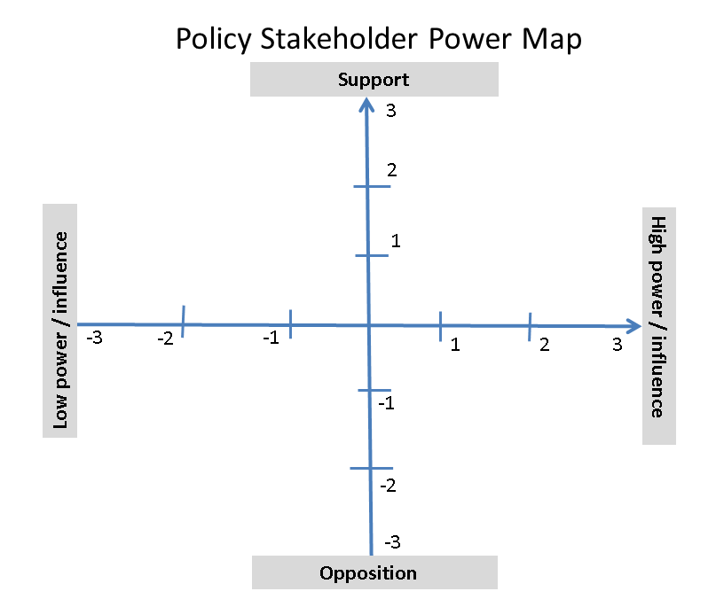
Stakeholder Mapping
Notes:
This is one example of a stakeholder map that we like. You can see that we use two axes. Going from right to left, we have the stakeholders’ degree of power and influence. This runs from low (-3) to high (+3). From bottom to top, we have their degree of opposition, from very opposed (-3) to very supportive (+3). Having identified all your stakeholders (and perhaps done a little research on them), you would then plot them out on this chart based on how influential and supportive you think they are. A map like this will come in useful when you start to decide which audiences you want to target with your policy communication activities. We’ll return to the idea of “audiences” in a few sessions.

Slide 19
Understanding the Policy Landscape
Secondary school students are undernourished
WHO are the stakeholders?
WHAT are the policies that are in place?
HOW are policies being funded and implemented?
Notes:
To begin to understand the policy landscape, you first need to know WHO is involved – we call these people the stakeholders, the people and groups who are affected by and who influence your issue.
Then, you need to know WHAT policies are in place. Are there national policies? Government policies at any administrative level? And if so, (perhaps more importantly) what do they say? Are there gaps, or has the government chosen not to act on the topic?
Then, the HOW. How are the mandates of the policies funded? Are there donors funding, and thereby influencing, the programs? What is really happening with implementation of the policy?

Slide 20
What Policies Are in Place?
Is there a dedicated policy for the given topic?
What other policies or strategies address this topic?
What are the stated objectives of the policy?
Does it address funding?
Does it specify implementation?
Are there recent developments or public statements?
Notes:
The next information to gather is what policies, strategies, or action plans are in place. Questions to consider include:
Is there a dedicated policy for the given topic? And is it at the appropriate level – national, district, facility, etc?
What other policies or strategies address this topic? Sometimes policies have an associated strategic plan. Sometimes there may be a national level policy, but a district level strategy or implementation plan is required to direct how the policy will be implemented in a given district.
What are the explicit objectives of the policy?
Does the policy specify how it will be funded? If not, are budgets at the appropriate level funding the programs or activities specified by the policy?
Does the policy say how it will be implemented? Or is there a separate implementation plan document?
Are there any recent developments that might impact these policies? Have any officials or influential stakeholders made public statements or commitments regarding the issue? Knowing what your leaders have committed to, and comparing that to the reality of the policy landscape, is a way of holding leaders accountable.
You’ll need to consider how the government and policymaking in the country is organized. Are decisions (policies, funding) made at the national level? Regional or district level? Is there a national-level policy that relates, directly or indirectly, to your issue?

Slide 21
Policy Analysis
What does the policy actually say?
Notes:
Then – what does the policy actually SAY?
Are the key terms defined? What groups are named, and what could be left to interpretation? For example, does the policy specifically address school feeding for secondary school students?
There are many approaches to policy analysis that look critically at the actual language of the policy. One approach is to use WHO guidance to analyze the text of the policy, and see where the policy explicitly addresses WHO recommendations and where there are gaps in addressing those recommendations. WHO guidance docs are available on a variety of health

Slide 22
Understanding the Policy Landscape
Secondary school students are undernourished
WHO are the stakeholders?
WHAT are the policies that are in place?
HOW are policies being funded and implemented?
Notes:
To begin to understand the policy landscape, you first need to know WHO is involved – we call these people the stakeholders, the people and groups who are affected by and who influence your issue.
Then, you need to know WHAT policies are in place. Are there national policies? Government policies at any administrative level? And if so, (perhaps more importantly) what do they say? Are there gaps, or has the government chosen not to act on the topic?
Then, the HOW. How are the mandates of the policies funded? Are there donors funding, and thereby influencing, the programs? What is really happening with implementation of the policy?

Slide 23
Policy Implementation Assessment
Current indicators
Implementation science & accountability research
Key informants:
Policymakers
Health professionals
Civil society
Experts
Beneficiaries
Notes:
Then the question is, what’s really happening? We know who the stakeholders are. We know what the policy says. But what’s really happening?
Policy implementation refers to the mechanisms, resources, and relationships that link health policies to program action – this includes all those operational policies we discussed in previous slides. A policy implementation assessment looks at how a given policy is translated into action. Many countries have policies in place for the issues you are considering – but the implementation may be an issue. A policy implementation assessment is a way to hold leaders accountable by determining which commitments are being translated into action.
One piece of data to consider is current indicators – depending on the issue, information that may be readily available in a DHS or national level survey. If you’re exploring the policy environment for adolescent nutrition, what do the indicators tell you about this?
Consider implementation of the policy. How is this being implemented?
Valuable information also comes from key informants from among the stakeholder groups. These are individuals who have first hand experience implementing or monitoring the policy and can provide insight about what is happening. Stakeholders may be able to speak to how politics, beliefs, values, or social norms may be influencing the policy context.

Slide 24
Formal Policy Assessment
The Policy Implementation Assessment Tool
PRB’s Kenya Adolescent Reproductive Health & Development Policy Implementation Assessment Report
Notes:
A full scale policy implementation assessment to determine what’s really happening is equivalent to undertaking a large scale research activity. It’s an important piece of holding policymakers and leaders accountable for the policy commitments they’ve made, and ensuring that policies are meeting the goals they were put in place for.
The USAID-funded Health Policy Initiative created a tool several years ago that provides detailed guidance on how to conduct a formal policy assessment. They advise that the full process takes 4-6 months, and is best accomplished by a multisectoral stakeholder team.
Using that tool as a starting point, PRB led a mutlisectoral team to conduct an assessment of Kenya’s Adolescent Reproductive Health and Development policy in 2012. The results were published in 2013, and formed the basis for policy communication activities from 2013-2015 that ultimately culminated in a revised ARHD policy that addresses many of the gaps identified in this report.
Even if you can’t do a full assessment (which is beyond the scope of most individuals), it’s important to consider the question of implementation, and seek out what information might be readily available. Maybe another group has undertaken the research and it’s published on their website or in a journal. Maybe you can use your networks to have a formal or informal interview with a key informant, such as a nurse, or MOH official.

Slide 25
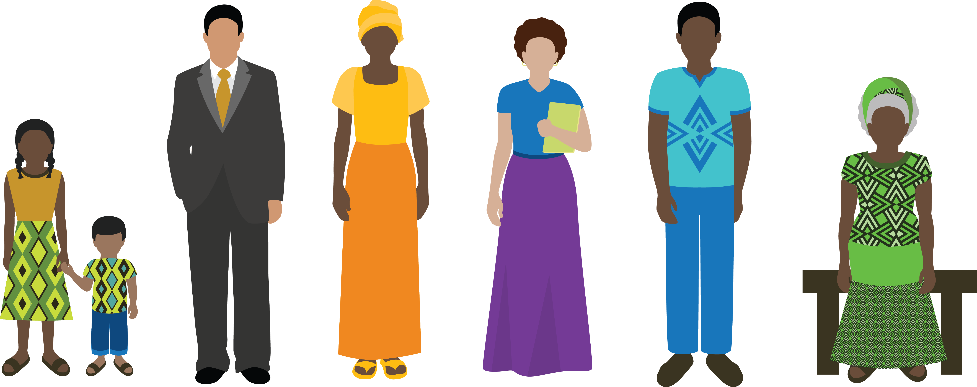
Policy Assessments and Marginalized populations
What are some examples of marginalized populations/ groups?
Notes:
Another factor to consider in the policy landscape, and any type of policy assessment, is gender. What do we mean when we say gender? Generate response.

Slide 26
Policy and Gender
Health policies affect women and men, girls and boys, differently
Women frequently have less control over participation in sexual activity and reproductive health
Men also face gender norms that increase health risks
Policies provide an opportunity to identify and remove these inequalities
Notes:
Integrating gender into policy development, advocacy and implementation ensures that the needs of women and men, girls and boy, and gender and sexual minorities are considered and addressed.
Health policies often affect women and men, girls and boys, and GSM differently. These differences are often the result of local gender norms and values that shape the freedom and opportunities open to women/men, boys/girls in society. In developing countries, women may depend on men for livelihood needs such as food, shelter, money for medical treatment, school fees for children, etc.,
Therefore, policies need to consider gender and gender norms carefully.
Men also face gender norms that increase their health risks. They tend to seek healthcare less often than women and thus have less interaction with healthcare providers.
Policies provide an opportunity to identify and remove these inequalities. In fact, policymakers and other stakeholders must identify and remove these gender inequalities – whether they result from oversights in policy or breakdowns in in implementation.

Slide 27
Summary
Policy:
Guide action
Achieve goals
Different mechanisms at many levels
Policy Landscape:
Stakeholders
Policy documents
Implementation
Notes:
In summary, the key points to take away from this session are that policies are meant to guide action and achieve goals, and are put in place through a variety of mechanisms at many different levels.
Understanding the policy landscape for a given issue is an important first step as you consider the policy implications of your research or topic. Important components of a policy landscape assessment include the stakeholders, the policies and what they say, and the implementation of the policies – translating the statements in the documents into action.

Slide 28
Learn More
“Policy,” www.wikipedia.org.
Harry Cross, Karen Hardee, & Norine Jewell, Reforming Operational Policies: A Pathway to Improving Reproductive Health Programs, Occasional Paper #7, Futures Group: The Policy Project, 2001.
Andy Sumner et al., “What Shapes Research Impact on Policy? Understanding Research Uptake in Sexual and Reproductive Health Policy Processes in Resource Poor Contexts,” Health Research Policy and Systems 9 , supplm 1 (2011):S3.
Jennifer Rietbergen-McCracken and Deepa Narayan, ed. Participation and Social Assessment: Tools and Techniques (Washington, DC: World Bank, 1998).
Health Policy Initiative, Policy Implementation Assessment Tool.
National Council for Population and Development and PRB, Kenya Adolescent Reproductive Health and Development Policy: Implementation Assessment Report, 2013.
Notes:
28

